Slide 1



5 Tips on Optimizing VSD Vacuum Pumps
Sponsored by
Tim Dugan, P.E., Compression Engineering Corporation
Keynote Speaker
For your free subscription, please visit www.blowervacuumbestpractices.com/magazine/subscription.

Slide 2
5 Tips on Optimizing VSD Vacuum Pumps
Tim Dugan, P.E., Compression Engineering Corporation
Keynote Speaker
The recording and slides of this webinar will be made available to attendees via email later today.
PDH Certificates will be e-mailed to Attendees within two days.
Sponsored by
For your free subscription, please visit www.blowervacuumbestpractices.com/magazine/subscription.

Slide 3
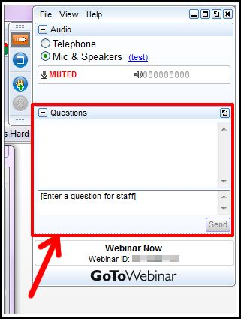
Q&A Format
Panelists will answer your questions during the Q&A session at the end of the Webinar.
Please post your questions in the Questions Window in your GoToWebinar interface.
Direct all questions to Blower & Vacuum Best Practices Magazine
Sponsored by
For your free subscription, please visit www.blowervacuumbestpractices.com/magazine/subscription.

Slide 4
Handouts

Slide 5
All rights are reserved. The contents of this publication may not be reproduced in whole or in part without consent of Smith Onandia Communications LLC. Smith Onandia Communications LLC does not assume and hereby disclaims any liability to any person for any loss or damage caused by errors or omissions in the material contained herein, regardless of whether such errors result from negligence, accident, or any other cause whatsoever.
All materials presented are educational. Each system is unique and must be evaluated on its own merits.

Slide 6
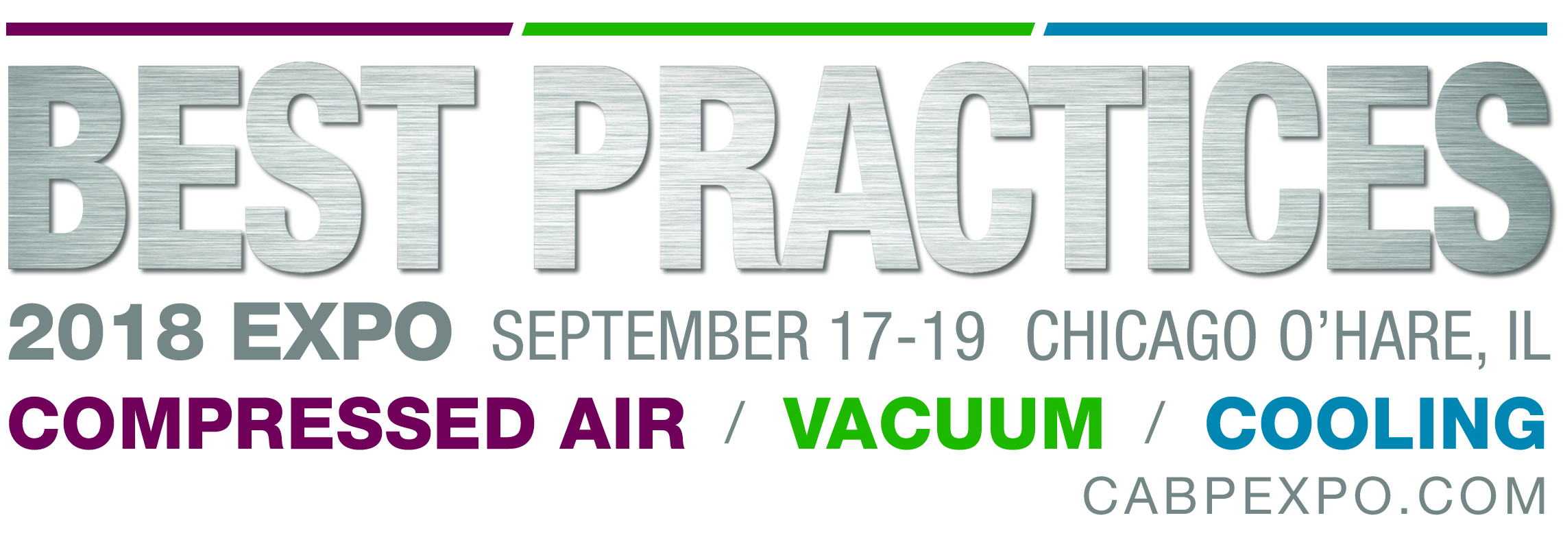
ATTEND THE INAUGURAL 3-DAY CONFERENCE & EXPO!
September 17-19, 2018, Chicago O’Hare Crowne Plaza Conference Center
FREE EXPO
Booths from Atlas Copco, Busch USA, Gardner Denver, Kaeser Compressors, Leybold USA, Edwards, Howden Roots, Solberg
HIGH-ROI CONFERENCE
TRACK 3: BLOWER & VACUUM OPTIMIZATION
Vacuum System Centralization, Vacuum Demand Reduction, Utility Incentive Program Design
Limited Hotel Space Remaining. Register Today!
www.cabpexpo.com

Slide 7
5 Tips on Optimizing VSD Vacuum Pumps
Introduction by Rod Smith, Publisher
Blower & Vacuum Best Practices Magazine
Sponsored by
For your free subscription, please visit www.blowervacuumbestpractices.com/magazine/subscription.

Slide 8
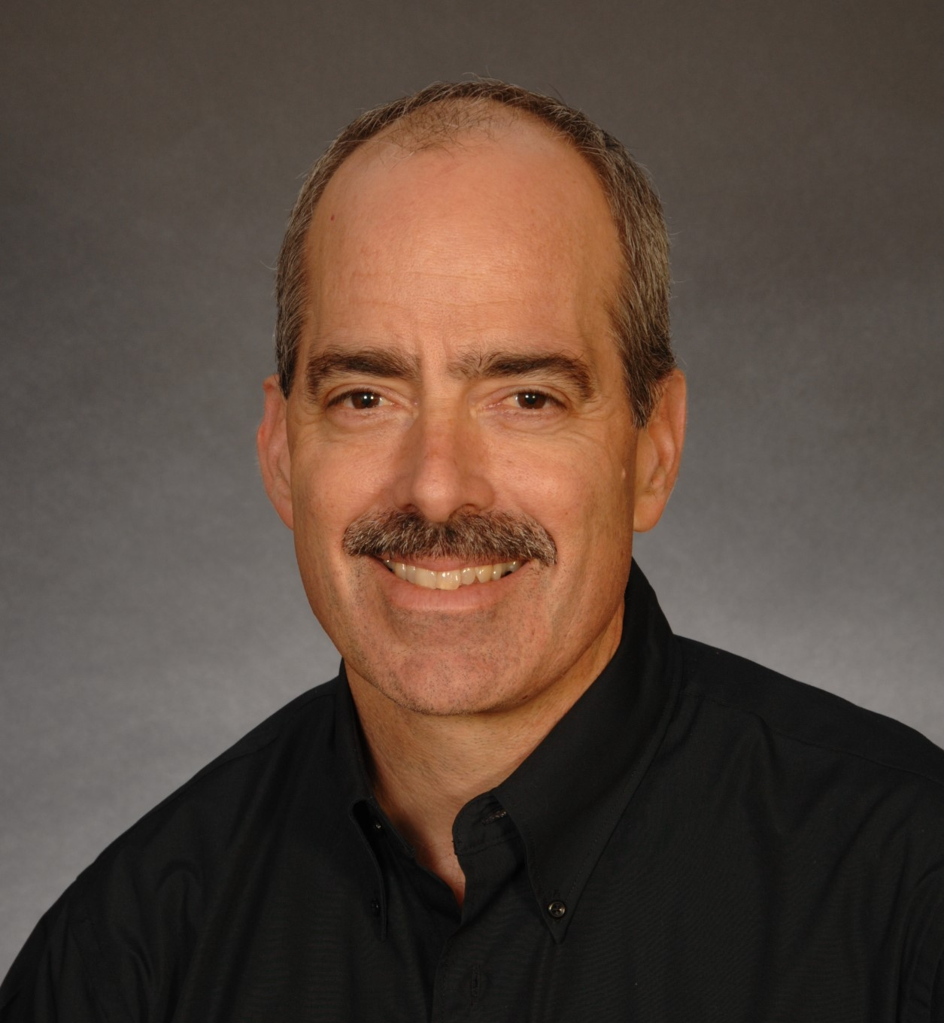
About the Speaker
President and Principal Engineer of Compression Engineering Corporation
Over 25 years of experience in the industry
Sponsored by
Tim Dugan, P.E.
Compression Engineering Corp.
For your free subscription, please visit www.blowervacuumbestpractices.com/magazine/subscription.

Slide 9
5 Tips for Optimizing Vacuum Pumps
Tim Dugan
Compression Engineering Corp.
For Blower & Vacuum Best Practices Magazine
6-28-18
Presentation is property of Blower & Vacuum Best Practices Magazine
Do not copy or distribute without permission

Slide 10
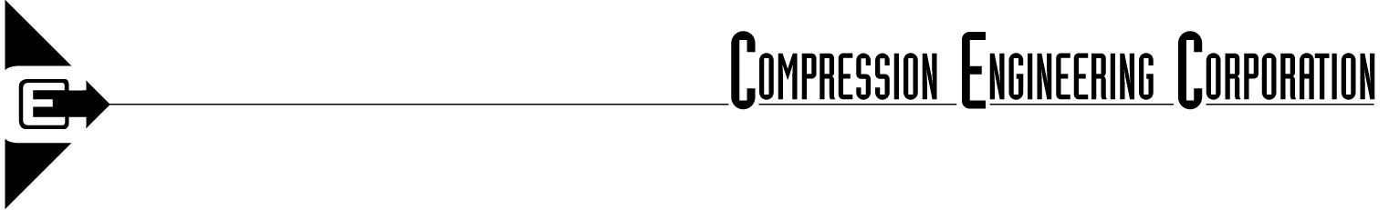
Outline
Fundamentals of Vacuum
Determine Your Maximum Vacuum Requirements by Testing
Determine Your Minimum Vacuum Requirements by Testing
Select a Vacuum Level and Determine Max Flow
Size Vacuum Pump(s)

Slide 11
Fundamentals of Vacuum
Knowing your vacuum requirement is more important than you think – not just a “motor load” issue.
If you pull too deep of a vacuum, you are effectively reducing the size of your vacuum pump.
If you ran a compressor at 125 psig instead of 100 psig, it would just use more power. You still have the same size compressor capacity.
The vacuum level affects the process’ mass flow of air dramatically.
If you actually knew the process first, you can have a huge impact on the sizing of the vacuum pump(s).
So, know your real vacuum requirement!

Slide 12
Fundamentals of Vacuum
Vacuum level is measured in “Hg or mm Hg “gauge”, the difference between atmospheric and the actual pressure.
Absolute pressure is atmospheric (Patm) minus the vacuum.
Patm at sea level is 29.92”Hg, 30” for simplification.
At 20”Hg vacuum, the inlet absolute pressure is 30-20 = 10”Hg.
At 25”Hg vacuum, the inlet absolute pressure is 30-25 = 5”Hg.

Slide 13
Fundamentals of Vacuum
“icfm” is the volume flow rate at the intake of the vacuum pump, irrespective of how dense it is. A 300 icfm unit will take in 300 cubic feet of air every minute, at 20”Hg or 25”Hg.
For a positive displacement (vane, screw, other) vacuum pump, the icfm is fairly constant.
“scfm” is the air flow that you have at the exit of the vacuum pump (at sea level). It is also directly related to the mass flow of air pulled across/through the process.
Scfm = Pabs / Patm x icfm.
At 20”Hg vacuum, scfm = (30-20)/30 x 300 = 100 scfm.
At 25”Hg vacuum, scfm = (30-25)/30 x 300 = 50 scfm.
A 2X ratio in size of vacuum pump, if you had started with scfm!

Slide 14
The Importance of Testing
How do you find out what your real vacuum level is?
Do you have a spec that requires a particular vacuum at a process? Is that spec just a guess from the OEM?
Did you ever commission your process? Has it ever been tested to determine its actual vacuum requirement? Typically not.
Has the process significantly changed since the initially installed? Probably.
Recommissioning is essentially revalidating a process and adjusting it to the optimal level.
You can do this yourself or have an outside party help.

Slide 15
Testing to Determine Maximum Vacuum
Run the first test with the vacuum pump already dedicated to that process – if system has dedicated vacuum pumps.
If pumps are manifolded together, during a shut-down, isolate one process to one of the larger positive displacement vacuum pumps. Shut off all other processes but the tested one.
Get its inlet capacity (icfm) rating. It is fairly constant at all vacuum levels if it is PD.

Slide 16
Testing to Determine Maximum Vacuum
Install large throttling & small bleed-in valve.
Install 2 vacuum gauges.

Slide 17
Testing to Determine Maximum Vacuum
Fully close throttling valve.
Close all false loads.
Crack open bleed-in valve.
Turn on vacuum pump and let it run at its set point (not load-unload – steady). Adjust bleed-in valve to get unit at max vacuum (min pressure) and steady.
Open throttling valve to process to 10 deg and close bleed-in valve.
Process is at min vacuum, might not be able to operate.
Gradually open throttle valve until process has enough vacuum to barely run.

Slide 18
Testing to Determine Maximum Vacuum
Record vacuum pump and process pressures (keep vent valve closed):
  At max vacuum at vacuum pump, min vacuum at process
  One step up (adjust throttling valve slightly open), vac pump vacuum goes down and process goes up.
  Another step up, etc.
  Keep going until you hit the max process vacuum (min absolute pressure) which process can operate at.

Slide 19
Testing to Determine Maximum Vacuum

Slide 20
Testing to Determine Minimum Vacuum
You can throttle the larger vacuum pump back and calculate the minimum point. However, it is valuable to perform a test with a smaller vacuum pump and discover the significant size difference opportunity.
With the smaller vacuum pump piped to the same process with the same valving, run the same test. This time, try to hit the minimum point that the process would work.
To demonstrate this, I am providing calculations for running the same process against a 100 acfm and a 400 acfm vacuum pump.

Slide 21
Testing to Determine Minimum Vacuum

Slide 22
Select Vacuum Level
Based on the test data, the process will work acceptably between 17”Hg and 25”Hg.
Flow requirement is 52% higher at 25”.
Select 18”Hg for that process.
If vacuum system consolidation / centralization is being looked at, test other primary processes similarly. If there are multiple processes of each type, just test one of each.
Select the maximum vacuum level of all processes you want to combine, and add a margin (at least 1”Hg) for the minimum vacuum pump setting.

Slide 23
Size Vacuum Pump(s)
If a new vacuum pump is being considered, or consolidation is being considered, the total inlet flow required at peak needs to be calculated.
In this example, only about 50 scfm would be needed at 18”Hg, requiring about 126 acfm. The current 400 acfm vacuum pump is > 3X that size!
A typical 126 icfm unit is about 7.5hp, and a 400 icfm unit is about 20hp.
Min power for most PD vacuum pumps is >60% of nameplate, so you could be saving 2/3 of the energy by sizing properly.

Slide 24
Size Vacuum Pump(s)
If consolidation or centralization is being considered, an audit is needed to determine the total flow of all the production system vacuum.
The total inlet flow (icfm) can be calculated from the total flow (scfm).

Slide 25
Conclusions
It’s important to get the actual vacuum level requirements before vacuum pumps can be sized or reconfigured.
Testing is the best way, to determine the minimum and maximum allowable vacuum for a process.
Size your vacuum pump(s) based on the required vacuum level, not the maximum.
Optimal sizing saves a lot of energy.

Slide 26
Thank you
Tim Dugan
Compression Engineering Corporation
503-520-0700
tim.dugan@comp-eng.com

Slide 27
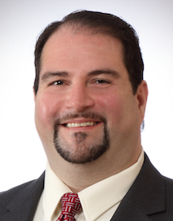
About the Speaker
Product Marketing Manager for the Industrial Vacuum Division of Atlas Copco Compressors
Walter See
Atlas Copco
For your free subscription, please visit www.blowervacuumbestpractices.com/magazine/subscription.

Slide 28
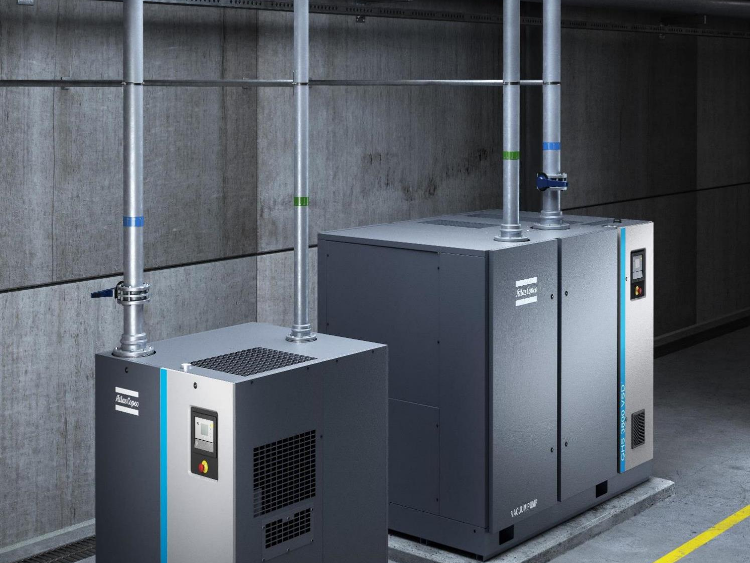

Maximizing the
Benefit and Savings of a
VSD Vacuum Pump
Walter See
Product Marketing Manager
June 28, 2018

Slide 29
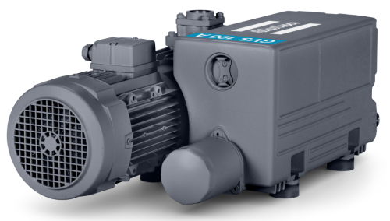

Traditional Fixed-Speed Controls
On / Off
Notes:
Many operations use less than half the maximum vacuum available.
Before VSD technology, constant high speed just to handle occasional short intervals of demand.

Slide 30
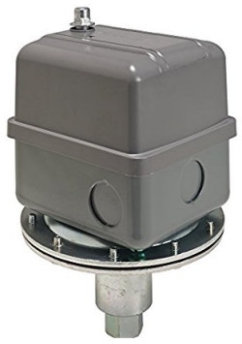
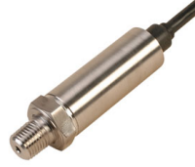
Traditional Fixed-Speed Controls
Automatic On / Off Control
0”HgV
Atmosphere
Vacuum Switch
22”HgV
Cut In
OPERATING
RANGE
26”HgV
Cut Out
Vacuum Transducer
29.92”HgV
Perfect Vacuum
Notes:
But still on/off

Slide 31

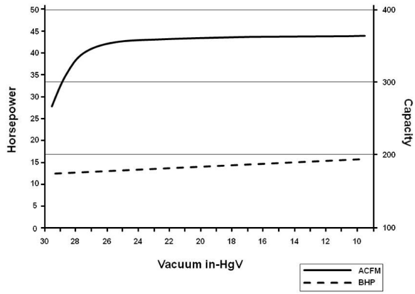
STOP The Confusion
“It’s better that my vacuum pump runs at ultimate vacuum because it’s at this point that I will have the lowest power consumption”
This considers the pump alone, without considering the actual process
If the pump runs at ultimate vacuum, more than likely, that means that the pump is oversized
We MUST consider the process

Slide 32
Fixed Speed Compressor Unload Time vs Vacuum Pump
32
100 %
100 %
75 %
75 %
50 %
50 %
25 %
25 %
0 %
0 %
Power
Demand
Power
Demand
Power
Demand
Power
Demand
Load
Unload
Load
Ultimate
FIXED SPEED COMPRESSOR
FIXED SPEED VACUUM PUMP
A compressor use 25% of full load power at unload
A vacuum uses about 60% of its loaded power at ultimate vacuum
= Waste of Energy

Slide 33
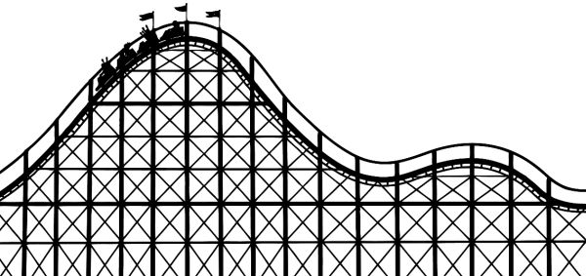
Stable Pressure & Variable Speed
33
Vacuum Process is NEVER Constant
Pressure
Demand
Time

Slide 34
Stable Pressure & Variable Speed
34
Vacuum Process is NEVER Constant
Fixed Speed
What happens with a Fixed Speed machine?
A Fixed Speed machine cannot adjust its rotor speed
  process demand increases, the pressure in the system increases
  process demand decreases, the pressure in the system decreases
pressure
time
Variable Speed
What happens with a Variable Speed machine?
A Variable Speed adjusts the rotor speed to match the demand coming from the process and maintain a constant pressure
  process demand increases, the VSD machine accelerates
  process demand decreases, the VSD machine slows down
pressure
time

Slide 35
Fixed Speed vs VSD
35
Varying Demand
At variable demand, the VSD machine will always maintain a constant pressure compared to a Fixed Speed machine and will consume only what is needed
100 %
100 %
75 %
75 %
50 %
50 %
25 %
25 %
0 %
0 %
Power
Demand
Power
Demand
Power
Demand
Power
Demand
Load
Ultimate
100% Load
25% Load
Fixed Speed Machine
With VSD
Significant additional energy savings Available due to addition of vsd set point control

Slide 36
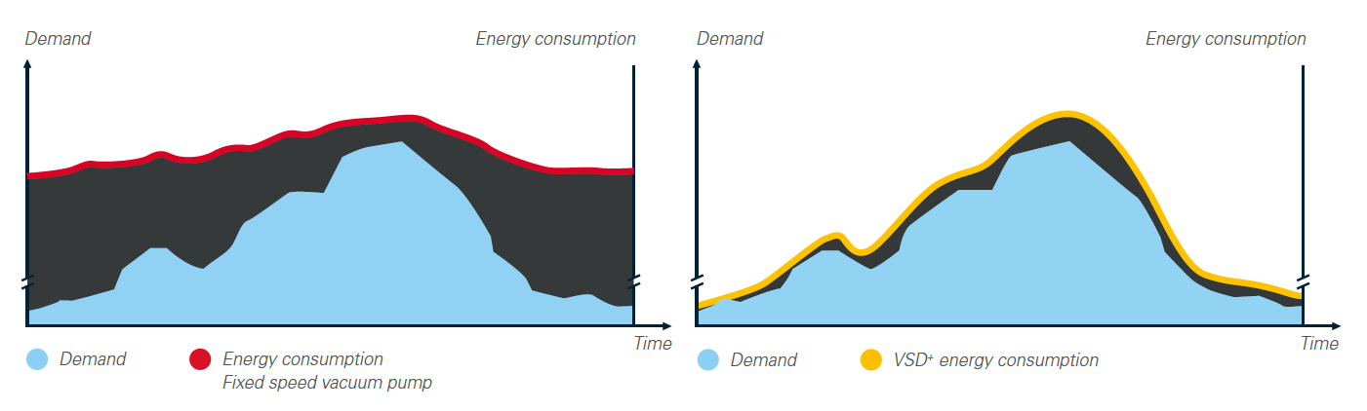
Stable Pressure & Variable Speed
36
Variable Speed Drive is the most efficient way to control the pressure and allows to set at the optimum pressure for the customer process.
Variable Speed Drive machine allows to have an energy consumption matching with the demand

Slide 37
Optimizing Pressure – Boyle’s Law
37
…designing for 27.5”Hg requires twice the size vacuum pump as 25”Hg
P₁V₁ = P₂V₂
1
2

Slide 38
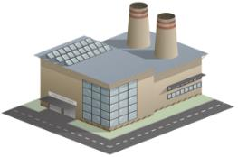
Optimizing Pressure – Boyle’s Law
38
This is our DEMAND
Our Vacuum Pump must meet the Demand
K = Constant
P₁V₁ = P₂V₂
1
2

Slide 39
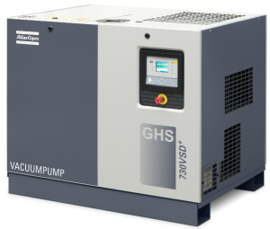

Optimizing Pressure – Boyle’s Law
39
P₁V₁ = K
K = Constant
1
K

Slide 40
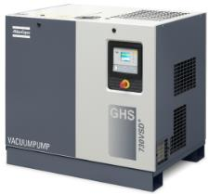

Optimizing Pressure – Boyle’s Law
40
What does it all mean?
Imagine a process demand of:
  27.5”HgV (29.92 - 27.5 = 2.42”HgA)
  300 acfm
P = 2.42”HgA (always use absolute terms)
V = 300 acfm
PV = (2.42)(300) = K = 726 (constant)

Slide 41
Optimizing Pressure – Boyle’s Law
41
What does it all mean?
So, if we can adjust the vacuum level to 25”HgV (29.92 – 25 = 4.92”HgA)
P = 4.92”HgV (always use absolute terms)
K = 24,600 (from previous calculation)
V = ? acfm
PV = (4.92)V = 726
V = 147 acfm
…designing for 27.5”Hg requires twice the size vacuum pump as 25”Hg
Flow requirement went from 300 to 147 acfm
→ $ and Energy SAVINGS

Slide 42
Optimizing Pressure
42
General Rule of Thumb
Compressed Air
Lower Pressure = Energy Savings
115 PSI
100 PSI
Atmosphere 1bar(a) = 1000mbar(a) = 0”HgV
24”HgV
Vacuum Pump
Same message, set the pump at the maximum allowable vacuum level = Energy Savings
27”HgV

Slide 43
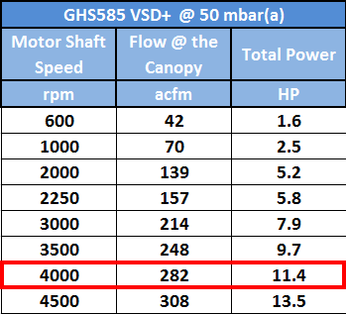
Optimizing Pressure
43
Energy Savings
Another Example: VSD Pump runs at 90% max speed at 50 mbar(a) (~28.5”HgV)
The process flow required at 50mbar(a) (~28.5”HgV) is 282 cfm and the total power is 11.4 HP.
PV = K or (50)(282) = K
K = 14,100
But for the process, the minimum vacuum level required to ensure the quality of the production is 75mbar (~27.7”HgV)…

Slide 44
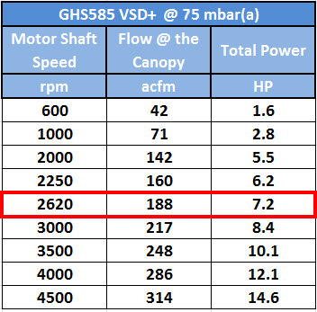
44
Optimizing Pressure
Energy Savings
But for the process, the minimum vacuum level required to ensure the quality of the production is 75mbar (~27.7”HgV)
What flow does the process need at 75mbar?
We know K = 14,100, so solving for V…
(75)(V) = 14,100, V = 188 acfm
The power consumes is 7.2 HP and the machine is running at 52% max speed.
Conclusion: A vacuum pump that works at deeper vacuum levels than what is needed is waste of energy!
Optimum pressure = maximum vacuum level for the customer’s process

Slide 45

Optimizing Pressure
45
Trial & Error Testing
Test to identify the maximum allowable operating pressure
Adjust set point to slightly deeper vacuum level than maximum allowable

Slide 46
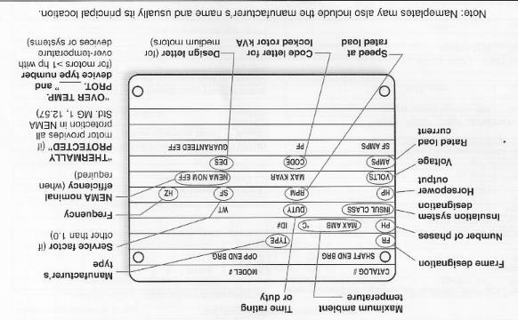
Optimal Vacuum Pump Technologies for VSD Control
46
Motor & VFD
Motor Considerations:
Inverter-Duty
Constant Torque Speed Range
Service
VFD Considerations:
Breaking Resistor
Tweaked Settings
  Avoid frequencies harmful to bearings
  Avoid noise harmonics

Slide 47

Optimal Vacuum Pump Technologies for VSD Control
47
Feedback & Control
Vacuum Sensor:
Fast enough response time
Usually best located at tool creating demand
Software & Algorithm:
P-I control usually best
  Avoid noise or oscillatory instability common with P-I-D control
Or purchase pre-configured from a reputable vacuum pump supplier

Slide 48
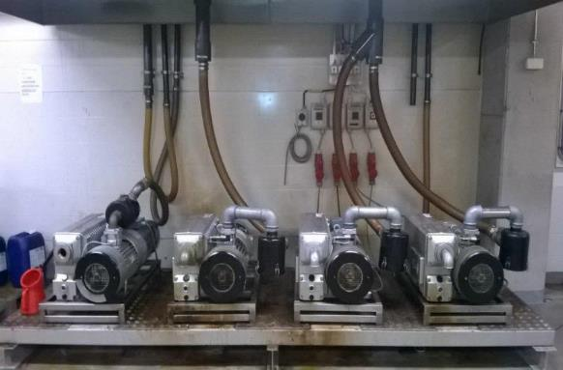
Optimal Vacuum Pump Technologies for VSD Control
48
From Spike to Demand
Vane pumps are often limited to 6 stop / starts per hour
Thermal limits of the motor
Mechanical limits of the coupling (vane has a much larger inertia than a screw)
Need to cool the oil
This is why in many system pumps are just running continuously. Or in the best case, machines are stopped after a minimum period (+/-10 minutes) in order to prevent mechanical damage.

Slide 49
Optimal Vacuum Pump Technologies for VSD Control
49
From Spike to Demand
Demand increases, a 2nd pump starts
Demand
Demand decreases
Period of time where one pump keeps running at lower pressure than needed
and extra consumption for nothing !
Number of pumps
running
2
1
➔ Bad management of the spikes
Power
200%
160%
100%
Time
Notes:
A motor run at full speed will have a shorter life span than a motor that regularly runs at a lower speed. The same applies to frequent stop/starts.
Since VSD operates the vacuum pump at reduced RPM’s, bearings and other internal components last longer and require less frequent maintenance.

Slide 50
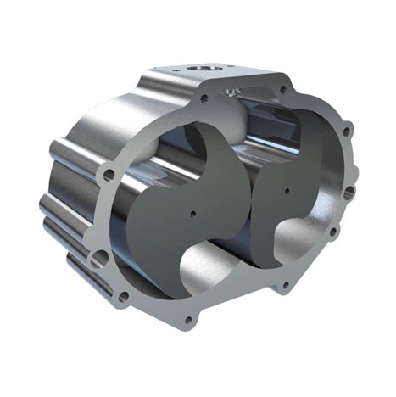
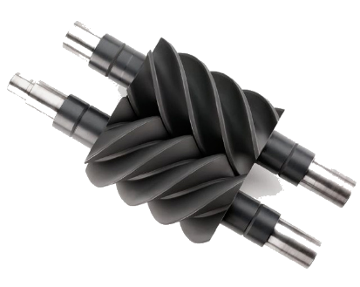
Optimal Vacuum Pump Technologies for VSD Control
50
Turndown Range
Various Technologies Have Varying Turndown Ranges
The greater the turndown range, the greater the set point control possible
→ SAVINGS POTENTIAL
Screw Vacuum Pumps provide the greatest turndown ranges, as much as 90%
Dry Claw Vacuum Pumps typically provide up to 67% turndown potential
Other technologies often have technological issues that limit the turndown range
  Liquid ring collapse
  Lack of centrifugal force for vanes

Slide 51
How We SAVE with VSD Technology
51
Around 50% of energy savings

Slide 52

Summary
52
VSD Set Point Control
VSD’s open opportunities to save:
Limiting Starting Power
  Smaller motors
  Smaller control panel devices and cabling
  Smaller utility supply lines
Potential Energy Rebates
More Accurate and Stable Supply Matching Demand
  Lower scrap rates
Less Heat Generated
  Lower cooling costs
  Happier employees
Less Maintenance
  Longer bearing, component, and motor life

Slide 53
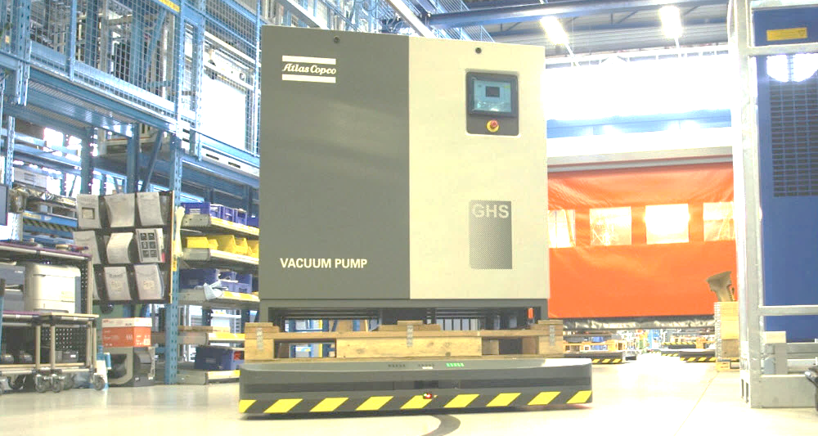
Thank you!
53
Walter See
Product Marketing Manager
Industrial Vacuum Division
Atlas Copco
412-605-2261
walter.see@us.atlascopco.com
www.atlascopco.us
COMMITTED TO SUSTAINABLE PRODUCTIVITY

Slide 54
54

Slide 55
55

Slide 56
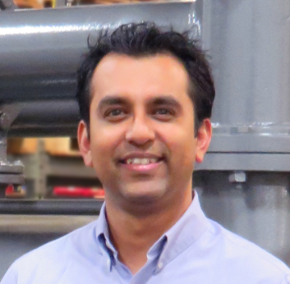
About the Speaker
Systems Engineering Manager for Busch USA
VJ Gupta
Busch USA
For your free subscription, please visit www.blowervacuumbestpractices.com/magazine/subscription.

Slide 57
Key Tips for Using Variable Speed Drives (VSD) on Vacuum Equipment
Webinar: Optimizing VSD Vacuum Pumps
VJ Gupta, Systems Engineering Manager
June 28, 2018
Page 1

Slide 58
Using Variable Speed Drives (VSD) on Vacuum Equipment
Busch’s perspective…
  We have been designing and operating VSD on pumps and central systems for decades.
  First, we determine if you benefit from Variable Speed Drives (VSD) for your application?
    There are many ways to optimize your process besides VSDs!
  If yes, we ensure you are really getting the benefits you expect.
    VSD’s are not meant to be one-size-fits all!
Page 2

Slide 59
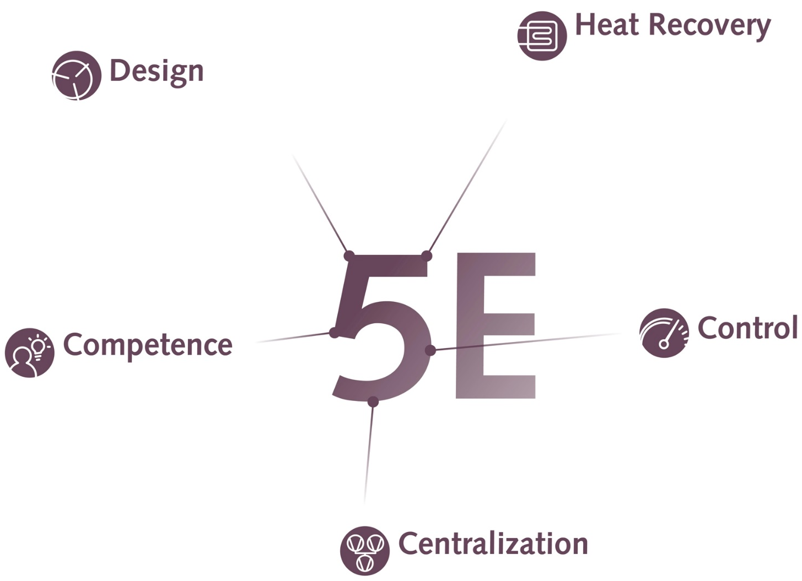
Vacuum Performance Optimization
5-Elements of Efficiency
During operation, vacuum pumps convert kinetic energy into heat energy. Heat recovery systems can harness this energy.
Selecting the most suitable pump technology for the process is crucial to performance, efficiency and total life costs.
VSD can
be used!
Efficient operation of vacuum processes requires experience in the interaction of all process components.
Control of vacuum systems finely tuned to production ensures optimum process stability and output.
A central vacuum supply offers the potential to reduce operating costs and increase energy efficiency.
Page 3

Slide 60
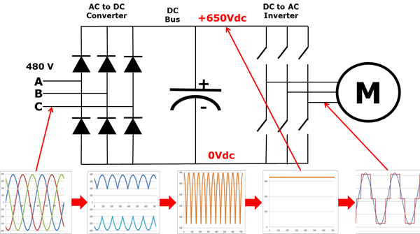
VSD Introduction
How does it work?
Input
460V
→
VSD Sine Wave Processing
First stage: Converts 3-phase alternating current (AC) to direct current (DC).
Second stage (Bus Filter): Removes AC ripples from DC converter waves
Third stage (Inverter): Convert DC to AC
VSD output voltage and frequency determined by control logic and inverter stage via control scheme called Pulse Width Modulation (PWM).
Page 4

Slide 61

VSD on Vacuum Equipment
Pros & Cons
PROS +
Potential energy cost savings.
Better process control possible.
Improved monitoring capabilities to verify against design parameters.
Reduced pump wear at lower speeds.
Best suited for processes with significant demand variation.
Helps qualify for Energy Rebates.
CONS –
Higher capital cost!
VSD could be misapplied and not save energy.
Higher potential of structural resonance issues.
Risks due to additional devices and controls requirements.
Controls expertise needed for optimal performance could add to cost.
Source: US Department of Energy
Variable Speed Pumping (Executive Summary 2014)
Page 5

Slide 62
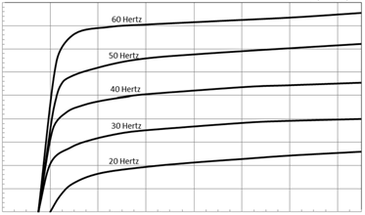
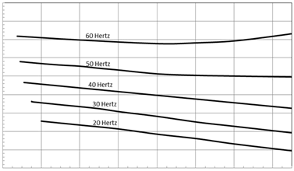
VSD on Vacuum Equipment
Performance Curve Basics
180
160
140
120
100
Pumping Speed (ACFM) ➔
80
60
40
20
0
➔
Vacuum (″ HgV)
8
7
6
Shaft Power (BHP) ➔
5
4
3
2
1
0
➔
29.92"
26"
22"
18"
14"
10"
6"
2"
Vacuum (″ HgV)
Page 6

Slide 63
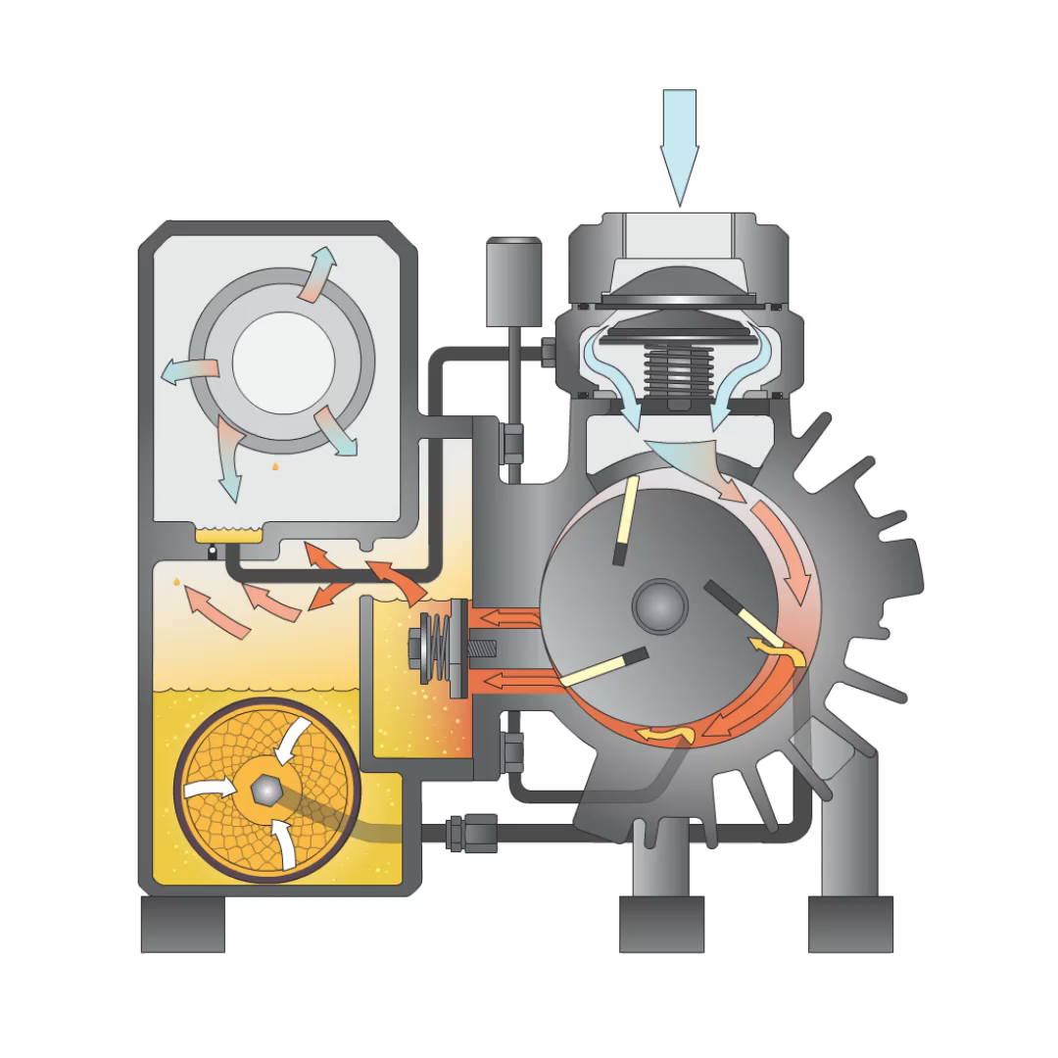
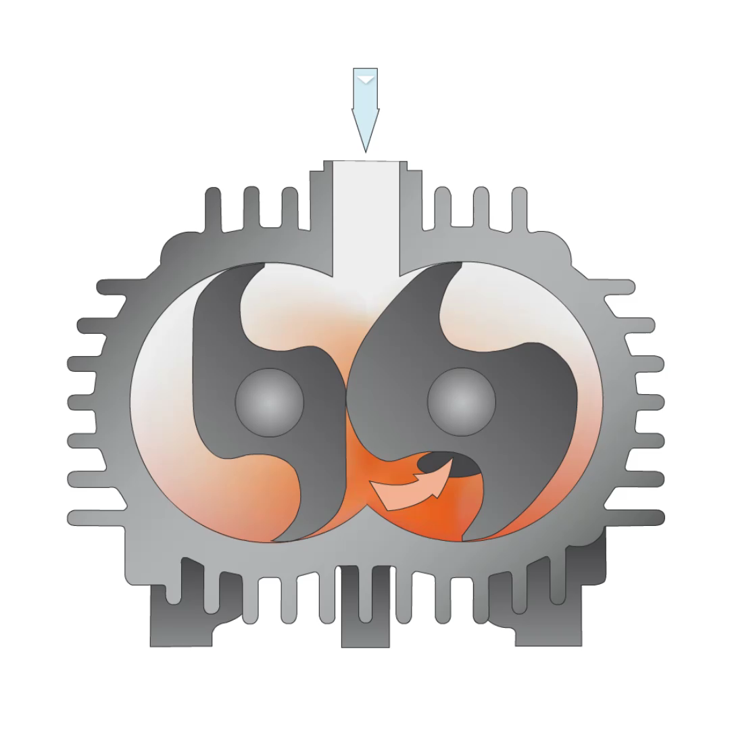
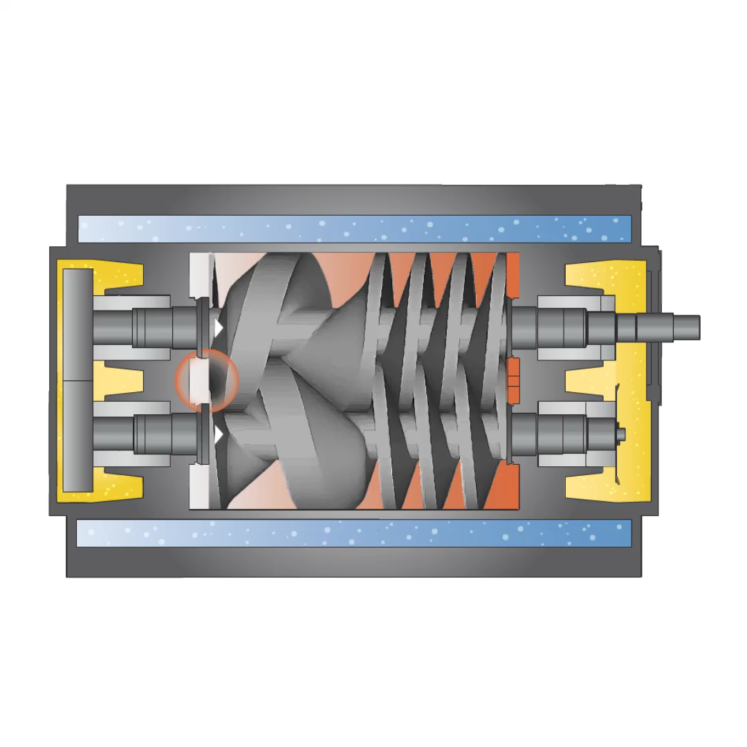
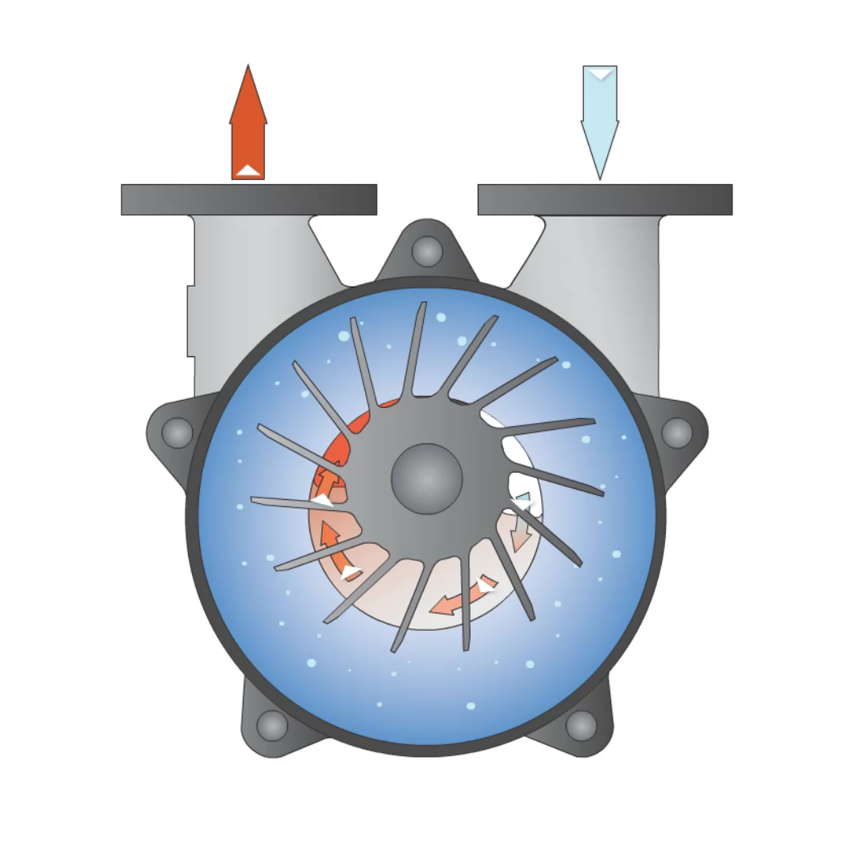
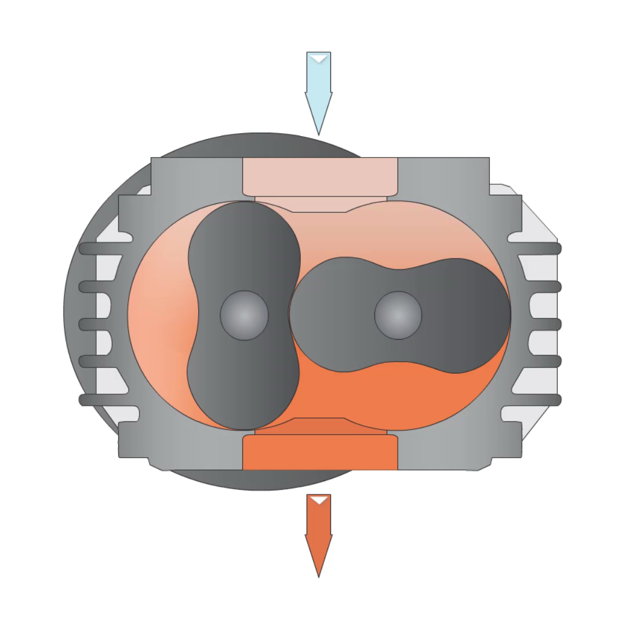
VSD on Vacuum Equipment
TIP 1 – Select Pump, then Controls!
Hz
₆₀
₅₀
₄₀
₃₀
₂₀
₁₀
Speed
Range
Why is this important?
First, pick a pump technology most suitable for your unique process needs.
Allowable speed regulation is dependent on pump technology used.
Pump efficiencies (HP / CFM) are better at higher frequencies.
Page 7

Slide 64
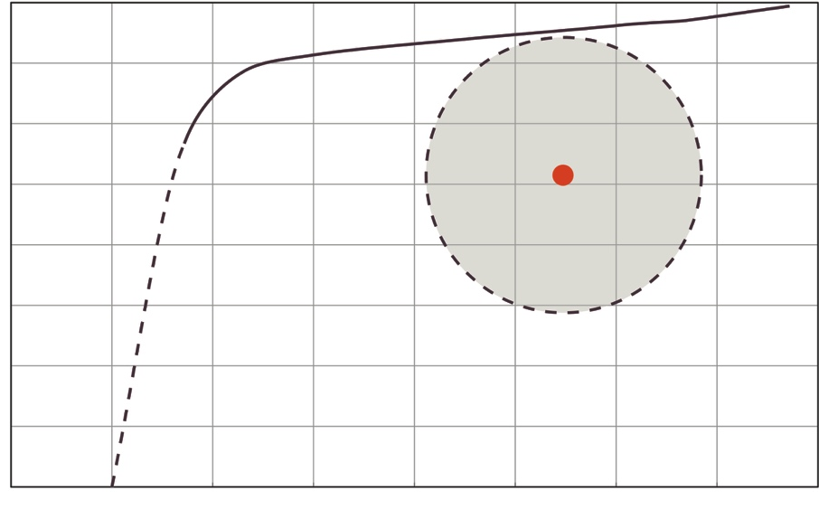

Application Evaluation
Random Process Demand (Flow vs Vacuum)
60 Hz
Design Point
Demand Variation
Pumping Speed (ACFM) ➔
VSD
29.92"
26"
22"
18"
14"
10"
6"
2"
0"
➔
Vacuum (″ HgV)
Page 8

Slide 65
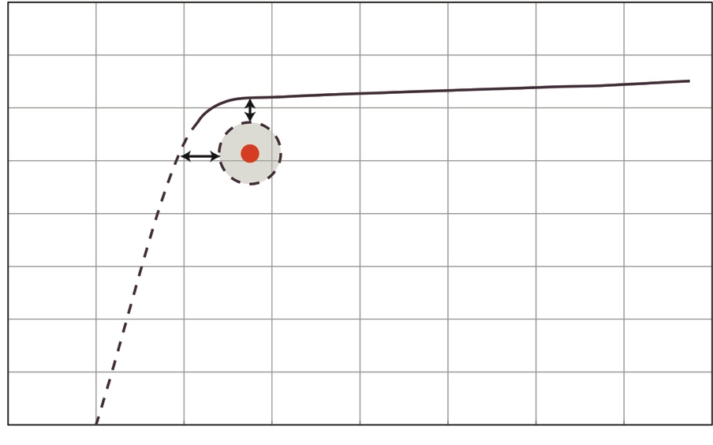

Application Evaluation
Steady Process Demand (Flow vs Vacuum)
60 Hz
Pumping Speed (ACFM) ➔
VSD
29.92"
26"
22"
18"
14"
10"
6"
2"
0"
➔
Vacuum (″ HgV)
Page 9

Slide 66
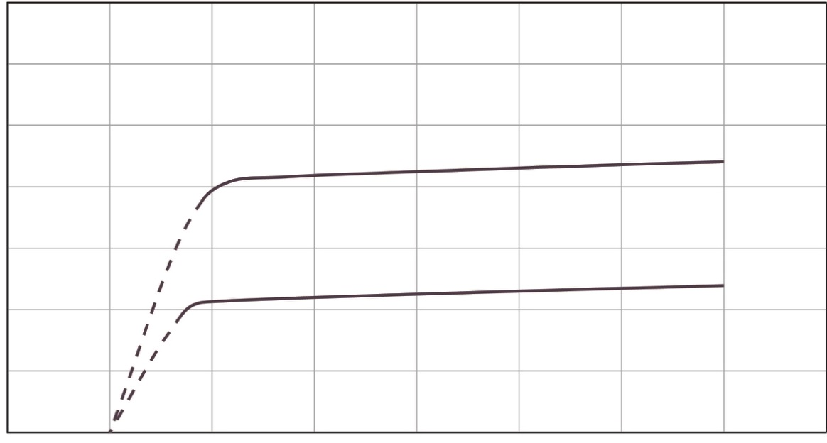

Known Demand Variation
TIP 2 – Consider both VSD or Lead/Lag configurations
Process 1
50 ACFM
20” HgV
Process 2
50 ACFM
20” HgV
160
Two Processes Running
Pump Curve
110
Pumping Speed (ACFM) ➔
Pump
2nd Pump
One Process Running
Pump Curve
60
29.92"
20"
0"
Vacuum (″ HgV)
➔
Why is this important?
VSD is not the solution for all applications.
Multiple fixed speed pumps offer simplicity, higher efficiency and redundancy.
VSD
Page 10

Slide 67
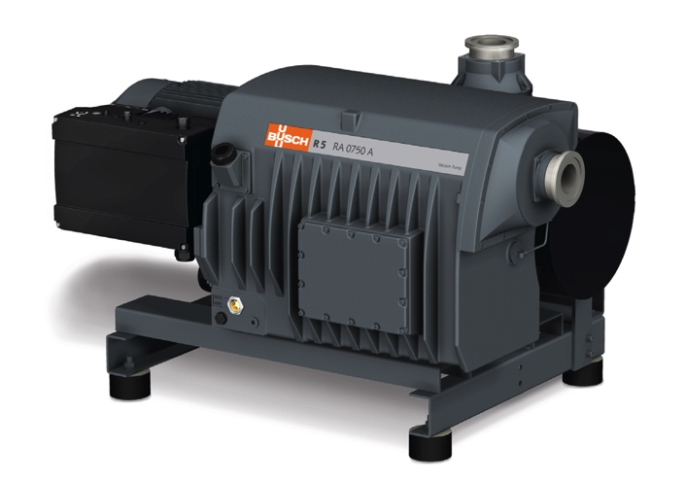
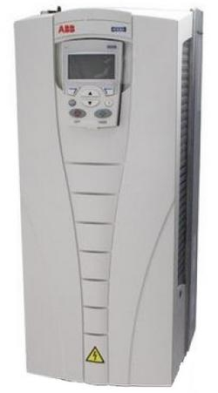
VSD on Vacuum Equipment
TIP 3 – Consider All Installation Options
Non-Hazardous
area
Hazardous
area
VSD
VSD mounted
on Pump
VSD (external) located
remotely
Why is this important?
Controls should be easily accessible for operators.
Cost benefits to installing VSD and Control Panels outside of hazardous areas.
Page 11

Slide 68
VSD on Vacuum Equipment
TIP 4 – Consider Central Vacuum Systems with VSD!
Point-of-Use Vacuum Pumps
Centralized Vacuum
POU
Application(s)
POU
Application(s)
Remote location
Centralized Vacuum Unit with VSD
POU Vacuum
Source(s)
Common Vacuum Header
Customer’s Facility
Customer’s Facility
Why is this important?
Centralized VSD can “trim” system performance to match the demand.
Reduced noise, heat and footprint in production area.
Page 12

Slide 69
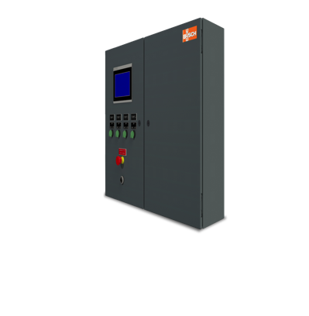
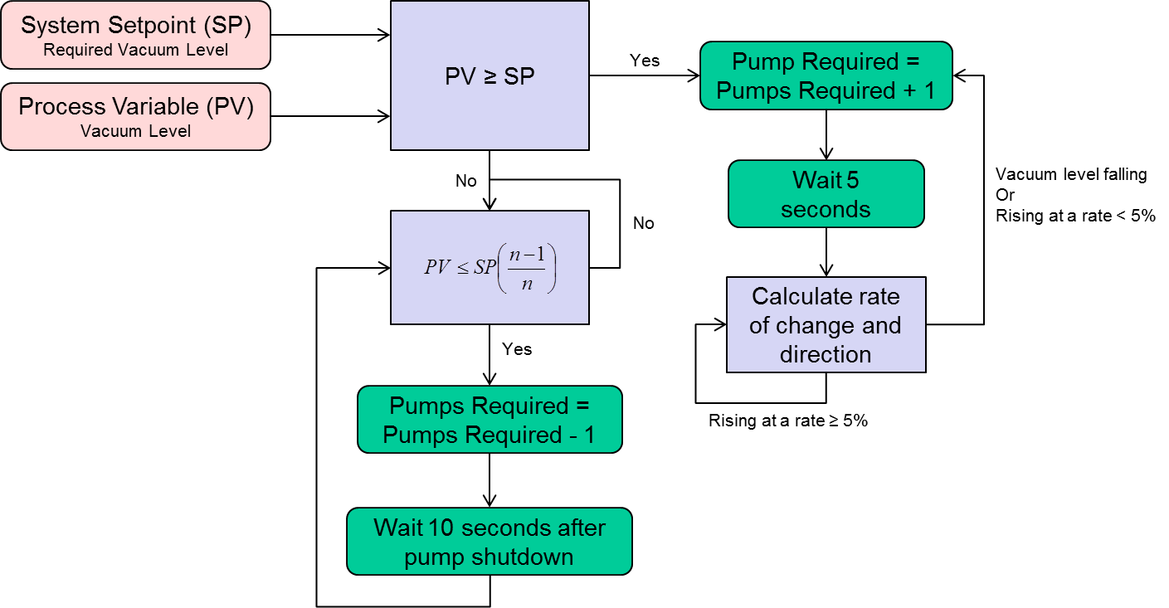
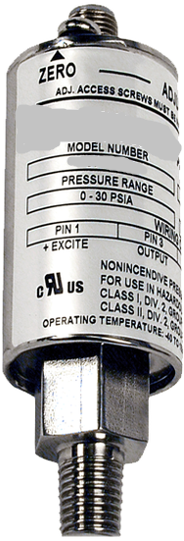
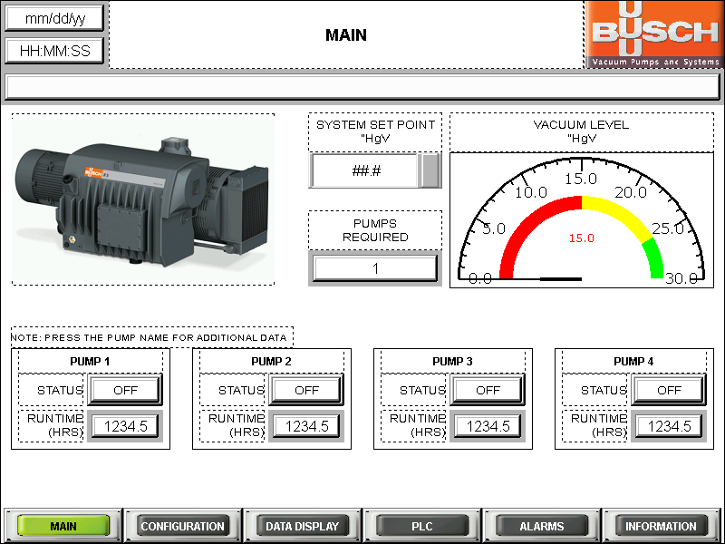
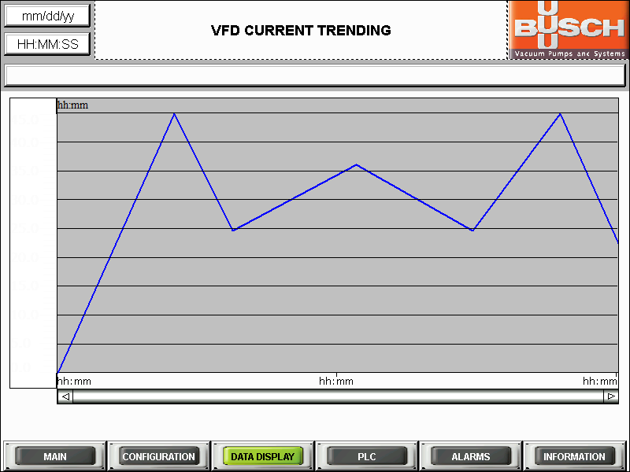
VSD on Vacuum Equipment
TIP 5 – Use Modern Day Features and Options
VSD with Sensor
Control Panel w/ VSD & Sensor
Why is this important?
Control Panel with Programmable Logic Controller (PLC) simplifies coordination of multiple pumps and optimizing efficiencies.
USB connectivity makes communication, programing and monitoring easy.
Many standard VSD enclosure types to choose from: NEMA 1, 12, 4, 4X etc.
Page 13

Slide 70
VSD on Vacuum Equipment
TIP 5 (continued…) – Sensor Location
Sensor on Vacuum Pump Suction
Sensor on Process (away from pump)
Sensor
Process
Sensor
VSD
VSD
Vacuum Pump
Why is this important?
Sensor provides real time feedback to VSD from a location that is critical to the process.
If sensor is installed at process, VSD can respond faster to demand changes.
Page 14

Slide 71

VSD on Vacuum Equipment
Summary
  Remember the Tips!
  Vacuum process evaluation:
    Does my process flow requirement match my pump’s capacity at 60Hz?
    Is there significant demand variation in my vacuum application?
    Am I using a closed loop pressure control system with automatic valves for pressure regulation?
    Can I benefit from Energy Savings or Rebates?
    Do I have process “idle” times? Are they substantial?
    Do I have in-house expertise to program and monitor VSDs or would I prefer a complete turn-key control panel?
    If a VSD is beneficial for me, do I have a preference on make/model to stay consistent with my existing plant equipment?
  Choose the appropriate pump technology before implementing controls!
  Conduct a comprehensive vacuum optimization study (i.e. Busch’s 5-Elements of Efficiency program).
Page 15

Slide 72
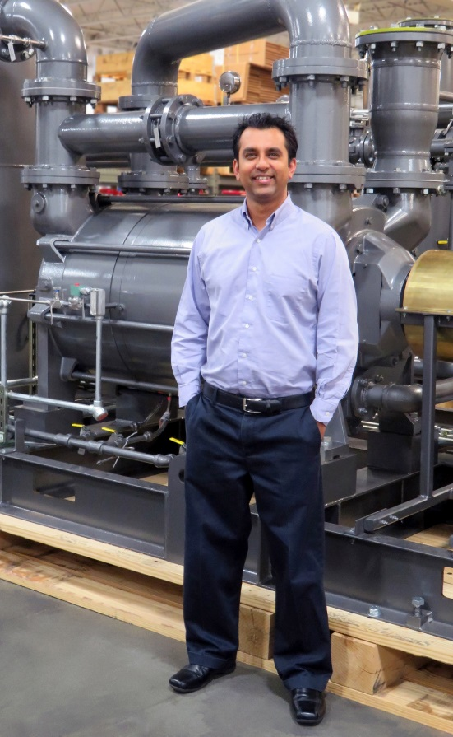
Key Tips for Using Variable Speed Drives (VSD) on Vacuum Equipment
Contact Us
Thank you!
For more information about Busch Vacuum Pumps and Systems, please visit: www.buschusa.com
VJ Gupta
Systems Engineering Manager for Busch USA Office: (757) 502-7084 • Cell: (757) 373-0099 vj.gupta@buschusa.com
Page 16

Slide 73
5 Tips on Optimizing VSD Vacuum Pumps
Q&A
Please submit any questions through the Question Window on your GoToWebinar interface, directing them to Blower & Vacuum Best Practices Magazine. Our panelists will do their best to address your questions, and will follow up with you on anything that goes unanswered during this session. Thank you for attending!
Sponsored by
For your free subscription, please visit www.blowervacuumbestpractices.com/magazine/subscription.

Slide 74
Thank you for attending!
The recording and slides of this webinar will be made available to attendees via email later today.
PDH Certificates will be e-mailed to Attendees within two days.
Sponsored by
For your free subscription, please visit www.blowervacuumbestpractices.com/magazine/subscription.

Slide 75
ATTEND THE INAUGURAL 3-DAY CONFERENCE & EXPO!
September 17-19, 2018, Chicago O’Hare Crowne Plaza Conference Center
FREE EXPO
Booths from Atlas Copco, Busch USA, Gardner Denver, Kaeser Compressors, Leybold USA, Edwards, Howden Roots, Solberg
HIGH-ROI CONFERENCE
TRACK 3: BLOWER & VACUUM OPTIMIZATION
Vacuum System Centralization, Vacuum Demand Reduction, Utility Incentive Program Design
Limited Hotel Space Remaining. Register Today!
www.cabpexpo.com

Slide 76



July 2018 Webinar
5 Tips on Optimizing VFD Air Compressors
Sponsored by
Loran Circle
Compressed Air System Training & Consulting
Keynote Speaker
Thursday, July 19, 2018 – 2:00 PM EST
Register for free at
www.airbestpractices.com/magazine/webinars

