Slide 1
Aeration Blower Control Strategies
Tom Jenkins, P.E., JenTech Inc.
Keynote Speaker
The recording and slides of this webinar will be made available to attendees via email later today.
PDH Certificates will be e-mailed to attendees by Monday.

Slide 2
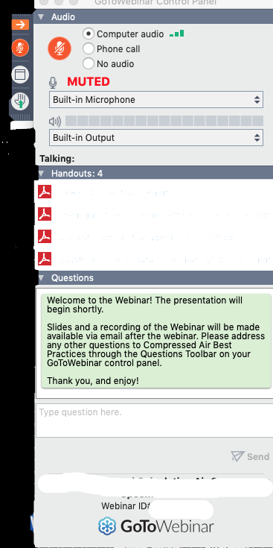
Q&A Format
Panelists will answer your questions during the Q&A session at the end of the Webinar.
Please post your questions in the Questions Window in your GoToWebinar interface.
Direct all questions to Compressed Air Best Practices® Magazine
Sponsored by

Slide 3
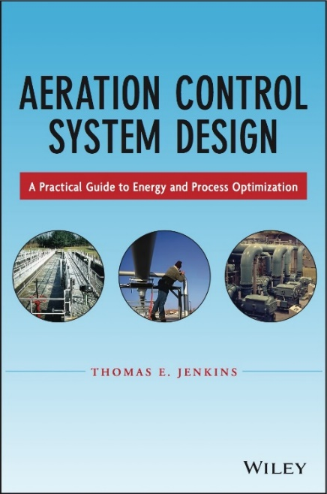
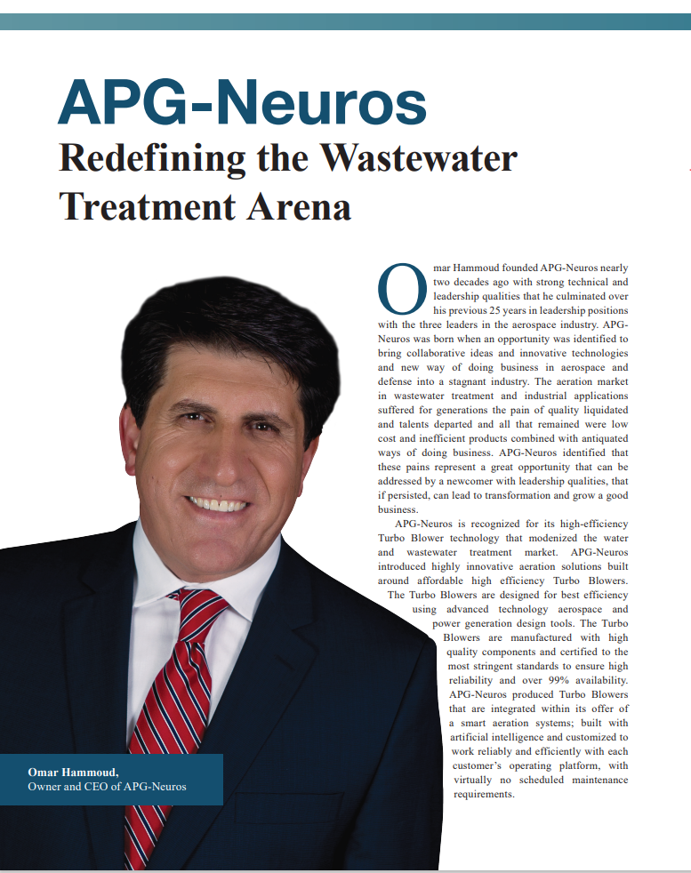
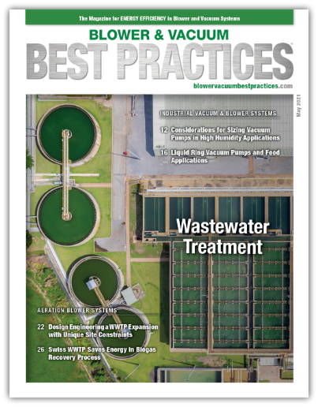
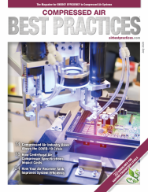
Handouts

Slide 4
Disclaimer
All rights are reserved. The contents of this publication may not be reproduced in whole or in part without consent of Smith Onandia Communications LLC. Smith Onandia Communications LLC does not assume and hereby disclaims any liability to any person for any loss or damage caused by errors or omissions in the material contained herein, regardless of whether such errors result from negligence, accident, or any other cause whatsoever.
All materials presented are educational. Each system is unique and must be evaluated on its own merits.

Slide 6
Aeration Blower Control Strategies
Introduction
Blower & Vacuum Best Practices Magazine
Sponsored by

Slide 7
About the Speaker
President of JenTech Inc.
Over 30 years of experience with aeration blowers and blower controls
Tom Jenkins, P.E.
JenTech Inc..
Sponsored by

Slide 8
Topics
Basis of Process Demand
Control Strategies
Positive Displacement Blower Control
Calculation Methods: Variable Speed
Dynamic (Centrifugal) Blower Control
Calculation Methods: Throttling
Calculation Methods: Variable Speed
Future Trends

Slide 9
Basis of Process Demand
Most blower applications are based on delivering the required airflow rate to the process
Some require a specific volumetric flow rate of air
Channel aeration and equalization tank mixing
Pneumatic conveying and vacuum cleaning, air knives
Many require a specific mass flow rate of oxygen to the process
Wastewater aeration for secondary treatment and digestion
Combustion air for furnaces
Process performance rarely depends on providing a specific pressure

Slide 10
Control Strategies
You can’t control blower discharge pressure – only air flowrate
Pressure is required to push air to the process
The blower doesn’t establish the pressure, the process and piping do
The system curve establishes the process’ relationship between air flow and pressure
In typical process control applications, the blower is modulated to meet process flow demand regardless of pressure variations
This is usually accomplished with a feedback loop
Sometimes you need to predict the change controls make in performance
ECM evaluation for example
10

Slide 11
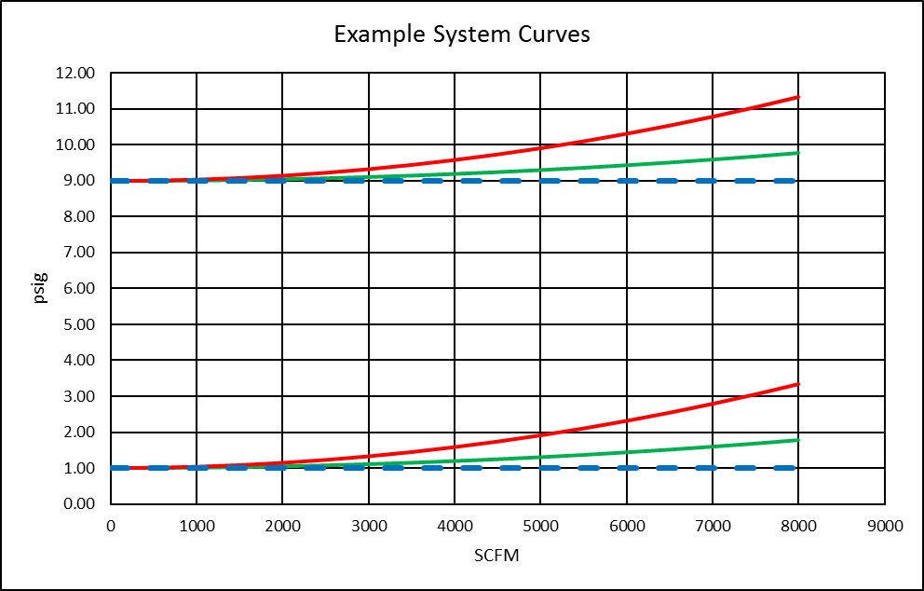
Control Strategies
High friction losses
Examples of system curves:
High static pressure
Low friction losses
Low static pressure
11

Slide 12
Control Strategies
The performance “curve” defines the operating capabilities of the blower
Constant speed positive displacement (PD) blowers operate at variable pressure and ≈ constant flow
Constant speed centrifugal (dynamic) blowers operate over a narrow pressure range and variable flow
Ambient conditions affect all blower’s performance
The intersection of the system and performance curves identifies the operating point
Blower control consists of manipulating the performance curve
PD and centrifugal blower performance must be analyzed differently
12

Slide 13
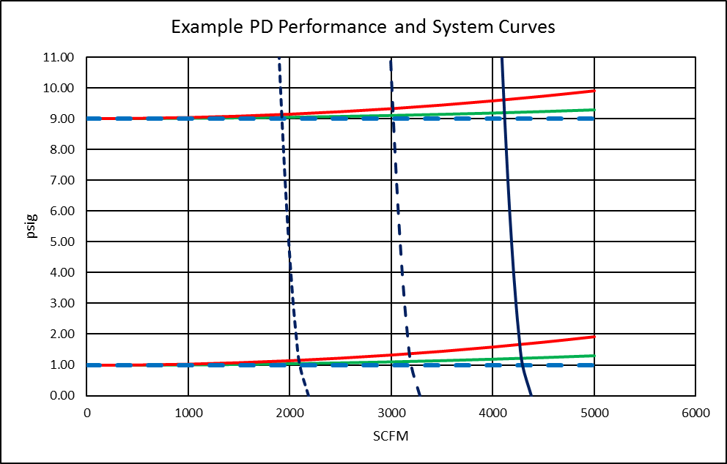
Positive Displacement Blower Control
The only practical flow control method for PD blowers is variable speed
100% rpm
75% rpm
50% rpm
13

Slide 14
Positive Displacement Blower Control
Reducing speed shifts the blower performance to the left
The curve isn’t quite vertical because internal leakage (slip or volumetric efficiency) increases with rising pressure differential
In most applications the operating pressure range is narrow enough that changes in slip can be ignored
Power is a function of flow and pressure
Both volumetric flow vs. speed and blower power vs. flow are linear
They both vary with pressure ratio
They both have a non-zero intercept
14

Slide 15
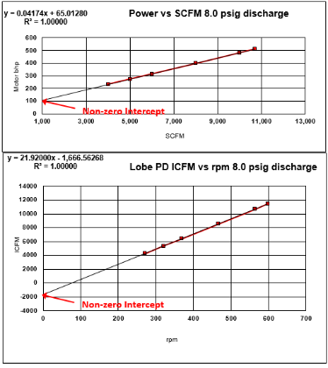
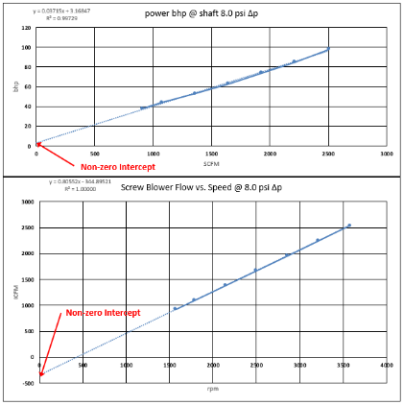
Positive Displacement Blower Control
Typical PD performance, Lobe and Screw:
15

Slide 16
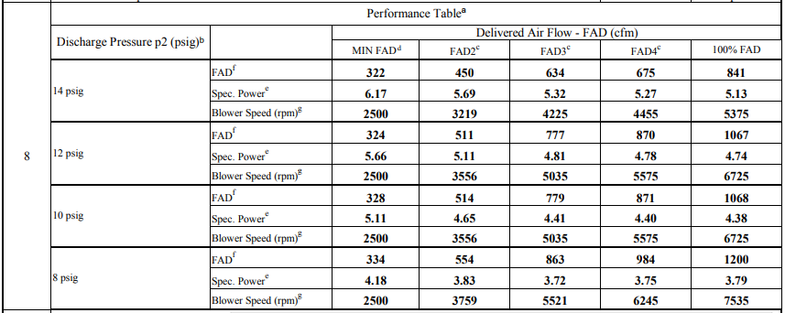
Positive Displacement Blower Control
PD performance is often given in tabular form:
From CAGI data sheet
16

Slide 17
Positive Displacement Blower Control
To calculate results of a speed change at ≈ constant pressure use y = mx + b
Two known data points can be used to predict a third at a different speed:
For a new pressure you can use different curves at two pressure values and linearly interpolate
$m=\frac{q_{2}−q_{1}}{{rpm}_{2}−{rpm}_{1}}$ or $\frac{{hp}_{2}−{hp}_{1}}{q_{2}−q_{1}}$
$$b=q_{1}−m∙{rpm}_{1} or{ hp}_{1}−m∙q_{1}$$
$$q_{new}=m∙{rpm}_{new}+b$$
$${hp}_{new}=m∙q_{new}+b$$
17

Slide 18
Positive Displacement Blower Control
Considerations and limiting factors for VFD control:
PD blowers are a constant torque load
Motor current is ≈ constant across speed range
The VFD is typically larger for a given hp rating
Blower temperature rise increases as speed decreases
This can limit turndown
Exceeding discharge temperature or ΔT limits may damage the blower
Motor cooling may be compromised at reduced speed
This can limit turndown
Motor temp switches or temperature monitoring is recommended
18

Slide 19
Positive Displacement Blower Control
Additional control and protection for PDs:
Motor overcurrent, phase loss, and phase imbalance
Bearing temperature for blower and motor
Blower case vibration
Discharge air temperature Hi
Discharge pressure Hi and Lo
All PDs should have a pressure relief valve
Differential temperature
Lube oil temperature Hi
Lube oil level and pressure Lo
Note: Recommended level of protection varies with blower size
19

Slide 20
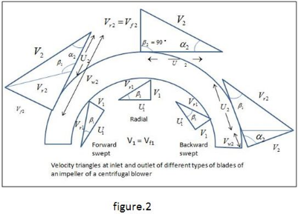
Centrifugal Blower Control
There are several types of centrifugal (dynamic) blowers in common use
Geared single stage are typically high hp
Multistage are typically mid-range
Gearless single stage (also called direct drive or turbo) are typically lower hp
There is a LOT of overlap on flow and pressure capabilities
Centrifugal blowers are kinetic energy machines
The impeller imparts kinetic energy to the air
The volute (diffuser) converts some of the kinetic energy
to potential energy (pressure)
Control is achieved by shifting the flow/pressure
curve
20

Slide 21
Centrifugal Blower Control
There are several ways to shift the performance curve
Throttling
Adjustable guide vanes
Inlet or discharge (diffuser)
Changing speed – this is the most efficient
Any of these can be used with any type of centrifugal blower
Most common control methods:
Geared single stage: variable inlet guide vanes and variable discharge diffuser vanes
Multistage: inlet throttled or variable speed
Gearless single stage: variable speed
21

Slide 22
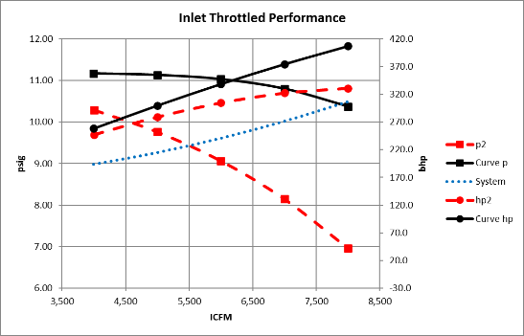
Centrifugal Blower Control
Throttling is the lowest cost control method
Throttling is the least efficient control method
Throttling converts some of the blower’s Δp into heat by creating a pressure drop across the valve
22

Slide 23
Centrifugal Blower Control
When throttling a constant speed blower:
Blower inlet volumetric flow rate is unchanged
Pressure ratio is unchanged
SCFM is changed because inlet density is changed
Hp decreases
For centrifugal blowers, inlet throttling is used most often
The Δp across the valve can be calculated from C_{v} or a known Δp value
$$∆p_{v}={\left(\frac{Q_{s}}{22.66∙C_{v}}\right)}^{2}∙\frac{SG∙T_{u}}{p_{u}}$$
Or
$$∆p_{2}=∆p_{1}∙{\left(\frac{q_{2}}{q_{1}}\right)}^{2}$$
23

Slide 24
Centrifugal Blower Control
The effect on performance can be calculated
$$p_{i2}=p_{bar}−{∆p}_{v}$$
$$p_{d2}=p_{i2}∙\frac{p_{d1}}{p_{i1}}$$
$$p_{d2gauge}=p_{d2}−p_{bar}$$
$$q_{vi2}=q_{vi1}$$
$$X_{2}={\left(\frac{p_{d2}}{p_{i2}}\right)}^{0.285}−1$$
$${bhp}_{2}=\frac{q_{vi2}∙p_{i2}∙X_{2}}{64.85∙η_{b}}$$
24

Slide 25
Centrifugal Blower Control
For variable speed calculations the affinity laws apply:
$$q_{v2}=\frac{{rpm}_{2}}{{rpm}_{1}}∙q_{v1}$$
$$X_{1}={\left(\frac{p_{d1}}{p_{i1}}\right)}^{0.285}−1$$
$$X_{2}={\left(\frac{{rpm}_{2}}{{rpm}_{1}}\right)}^{2}∙X_{1}$$
$$p_{d2}=p_{i1}∙{\left(X_{2}+1\right)}^{3.513}$$
$${hp}_{2}={\left(\frac{{rpm}_{2}}{{rpm}_{1}}\right)}^{3}∙{hp}_{1}$$
25

Slide 26
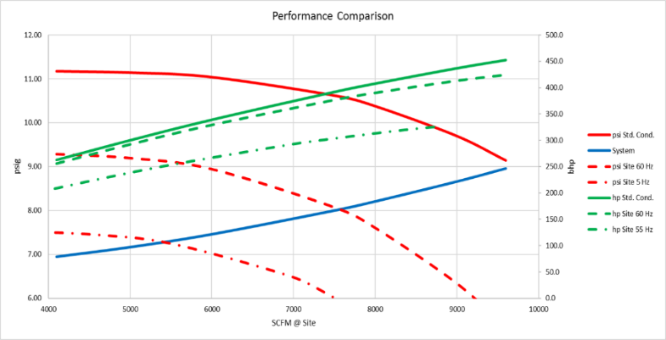
Centrifugal Blower Control
This is the wrong way to apply affinity laws: DON’T apply them directly to old operating points
26

Slide 27
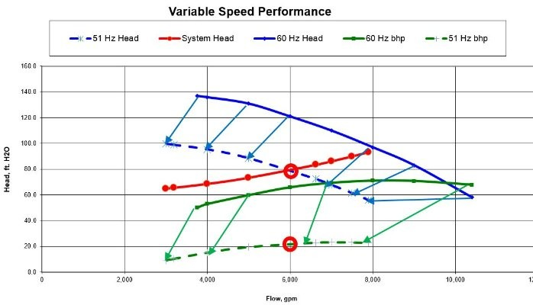
Centrifugal Blower Control
Right way to apply affinity laws: original system curve and new blower curve
27

Slide 28
Centrifugal Blower Control
Guide vane efficiency is intermediate between throttling and variable speed
Inlet guide vanes put spin in the air before it enters the impeller
This changes kinetic energy creation
At reduced opening inlet guide vanes create some pressure loss like throttling
Discharge diffuser vanes change the conversion of kinetic energy to potential energy, changing the discharge pressure
Guide vane designs and performance are proprietary
Control impact must be evaluated from manufacturer’s data
28

Slide 29
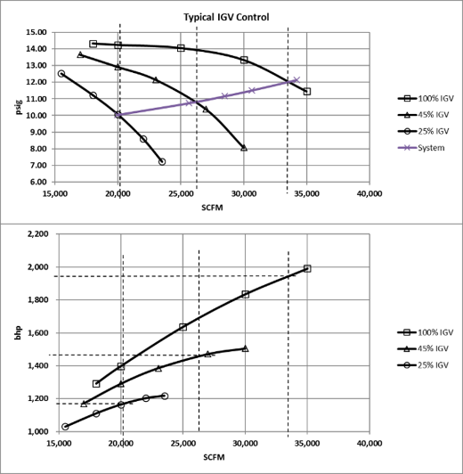
Centrifugal Blower Control
Control impact must be evaluated from manufacturer’s data
29

Slide 30
Centrifugal Blower Control
In real world applications feedback loops adjust the control apparatus until the new flow results in the measured parameter set by process control
Pressure setpoints are a common parameter
It is a throwback to older control methodology
For many processes it is a surrogate for the process demand for oxygen delivery
For a specific system curve flow changes result in pressure changes
Flow setpoints typically have a direct impact on process performance
Speed is sometimes used as a setpoint but has an indirect impact on the process
30

Slide 31
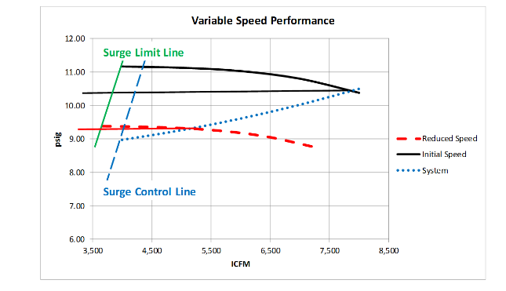
Centrifugal Blower Control
Surge protection is a critical aspect of any dynamic blower control system
Surge is a pulsating airflow that occurs at low flow and high pressure
It can destroy a blower if left unchecked
The surge limit or surge limit line identifies where actual surge conditions exist
The surge control point or line is the lower control limit for normal operation
31

Slide 32
Centrifugal Blower Control
The surge control point or surge line includes a margin of safety above the surge limit
At or below the surge control point corrective action is taken
An alarm may be triggered
The blower may be stopped
The blower control may modulate to increase flow back to a safe operating point
A blow off valve may open to increase flow and reduce system pressure
Or some combination of the above
32

Slide 33
Centrifugal Blower Control
Additional control and protection for centrifugal blowers:
Motor overcurrent, phase loss, and phase imbalance
Bearing temperature for blower and motor
Bearing vibration for blower and motor
Blower case vibration
Discharge air temperature
Discharge pressure
Lube oil temperature
Lube oil level and pressure
Note: Recommended level of protection varies with blower size and type of blower
33

Slide 34
Trends in Control
Increased connectivity with SCADA
Separation of process controls and blower control and protection
More precise controls
Replacement of pressure control with direct flow control
Wider application of premium efficiency motors
Example: permanent magnet synchronous AC motors now used on various blower types
Virtual machines for performance optimization
Industry 4.0 (Internet of Things: IoT) integration
Cloud connectivity for data storage and monitoring
34

Slide 35
Submit Questions and Comments

Slide 36
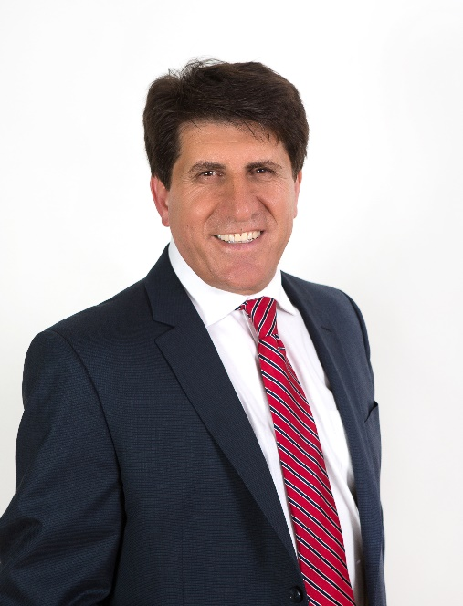
About the Speaker
President and CEO, APG-Neuros
Founded APG-Neuros in 2005
Spent 25 years in the aerospace and defense industries
Passionate about the environment and sustainability
Omar Hammoud
APG-Neuros
Sponsored by

Slide 37
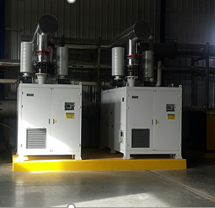
Agenda
Introduction
Challenges with PID controls
Enhanced aeration controls
Model Predictive Controls
Solutions offered by APGN
Case study
Q & A
15 KW to 750 KW Turbo Blowers

Slide 38
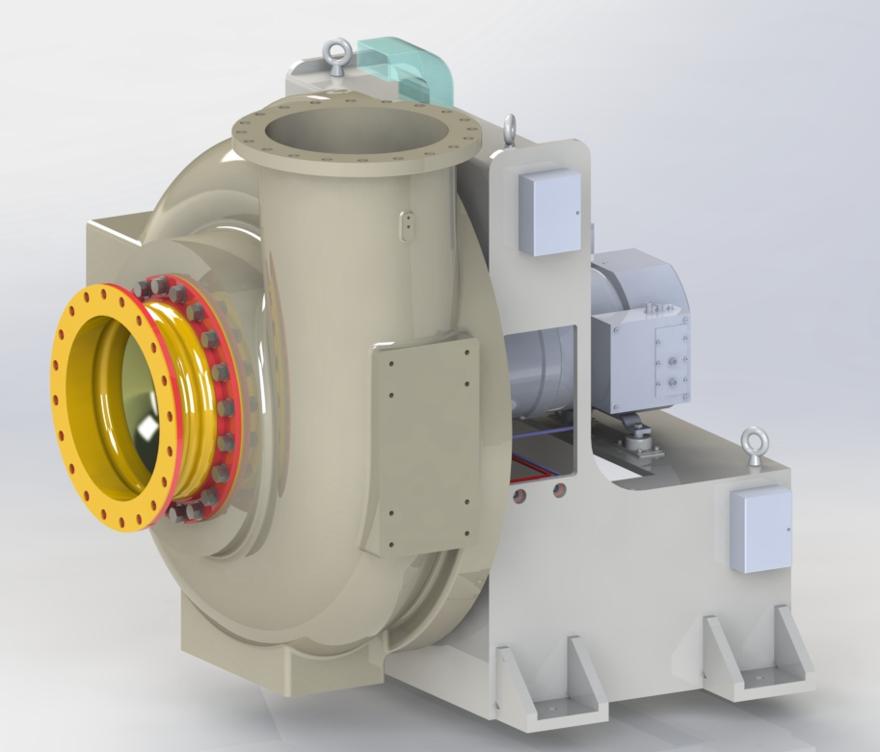
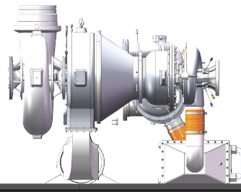
Introduction to APG-Neuros
Founded in 2005, Montreal, Canada with background in power generation technologies
1st. unit in 2005 in NA to 1,500 units in 2020 ( > 600 installations).
Aeration system design & supply; from diffusers to Turbo Blowers & Controls
Turbo Blower product range from 15 KW to to 2,200 KW rated power
450 SCFM (750 M3/HR) to 70,000 SCFM (120,000 M3/HR)
3.5 PSIG (0.25 Barg) to 45 PSIG (3 Barg)
Customer benefits:
Compact, Quiet, Vibration Free, High efficiency, quality & reliability
Demonstrated capability for Frequent Starts and Variable Pressure
Smart connected, low maintenance based on condition monitoring
Adapt to customers’ design requirements
Gas Turbine Blower operates on Biogas, NG & Kerosene fuels
Electric Grid independence
Operating cost savings
Low emissions
1 MW Turbo Blower
230 KW Gas Turbine Blower

Slide 39
Aeration and wastewater treatment
The Challenges
Aeration is main engine of wastewater treatment;
Providing sufficient DO for aerobic organisms performing BOD removal,
Nitrification in activated sludge,
Keeping biomass in suspension.
Treatment can be varied in relation to DO control in two ways:
By adjusting aeration intensity, or
By adjusting aerated volume
Apart from DO concentration, several other factors affect treatment:
Inorganic substrates,
Solids retention time (SRT),
Temperature,
PH and toxic inhibition.
Overaeration is generally practiced to care for
Uncertainties in measurement, predictions and controls
Fear of losing control on treatment or permit violation

Slide 40
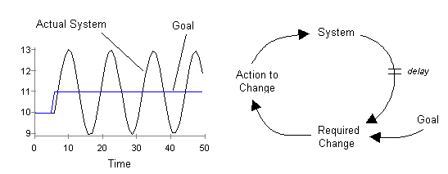
Control Strategy limitations
Issues with Application of PID Control
Key issues with PID :
Using linear formulas as Proportional Integral Differential (PID) to model non-linear systems
Using multiple independent PID loops that interfere with each other
Control process parameters that have long response times
Result:
Oscillation and instability

Slide 41
Challenges with PID control Explained
P, PI and PID control:
Efficient for linear processes with minimum lag due to time delay
Biological processes are NOT linear: multiple variables play against each other

Slide 42
Challenges with PID control explained
Independent PID controllers interact and influence each other causing
Process instability, oscillating air flow, valve hunting,
Surge and potential equipment failure
System charcteristics due to dead time and time constant
Ex. Process response time delays:
DO -up to 7 minutes
NH4 -up to 5 hours
Poor flow control accuracy and poor DO measurement and control
Means have to choose higher DO setpoint to ensure effluent limit is met
Ex. Care for anticipated sudden change in load or volume

Slide 43
Enhanced controls
Attempt to solve issues with PID Control
Enhanced control schemes to improve DO control
Ammonia Based Aeration Control (ABAC)
Good results in pilot studies and reported early operations
Similar challenges to PID control to maintain good effluent quality:
Maintaining good flow accuracy
Maintaining good DO accuracy
Maintaining good ammonia accuracy

Slide 44
Proposed New Solution for Aeration Control
Software that can generates valve and blower models based on historical data
Valve and vanes positions are predicted based on Machine Learning (ML) models (“big data”) rather than being calculated by PI algorithm
Objective from ML algorithms is to reduce inaccuracy in flow control:
From >20% (PID) to less than 4% (ML)

Slide 45
Model Predictive Controls (MPC) defined
Mathematical Models built with non-linear algorithims and simulations
Application of process fundamentals formulas for treatment
Analysis of Big Data from historians to establish paterns and relationships
Use of paterns to predict lowest airflow (DO) required
Correct in realtime predictions for valve position and blower operation
Model types:
Mechanistic (based on process fundamentals)
Heuristic (based on historical plant « Big Data »)
MPC Combines mechanistic & heuristic models to predict set point (Ex. DO SP)
Predictions are updated automatically based on historians
Self determined DO set point is maintained for required treatment

Slide 46
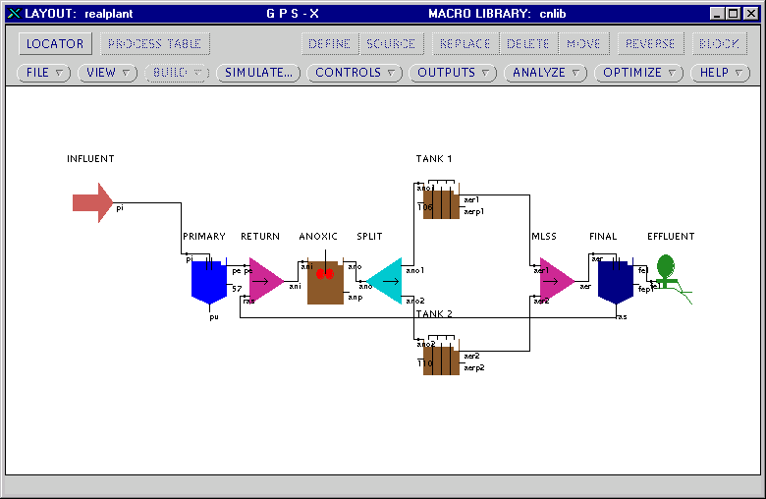
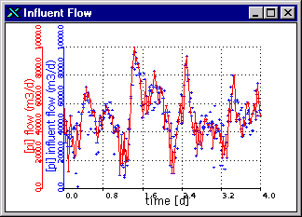
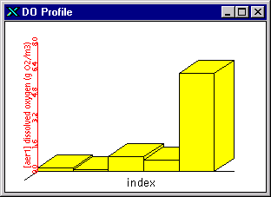
Model Predictive Controls Explained
Mechanistic Model Only
Activated sludge mechanistic model simulation built based on process fundamentals

Slide 47
Model Predictive Controls (MPC) Explained
Mechanistic Model
Using only mechanistic models for treatment of biology?
Problem is hydraulic flow, load and aeration flow change frequently
Affects accuracy of mechanistic model
Difficult to accurately modelize the various diffuser characteristics and resistance (ex. fouling)
Would require constant repetition of recalibrations
Mechanistic model can’t be used as sole source for greater forecasting,
Needs to be supplemented with Machine Learning (ML) of past operations data (Big Data)
It needs « Heuristic Model » for greater accuracy.

Slide 48
Model Predictive Control Explained
Heuristic Model
Built by collecting, Analysis and Simulations of historical data
Leading to defining relationships between values, trends and predictions of future outcomes
Some Heurstic Models have analytical means
Regression
ARIMA
Support vector machine (SVM)
Gaussian process
Case based reasoning (CBR)
Decision Tree, Random Forest, Gradient Boosting Machine (GBM), etc
Some Heurstic Models do not have analytical means
Artificial neural network (ANN)
Deep Learning (combination of several ANNs)

Slide 49
MPC Solution offered by APG-Neuros
Model Predictive Control (MPC) offer features:
Combines Mechanistic and Heuristic Models in one software
Can be added to existing aerations system control as an upgrade
Can be included with supply of Turbo Blowers and Aeration system
Can be offered indepenednt of Turbo Blower supply
MPC controller are located within APG-Nueors Aeration Master Control Panel :
MPC offer includes two components:
DO/N Master for aeration control (DO, Nitrogen)
SRT (Sludge Retention Time) Master; or Solid Inventory Control
APG-Neuros will provide monitoring and support to customer operations onsite and remotley

Slide 50
MPC Solutions offered by APGN
DO/N Master Scope and Control Logic Diagram
Ammonia
Meters
DO
Meters
Airflow
Meters
Hydraulic
Flow Meters
Operation Data Filtration
Machine Learning Algorithms
Total Ammonia
Nitrogen Set Point
Ammonia
Controller
DO
Targets
DO
Controller
Airflow
Targets
Airflow
Controller
Total System Airflow
Optional
Valve Position
Aeration Master Control Panel

Slide 51
Solutions offered by APGN
DO/N Master
MPC software logic generates valve and blower operating models
MPC requires fast air flow meters and precision in valve and actuator control

Slide 52
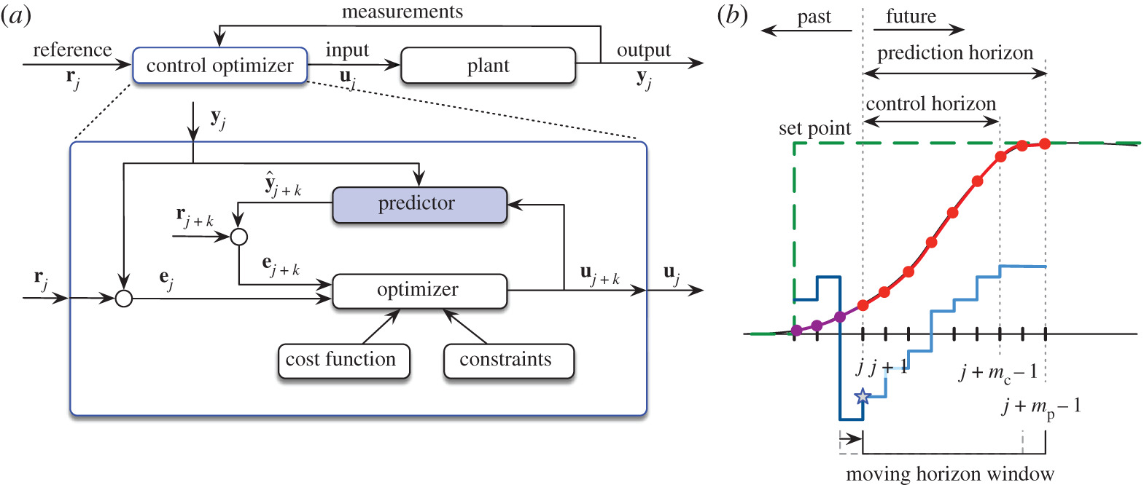
MPC Solutions offered by APGN
Ammonia Controller Module
MPC Ten-step iterations to set point to achieve Low DO (Sub-oxic) Ammonia control
Self-calibrating
in real time time-series model (s)
Air Flow
Notes:
A different model predictive control algorithm is used for DO control. At each iteration the computer updates the model based on comparison between predicted DO and measured DO and then calculates new airflow trajectory. The difference between MPC and PID is that MPC is non linear control vs. PID that is linear. Also MPC, unlike PID, does not try for DO to reach the set point within one iteration. Therefore it is a better algorithm to deal with delays. An ammonia control uses a combination of heuristic MPC with mechanistic feed-forward control. Now let me now move to, the results

Slide 53
MPC Solutions offered by APGN
SRT (Sludge Retention Time) Control Module
Refresher:
$$\text{Aerobic} \text{SRT}=\frac{\text{Total} \text{Solids} \text{Under} \text{Aeration}}{\text{Total} \text{Solids} \text{Wasted}}=\frac{\text{Total} \text{Solids} \text{in} \text{Aerobic} \text{Volume}}{\text{WAS}}$$
Aeration Basin
MLR
Influent
Effluent
RAS
Secondary Clarifier
Anoxic Zone
Aerobic Zone
WAS

Slide 54
MPC Solutions offered by APGN
Simplified Description
Feed-Forward MPC DO, N Control with built-in process treatment safegaurds
Inputs
Data Filtration
Control
Safeguard
Actuation
Mechanistic model check
and
Advanced predictive control
Flow is within the specified range
Flow set point to DCS
pattern recognition check

Slide 55
Case Study
MPC - DO/N master in Operation since in 2018
Improved Ammonia and DO Control Precisions Allowed us to Reduce DO

Slide 56
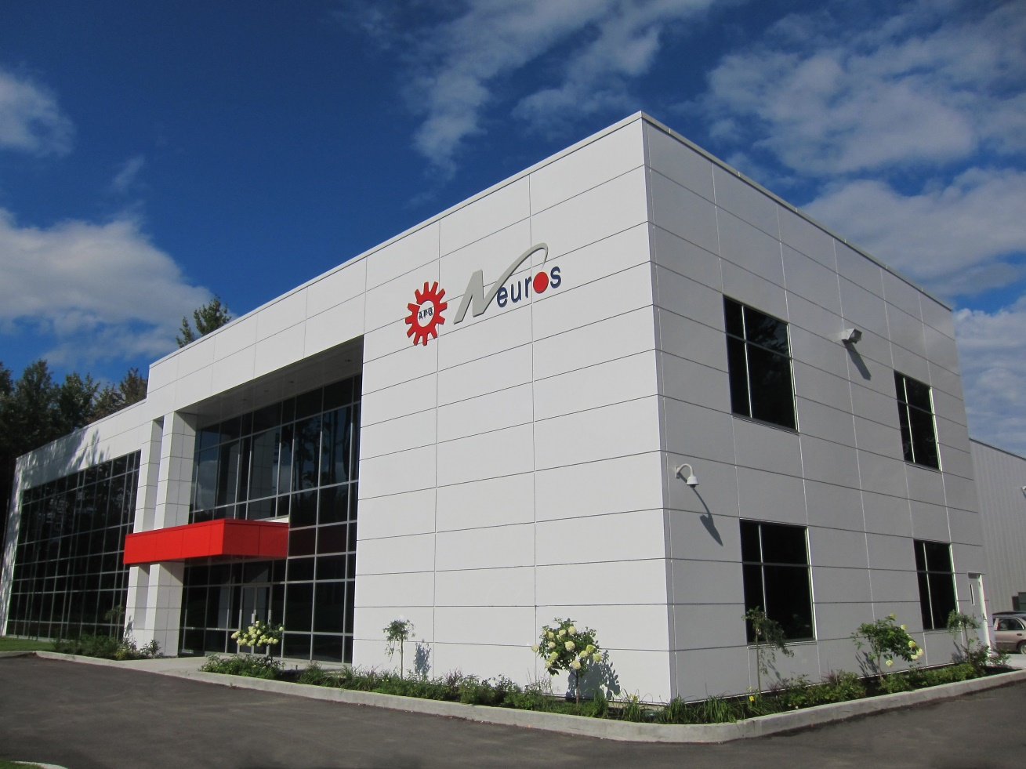
Thank you for your time
APG-Neuros thanks you for your time and attention
Please visit our website: www.apg-neuros.com , or
Contact us at communications@apg-neuros.com for any inquiries

Slide 57
Q&A
Q&A

Slide 58
Aeration Blower Control Strategies
Q&A
Please submit any questions through the Question Window on your GoToWebinar interface, directing them to Blower & Vacuum Best Practices Magazine. Our panelists will do their best to address your questions and will follow up with you on anything that goes unanswered during this session.
Thank you for attending!
Sponsored by

Slide 59
Thank you for attending!
The recording and slides of this webinar will be made available to attendees via email later today.
PDH Certificates will be e-mailed to Attendees by Monday.

Slide 60
August 2021 Webinar Air Compressor & Dryer Sizing for High Ambient Temperatures
Sponsored by
Paul Baker
Jacobs
Keynote Speaker
Thursday, August 12, 2021 – 2:00 PM EST
Register for free at
www.airbestpractices.com/magazine/webinars

