Slide 1
How to Correctly Apply & Size Oil-Free Vacuum Pumps
Andy Smiltneek, Growth Solutions Consultants
Keynote Speaker
The recording and slides of this webinar will be made available to attendees via email later today.
PDH Certificates will be e-mailed to attendees within 2 days.

Slide 2
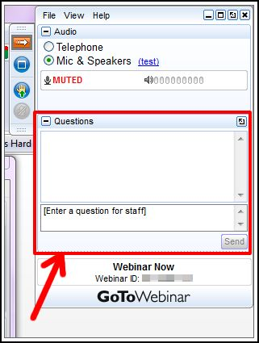
Q&A Format
Panelists will answer your questions during the Q&A session at the end of the Webinar.
Please post your questions in the Questions Window in your GoToWebinar interface.
Direct all questions to Blower & Vacuum Best Practices® Magazine

Slide 3
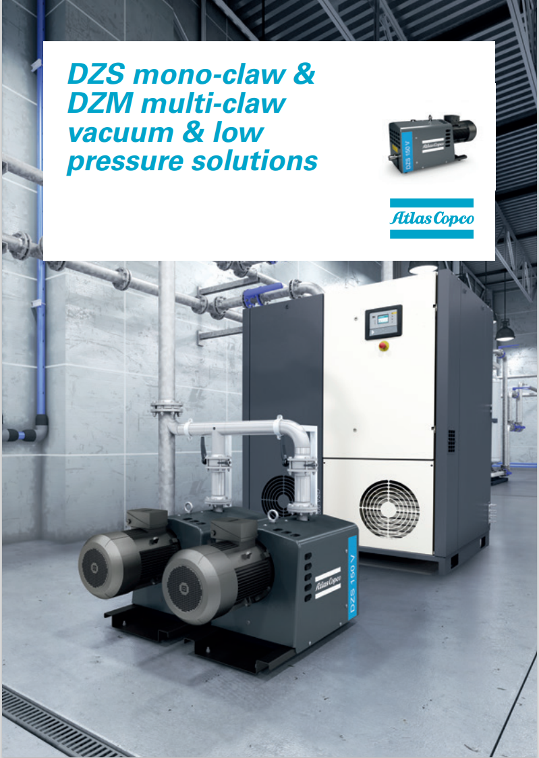
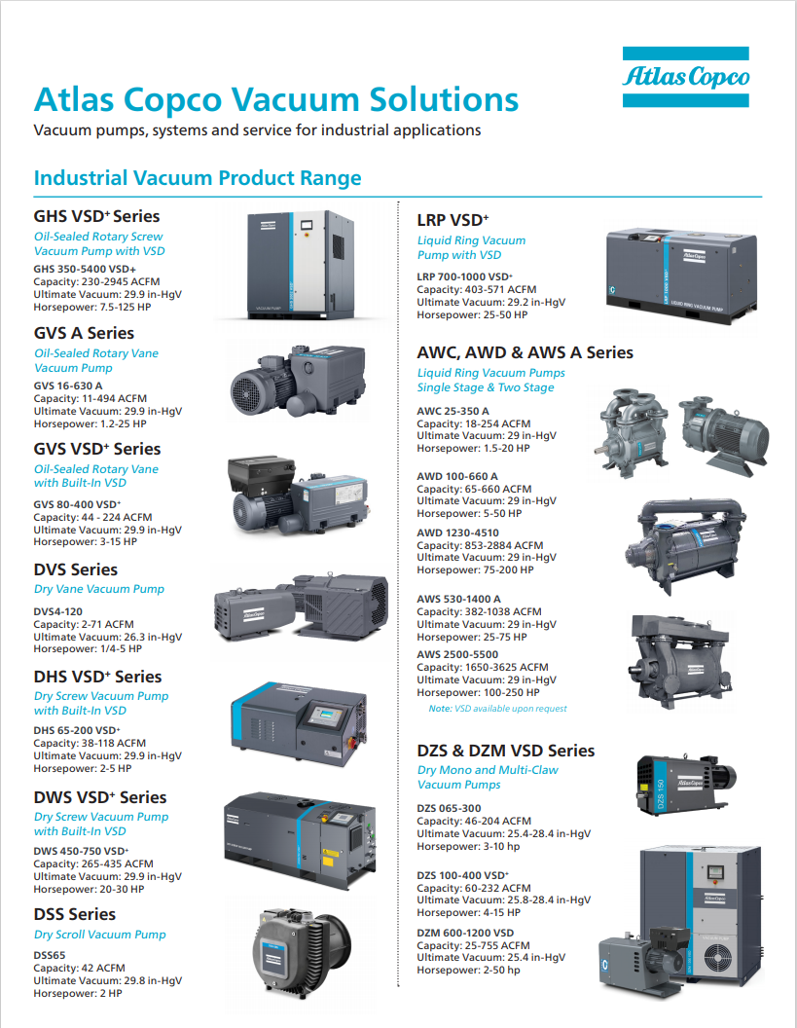
Handouts

Slide 4
Disclaimer
All rights are reserved. The contents of this publication may not be reproduced in whole or in part without consent of Smith Onandia Communications LLC. Smith Onandia Communications LLC does not assume and hereby disclaims any liability to any person for any loss or damage caused by errors or omissions in the material contained herein, regardless of whether such errors result from negligence, accident, or any other cause whatsoever.
All materials presented are educational. Each system is unique and must be evaluated on its own merits.

Slide 6
How to Correctly Apply & Size Oil-Free Vacuum Pumps
Introduction
Blower & Vacuum Best Practices Magazine

Slide 7
About the Speaker
President, Growth Solutions Consultants
Spent 30 Years at Kimberly-Clark
Prior Director of Tissue Machine Design with Asia Pulp and Paper in China
Prior Technical Director at Somarakis
Andy Smiltneek
Growth Solutions Consultants

Slide 8
The Coming Conflagration
The Andromeda galaxy is going to collide with the Milky Way. This may be problematic for us.
Most unfortunately, this will not happen for about 4.5 billion years, so you cannot use it an excuse for not managing your vacuum system.
The time of collision can be calculated, just like many of the aspects of your vacuum system
So take a deep breath

Slide 9
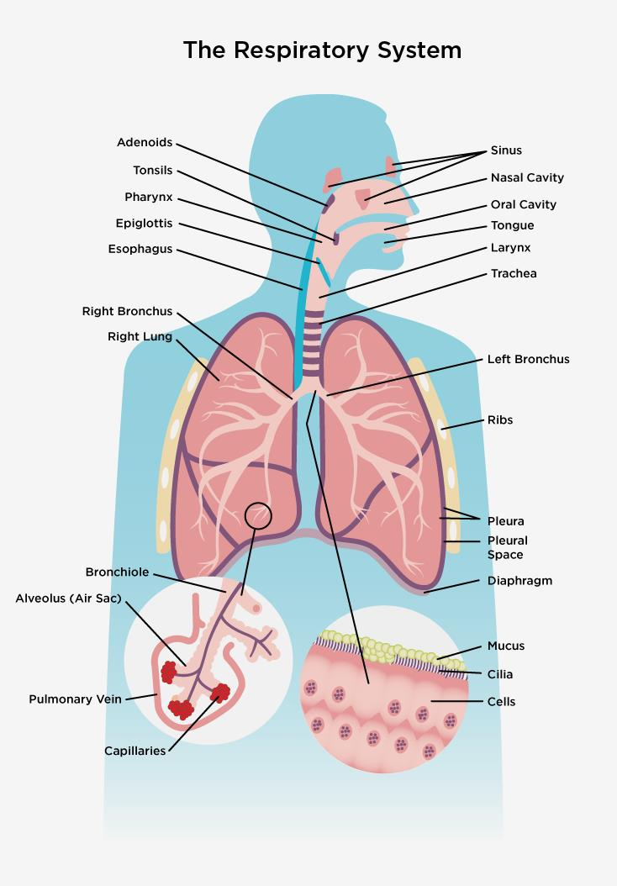
Taking a deep breath
Usually is calming
The diaphragm retreats and the chest cavity expands creating lower pressure in the lungs causing air to flow in permitting the exchange of oxygen and carbon dioxide in the blood, keeping your brain alive so you can think about your vacuum system.
An oil free vacuum pump works like the lungs.
The vacuum system works like the respiratory system.

Slide 10
Vacuum and Vacuum Pump Definition
Any pressure lower than the local atmospheric pressure is called a vacuum.
A machine capable of evacuating some of the gas from an enclosure so the enclosure is at a lower pressure than local atmospheric is called a vacuum pump.
The vacuum pump takes gas at a low pressure and delivers it to a higher pressure
By definition, the vacuum pump is a compressor.

Slide 11
The Oil Free Vacuum Pump
The Oil Free vacuum pump is a compressor that does not have oil on the sealing surfaces within the pump to prevent contamination of the gas being compressed.
Examples of oil free pumps include liquid ring, diaphragm, screw, vane and others. Most of these compressors are constant volume, although the fans and turbo blowers are constant pressure
Thermodynamically the constant volume compressors are all the same, but different than the constant pressure compressors which are all the same

Slide 12
Thermodynamics of Compression
Gentlemen,
This is the bible….I wrote it…… and I taught your fathers and I taught your grandfathers and you will do the same thing they did to get any kind of grade in this class.
Edward F. Obert
W_{rev of isothermal} =mRT ln(p₁/p₂)
W_{rev of polytropic} =m[(nRT₁/(1-n)]*[(p₂/p₁)^{(n-1)/n}-1)]

Slide 13
Equation
The power consumed goes up with the mass
The power consumed goes up with the inlet temperature
The power consumed goes up as “n” increases
Typical n=1.1 for a liquid ring pump (close to isothermal)
Typical n= 2.3 for the best turbo blower
The power consumed to compress one pound of air from 5”HgA (25”Hg vacuum) to 30“HgA is the same as compressing for 15 psia to 90 psia (104.7 psig)

Slide 14
The Pump Curve, what you should know
The pump curve supplied by the pump manufacturer is the performance of a representative pump at standard conditions
The standard conditions are usually 29.92 “Hg atmospheric pressure and 60° F with air at 50% relative humidity of the gas
The volumetric capacity of the pump and the power used versus the vacuum level is given
The volumetric capacity is at the inlet pressure
To size a pump your conditions must be known and the pump performance translated to those conditions

Slide 15
Representative Pump Curve
At 277 RPM you have 9100 CFM at 15”Hg costing you 280 HP at the pump shaft

Slide 16
Controlling the vacuum level
Since the pump is constant volume, it will evacuate a space until the leakage equals the pump capacity.
If this is too much vacuum, you can either open a valve and bleed in air, or you can slow the pump down.
The volume is proportional to the RPM.
The power is proportional to the RPM to some power. For liquid ring pumps it is the 1.7 power.
I am a fan of the variable speed drive for the vacuum pump to control vacuum, it saves a lot of energy and gives you flexibility in design.

Slide 17
Translations
Atmospheric Conditions (elevation)
Inlet Gas Temperature
Inlet Humidity
Gas Molecular weight
Condensables
Pressure at pump outlet

Slide 18
Elevation Example
Vacuum pump needed to handle 160 CFM air at 60°F and 14”Hg at 9000 feet above sea level?
The atmospheric pressure at 9000 ft is 21.4”HgA
The absolute pressure at 14”Hg is 21.4-14=7.4”HgA
The pressure ratio is 21.4/7.4=2.89
The reference vacuum at sea level is 29.92/2.89=10.34”HgA
10.34”HgA =29.92-10.34=19.57”Hg vacuum
The vacuum pump on the pump curve needed is 160CFM at 19.57 “ Hg
The power will be lower because the mass moved is less

Slide 19
Evacuation Example
Suppose you want to evacuate 20 million cubic feet of air at sea level 60°F and 50% relative humidity in one day to 24”Hg vacuum – someone actually wanted to evacuate a salt dome!
Consultants use factors to determine that you need to evacuate 32 million cubic feet, which over one day (1440 minutes) would be 22000 CFM
Unfortunately, the customer could not tell me the leakage rate and balked at the $500,000 approximate price for the 1000HP vacuum pump needed for this application
At 24”Hg, six 2” diameter holes will leak 22000 CFM, so you would need two vacuum pumps and $1,000,000

Slide 20
Condensables
The evaporation of water is dependent upon the temperature of the water and the pressure of the gas mixture.
The water will exist in liquid and vapor phases with a paired relationship at saturation between the temperature and pressure
Any condensable will behave similarily

Slide 21
Condensation Factor – 100% Humidity
Temp (°F) | Saturation Pressure ("Hg) | Vacuum Level ("Hg) | Absolute Pressure ("Hg) | % Water Vapor of Gas Mixture
212 | 30 | 0 | 30 | 100%
140 | 5.88 | 24.1 | 5.9 | 99.66%
100 | 1.926 | 20 | 10 | 19.26%
60 | .52 | 20 | 10 | 5.22%
90 | 1.417 | 20 | 10 | 14.17%
110 | 2.589 | 20 | 10 | 25.89%
Gain 14%
Air In
Air at Seal Water Temp
Lose 11%
Air In
Air at Seal Water Temp

Slide 22
Tissue Machine (8) Pump System- 8000 HP!

Slide 23
Typical Analysis - Paper Machine
Condensation Effect Calculator
 | Header | Header Vacuum | Vacuum Needed at Application ("Hg) | Volume Needed at Application (CFM) | Vacuum loss through piping | Inlet Vacuum | Condensing Multiplier | Volume Needed by Vacuum Pump
1st medium vacuum box | Header 1 | 14.70 | 3.2 | 346.5 | 0.2 | 14.90 | 1.03 | 668
2nd medium vacuum box | Header 1 | 14.70 | 4.5 | 346.5 | 0.2 | 14.90 | 1.03 | 637
Twin Vac 1 | Header 1 | 14.70 | 5.7 | 346.5 | 0.2 | 14.90 | 1.03 | 606
Twin Vac 2 | Header 1 | 14.70 | 5.3 | 346.5 | 0.2 | 14.90 | 1.03 | 615
2nd hi vac -1 | Header 1 | 14.70 | 8.1 | 346.5 | 0.2 | 14.90 | 1.03 | 546
2nd hi vac 2 | Header 1 | 14.70 | 9.5 | 346.5 | 0.2 | 14.90 | 1.03 | 511
third hi vac1 | Header 1 | 14.70 | 11.0 | 346.5 | 0.2 | 14.90 | 1.03 | 473
third hi vac 2 | Header 1 | 14.70 | 12.0 | 346.5 | 0.2 | 14.90 | 1.01 | 439
third hi vac 3 | Header 1 | 14.70 | 13.6 | 288.75 | 0.2 | 14.90 | 1.01 | 331
pickup roll low | Header 2 | 18.00 | 6.5 | 495 | 0.2 | 18.20 | 0.97 | 993
pickup roll high | Header 2 | 18.00 | 15.1 | 3850 | 0.2 | 18.20 | 1.00 | 5012
Couch | Header 3 | 18.40 | 17.7 | 8415 | 0.2 | 18.60 | 1.01 | 9421
Upper uhle #1 | Header 4 | 12.59 | 12.3 | 1980 | 0.2 | 12.79 | 0.98 | 1973
Upper Uhle #2 | Header 5 | 10.30 | 8.8 | 1980 | 0.2 | 10.50 | 0.87 | 1887
Lower Uhle #1 | Header 6 | 17.60 | 14.5 | 1980 | 0.2 | 17.80 | 0.87 | 2249
Lower Uhle #2 | Header 7 | 19.00 | 18.7 | 1980 | 0 | 19.00 | 0.87 | 1728

Slide 24
Possible Scenarios

Slide 25
Orifice Plate

Slide 26
Field Test Report Example
Liquid Ring Vacuum Pump Field Test
Tested By: |  |  | Andy Smiltneek
Date: |  |  | Thursday, March 7, 2019
Witnessed:
Certified: |  |  | Andy Smiltneek
Customer :
Customer Location: |  |  | Nekoosa |  |  |  |  |  |  | Dedicated to making you better than you think possible
Pump Number: |  |  | 1 | Pump Manufacturer/Model: |  |  | Nash L4408A |  |  | www.growthsolutionsconsultants.com
Barometric Pressure |  |  | 30.45 |  |  |  |  |  |  | andys@growthsolutionsconsultants
Air Temperature |  |  | 72 |  |  |  |  |  |  | 920 470 9432
Test Point | RPM | Idle End Vacuum ("Hg) | Drive End Vacuum ("Hg) | Orifice Size | Holes Open | Seal Water Temp | Corrected Idle End Vacuum ("Hg) | Corrected Drive End Vacuum ("Hg) | Corrected Idle End Capacity (CFM) | Corrected Drive End Capacity (CFM) | Total Corrected Capacity (CFM) | Average Corrected Vacuum ("Hg) | New Pump Capacity (CFM)
1 | 246 | 9.9 | 9.9 | 1.25 | 6 | 42 | 9.7 | 9.7 | 1927 | 1878 | 3804 | 9.7 | 4200
2 | 246 | 12.5 | 12.5 | 1.25 | 5 | 42 | 12.3 | 12.3 | 2018 | 1960 | 3978 | 12.3 | 4100
3 | 246 | 14.8 | 14.8 | 1.25 | 4 | 42 | 14.5 | 14.5 | 1897 | 1897 | 3793 | 14.5 | 4000
4 | 246 | 17.5 | 17.5 | 1.25 | 3 | 42 | 17.2 | 17.2 | 1754 | 1754 | 3508 | 17.2 | 3750
5 | 246 | 20.4 | 20.4 | 1.25 | 2 | 42 | 20.0 | 20.0 | 1557 | 1557 | 3113 | 20.0 | 3400
6 | 246 | 22.4 | 22.4 | 1.25 | 1 | 42 | 22.0 | 22.0 | 976 | 976 | 1952 | 22.0 | 2400
7 | 246 | 22.9 | 22.9 | 1.25 | 0.5 | 42 | 22.5 | 22.5 | 523 | 523 | 1047 | 22.5
Note:
This pump was tested aby isolating the manifold from the system and placing an orifice plate on the end of the manifold. This is thus a test of both sides of the pump and the result assumes that the sides contribute equally to the result. This approach was used as removing the manifolds from the top of the pump would take too much time.

Slide 27
Field Test Report Example

Slide 28
Piping Guidelines
Air velocity of 3000 fpm with entrained water
Air velocity of 6000 fpm with dry gas.
Friction loss is practically independent of pressure.
You may need additional equipment before and after the pump depending upon the process. In the paper industry an inlet water separator is used and a discharge separator to remove water from the exhaust stream is also used.

Slide 29
What’s Up With Andromeda?
If you measure, you can predict
If you predict, you can test your prediction
If you fall back to basic scientific principles, you can understand
If you understand, you can improve
It is convenient to have someone doing the measuring who has seen the problem before

Slide 30
Questions and Critique
And Thanks for your time
For more information, follow my blog at the growthsolutionsconsultants.com website, much of this information is explained in more depth
Contact me at:
andys@growthsolutionsconsultants.com
920 470 9432

Slide 31
About the Speaker
Products & Applications Manager, Atlas Copco Vacuum
Mechanical engineer specialized in materials and fluid mechanics
18 years of vacuum experience with roles in applications, engineering, design, sales, operation and project management
Rough, medium, HV and UHV experience
Antonio Mantilla
Atlas Copco Vacuum

Slide 32
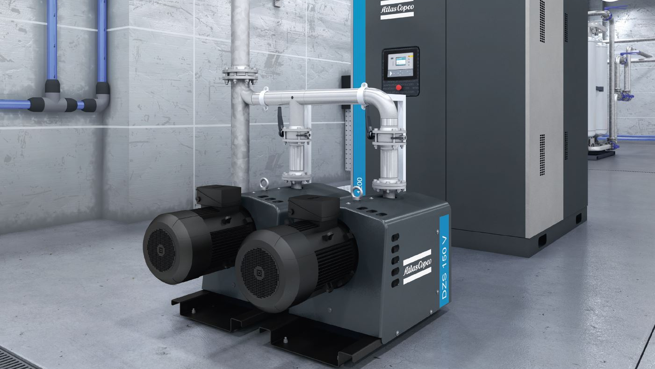
DRY CLAW VACUUM PUMPS IN HUMID APPLICATIONS
Antonio Mantilla
April 2021

Slide 33
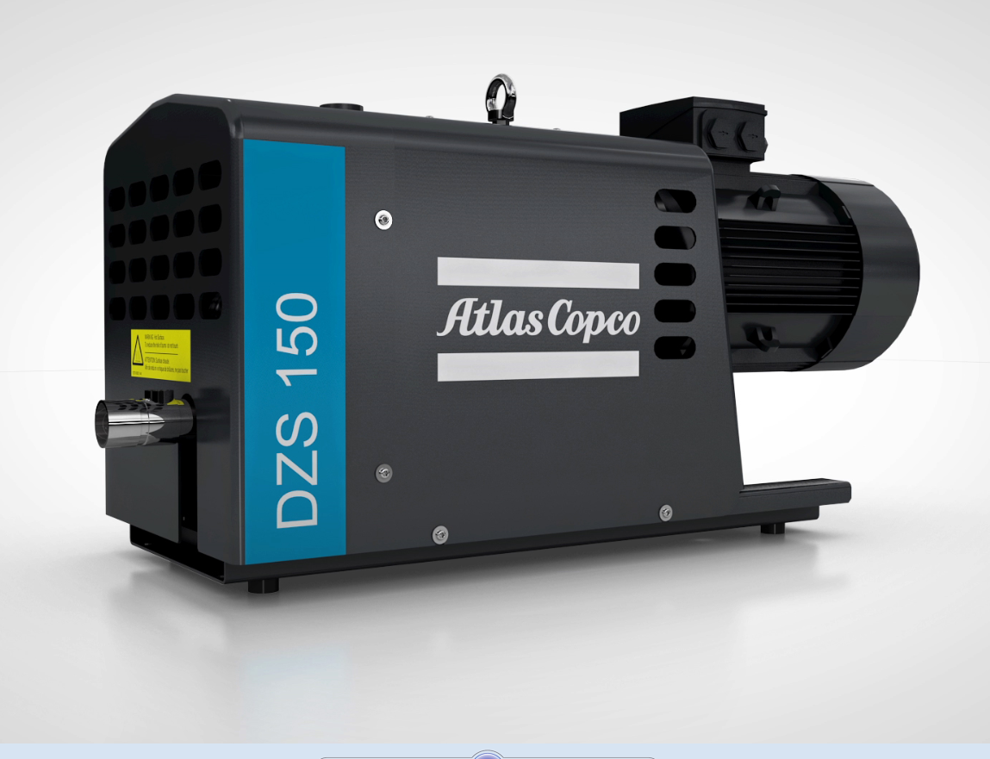
Dry Claw Principle
Simple Design
Process Inlet
Non-contacting parts , rotors synchronized with helical gears.
No lubrication/ sealing fluids in the pumping chamber.
Coated internals vary with the manufacturer.
labyrinth shaft seals provides extended lifespan but no real gas tight features.
Compatible with flushing to “wash “ out contamination/ deposits.
Cantilever design allows for internal cleaning without re-timing
Simple design with dry & contact free pumping element
Process Outlet

Slide 34
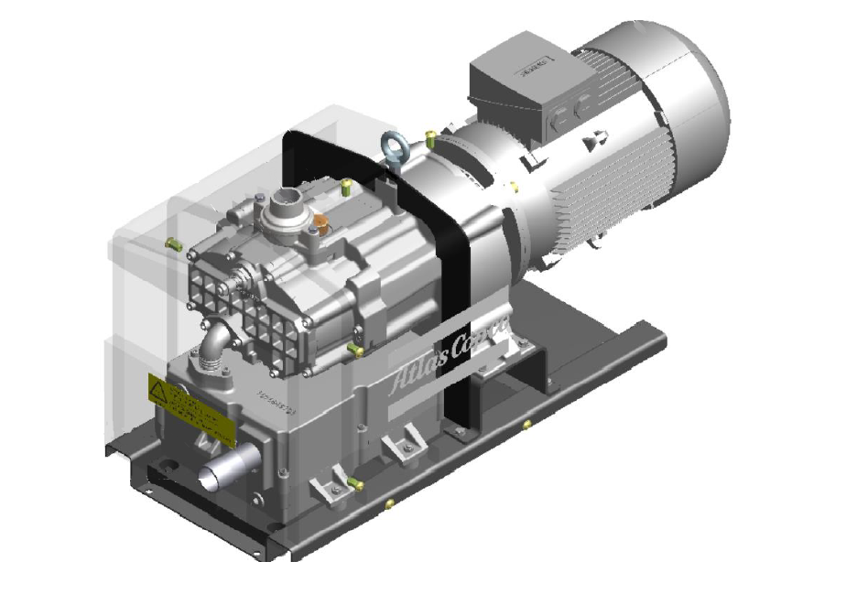
Dry Claw Layout
Dry pumping chamber ( no oil to contaminate)
Integrated Sound enclosure and muffler
Self contained.
Inverter duty, 20Hz min speed
Inlet pressure in the 30-150Torr range depending on the size.
Oil lubricated gear box separated from the process chamber. Small amounts of oil.
Ability to handle high vapor loads given operating temperatures
No wear components apart from bearings, virtually maintenance free.

Slide 35
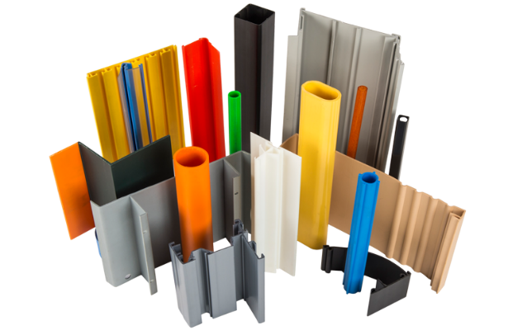
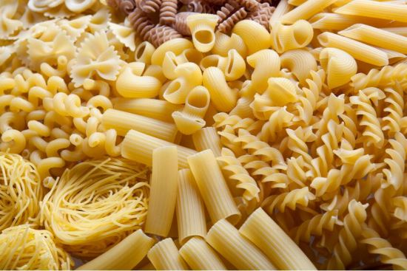
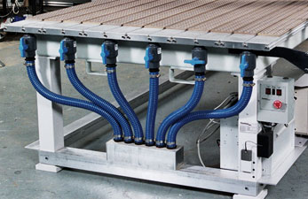
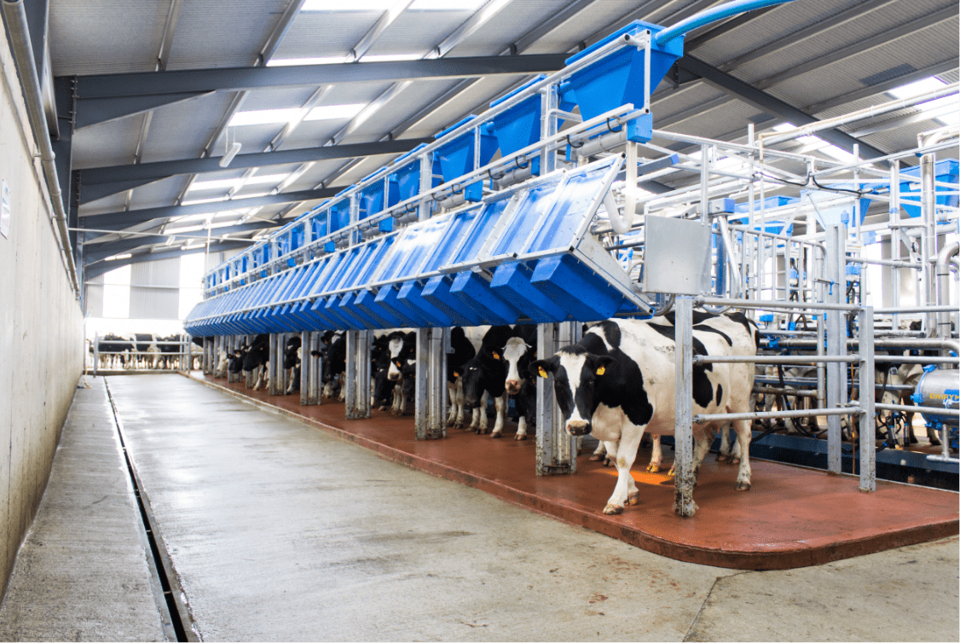
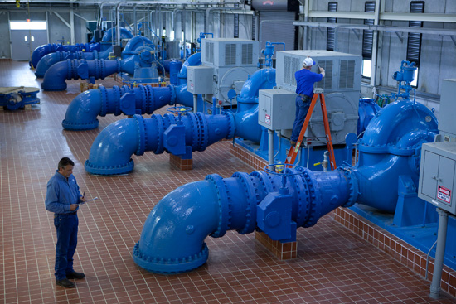
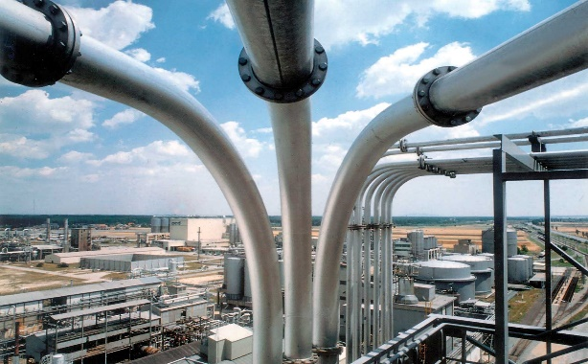
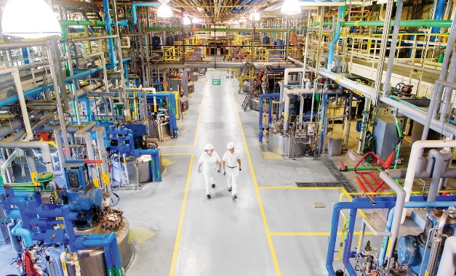
Typical Applications
Dry Claw pumps are used in a diverse range of markets including Chemical, Environmental, Food & Packaging, Health, R&D / Lab, Aerospace…
Applications withing these markets sometimes involve pumping vapors. A few examples are:
-Degassing & Calibration
-Milking
-Pump priming
-Laboratory & Medical Central Vacuum Systems
-Vacuum Holding
-Vacuum Filtration
-Conveying
-Remediation
… and many other

Slide 36
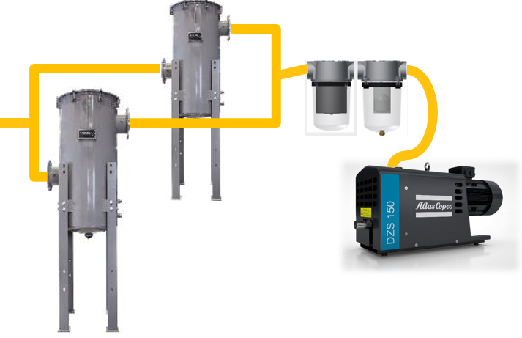
Why is it important?
Humid applications will require a few considerations to ensure the systems lives a healthy life.
104F, 760 Torr = 48lb/h air 2lb/hr vapor , 5lb/hr water !!!
Filtration
Process
100 ACFM Saturated air @ 70F , 100 Torr = 48lb/hr air + 7lb/hr vapor
240F, 760 Torr = 48lb/h air and 7lb/hr vapor

Slide 37
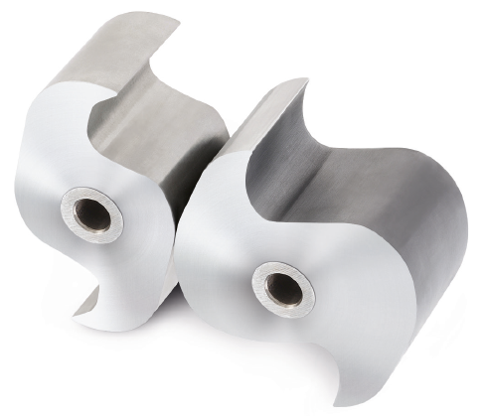
Recommendations
Use the correct materials, Stainless Claws and MoS2 + PTFE Internal coating
Use appropriate filtration to remove liquids and solids form the stream.
104F, 760 Torr = 48lb/h air 2lb/hr vapor , 5lb/hr water !!!
Use Purge in between cycles to prevent sitting liquids inside
Process
Watch for backpressure
100 ACFM Saturated air @ 70F , 100 Torr = 48lb/hr air + 7lb/hr vapor
240F, 760 Torr = 48lb/h air and 7lb/hr vapor
Drain the silencer and install a drip leg
Operate the pump hot and at the highest pressure the process allows.

Slide 38
How to Correctly Apply & Size Oil-Free Vacuum Pumps
Q&A
Please submit any questions through the Question Window on your GoToWebinar interface, directing them to Blower & Vacuum Best Practices Magazine. Our panelists will do their best to address your questions and will follow up with you on anything that goes unanswered during this session.
Thank you for attending!

Slide 39
Thank you for attending!
The recording and slides of this webinar will be made available to attendees via email later today.
PDH Certificates will be e-mailed to Attendees within 2 days

Slide 40
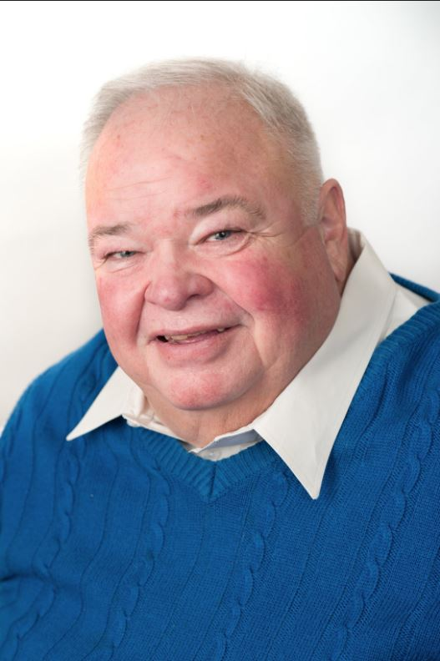
May Webinar
Understanding and Calculating Air Compressor Specific Power
Sponsored by
Loran Circle
Circle Training & Consulting
Keynote Speaker
Thursday, May 13, 2021 – 2:00 PM EST
Register for free at
www.airbestpractices.com/magazine/webinars

