Slide 1
How to Design a Centralized Vacuum System
Tim Dugan, PE., Compression Engineering Corporation
Keynote Speaker
The recording and slides of this webinar will be made available to attendees via email later today.
PDH Certificates will be e-mailed to attendees early next week.

Slide 2
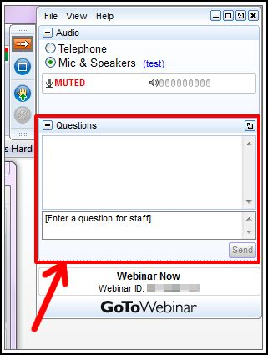
Q&A Format
Panelists will answer your questions during the Q&A session at the end of the Webinar.
Please post your questions in the Questions Window in your GoToWebinar interface.
Direct all questions to Blower & Vacuum Best Practices® Magazine

Slide 3
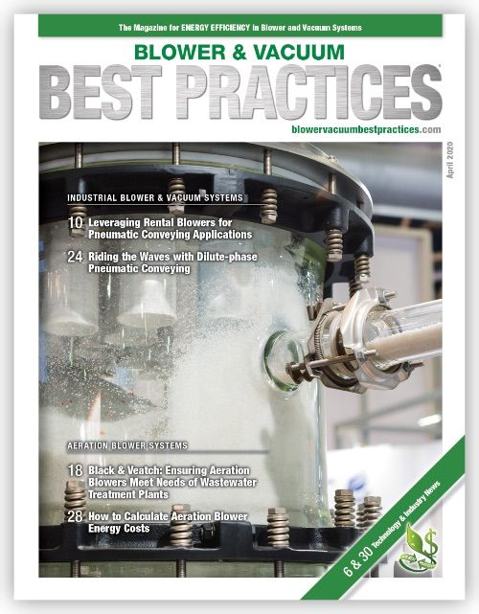
Handouts

Slide 4
Disclaimer
All rights are reserved. The contents of this publication may not be reproduced in whole or in part without consent of Smith Onandia Communications LLC. Smith Onandia Communications LLC does not assume and hereby disclaims any liability to any person for any loss or damage caused by errors or omissions in the material contained herein, regardless of whether such errors result from negligence, accident, or any other cause whatsoever.
All materials presented are educational. Each system is unique and must be evaluated on its own merits.

Slide 6
How to Design a Centralized Vacuum System
Introduction
Blower & Vacuum Best Practices Magazine

Slide 7
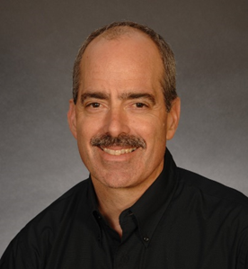
About the Speaker
•President and Principal Engineer, Compression Engineering Corporation
•Over 25 years of experience in the industry
Tim Dugan, P.E.
Compression Engineering Corporation

Slide 8
How to Design a Centralized Vacuum System
4/23/2020
Tim Dugan, P.E.
Compression Engineering Corporation

Slide 9
Outline
Introduction
Determine Consolidated System Vacuum Level
Estimate Demand Without Detailed Audit
Perform Detailed Audit Process for Variable Demands
Size Piping Header
Size receiver
Design Controls

Slide 10
Introduction
Speaker background
Scope of vacuum system addressed in the webinar:
Rough vacuum
Air only – no other gases

Slide 11
Determine Consolidated System Vacuum Level
Start at the processes, and work your way back
For pressure-critical process, determine needed VACUUM and calculate the FLOW
For flow-critical process, determine the FLOW necessary and calculate the VACUUM
Vacuum is proportional to flow at less than 15”Hg.
Ideally, measure with a flow meter and vacuum gauge.
Some low-cost thermal mass flow meters can work.
This can be done analytically with a detailed audit.

Slide 12
Determine Consolidated System Vacuum Level
Build a table:
23”Hg is the required common vacuum level AT THE PROCESS.

Slide 13
Determine Consolidated System Vacuum Level
What level at the VACUUM PUMP(s)?
Two allowances need to be added:
Pipe restriction allowance - use 1.0”Hg.
Control band allowance – start with +/- 1”Hg for VFD, +/- 2”Hg for start-stop.
For this example, let’s use start-stop. So now, we have an average level of 23+1+2 = 26”Hg for the pump inlets.

Slide 14
Estimate Demand Without Detailed Audit
First, calculate new total mass flow, or scfm.
Vacuum influences mass flow, and vice-versa.
For the demands that are less than 15”Hg, increasing vacuum to 25”Hg will not increase mass flow
For the demands that are less than 15”Hg, they will increase, up to 15”Hg, by the square root:
New demand = (15/current vac)^0.5 x mass flow at current vac

Slide 15
Estimate Mass Flow
Adjusted mass flow and summed mass flow:
But vacuum pumps are rated in “icfm” (or “acfm”), volume flow at intake, so you can’t size pumps yet!

Slide 16
Estimate Peak Demand at Required Vacuum Level
Calculate icfm from scfm and vacuum:
icfm = scfm x Pamb / (Pamb – Vac) – neglecting temperature effect
Note that Process D dominates the flow requirement.
These are PEAK flows.

Slide 17
Perform Detailed Audit Process for Variable Demands
For Each Process, Measure Vacuum (Pin).
At Each Vacuum Pump, Measure Pin and Power. Data-log.
From Pin and Vac Pump Curve, Calculate Volume Flow at Pump Inlet in “icfm” or “m3/hr”, at the vacuum pump inlet.
From Pin and Volume Flow, Calculate Mass flow = (Patm – Pin) / Patm.
Adjust Mass Flows (if Not Choked Flow) at New Vacuum.
Sum Flows to Develop Total Mass Flow Requirement.
Calculate Total Volume Flow Needed From Mass and Pressure (Vacuum) Actually Required.
Plot System Performance Curve.

Slide 18
Audit Process for Variable Demands

Slide 19
Audit Process for Variable Demands

Slide 20
Audit Process for Variable Demands

Slide 21
Size Vacuum Pump(s)
Let’s add production utilization numbers before we size pumps.
Some demands are constant and some are not.
In fact, it’s quite “peaky” in this example

Slide 22
Determine Average Demand at That Vacuum Level
To simplify, just calculate WEIGHTED AVERAGE FLOW.
This is more accurately done in an audit.

Slide 23
Size Vacuum Pump(s)
Huge variance - 56 icfm base to 382 icfm 5-10% of the time.
One VFD would not cover the range, and no backup.
Multiple smaller fixed-speed vacuum pumps recommended.
Add safety margin to the total peak flow, 450 icfm.
Use “N+1” design with a good split for following the demand.
A four-plex 150 icfm/ea set is recommended.
A duplex is oversized and inefficient at low demand.
Two VFDs are an alternative, but in reality you would need three to have a back-up.

Slide 24
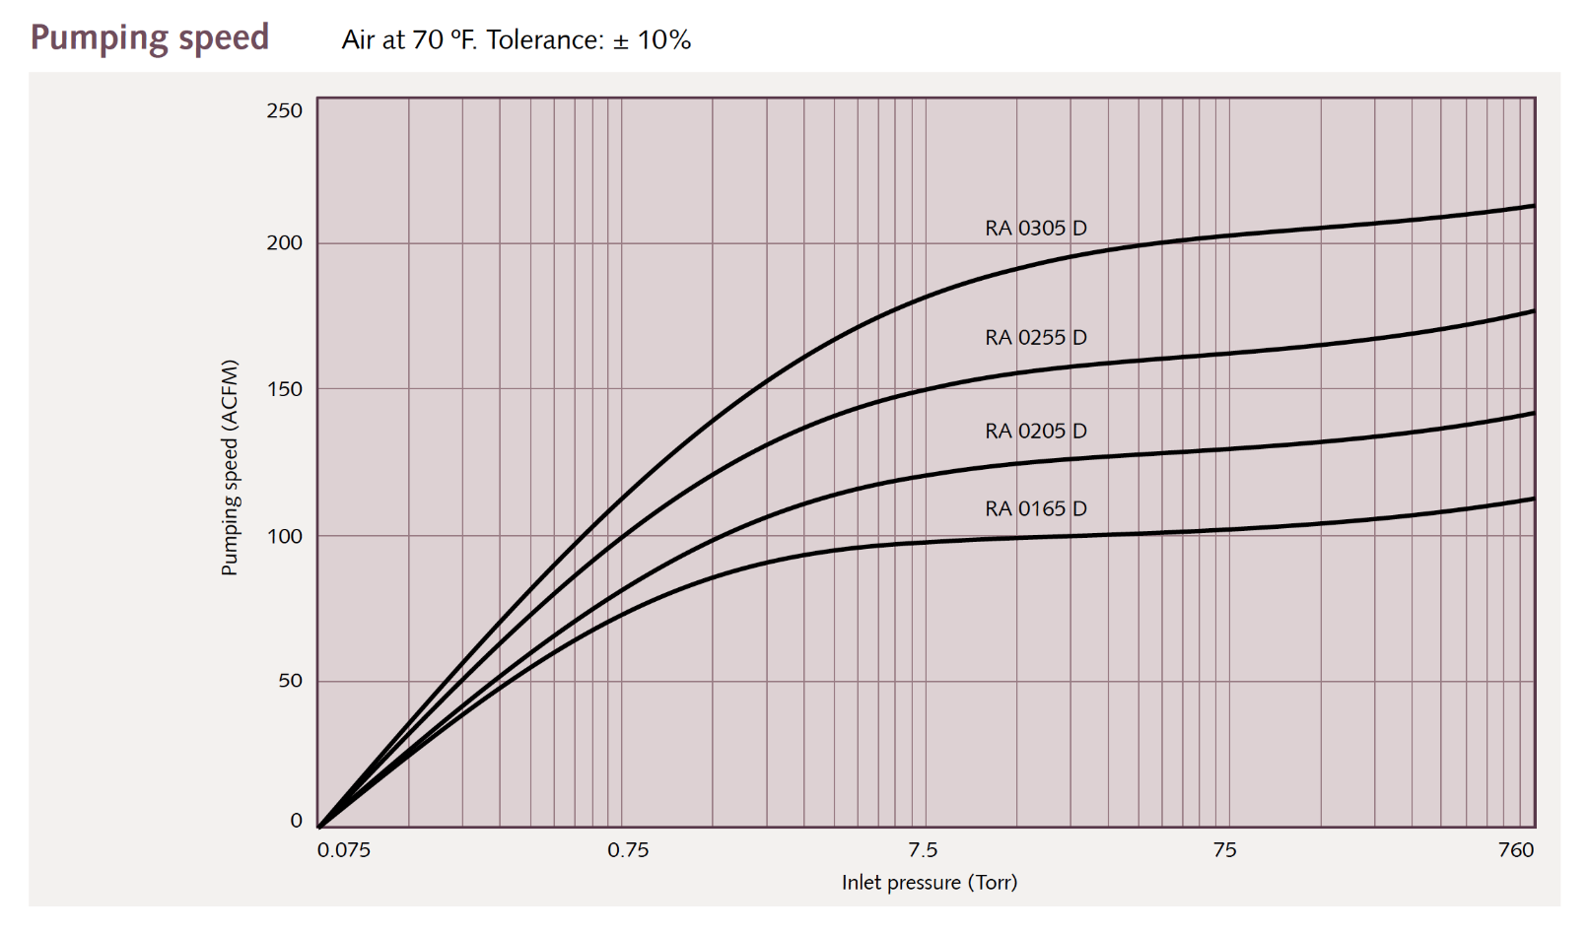
Size Vacuum Pump(s)
A common vacuum pump for this size is a lubricated vane type.
One suppliers’ curve set is below:
150 acfm
26”Hg = 100 Torr

Slide 25
Size Piping
Recall our piping pressure drop “allowance” is 1.0”Hg.
Use a pressure drop calculation tool like https://www.checalc.com/fluid_flow_fitting_losses.html

Slide 26
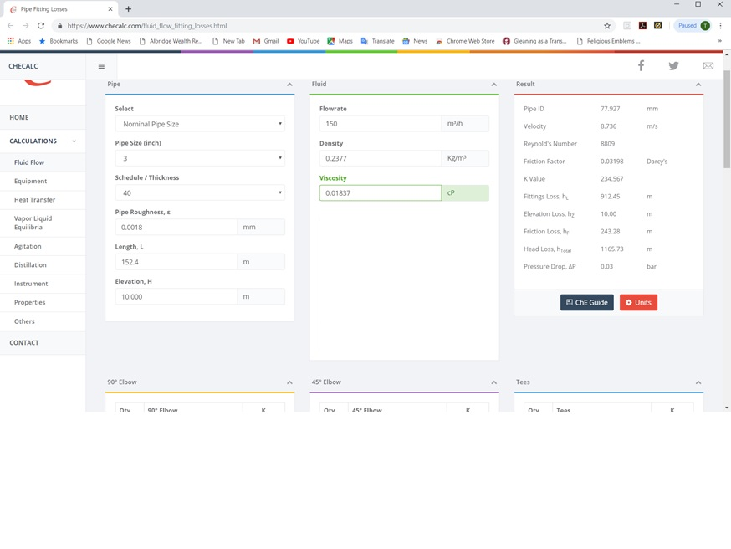
Size Piping

Slide 27
Size Receiver
For energy efficiency, master controls need to work.
Pumps have to start and stop to follow demand.
Which requires STORAGE
This vacuum pump is a 10hp. Start-stop frequency is the issue we are trying to manage with receiver sizing. 10 starts/hr is OK for this hp.
We calculated that a 2,000 gal tank is needed with a +/-2”Hg control band.
Small tanks end up with wide delta Ps and constant-running pumps.

Slide 28
Size Receiver

Slide 29
Design Controls
With a 4-plex, you must have a master controller.
I recommend a “target” algorithm if it is available.
The “trim” vacuum pump should run at the target +/- half of the control band.
“Cascade” not preferred – too wide of delta P.
The “base” pumps run at 100%.
Tune for actual demand changes, not just steady-state.

Slide 30
Summary
Determine Consolidated System Vacuum Level
Determine Demand at That Vacuum Level
Perform Audit if Variable Demand
Size Vacuum Pump(s)
Size Piping Header
Size receiver
Design Controls

Slide 31
How to Design a Centralized Vacuum System
Q&A
Please submit any questions through the Question Window on your GoToWebinar interface, directing them to Blower & Vacuum Best Practices Magazine. Our panelists will do their best to address your questions and will follow up with you on anything that goes unanswered during this session.
Thank you for attending!

Slide 32
Best Practices EXPO Contest
Play for a chance to win a FREE Full Conference Pass to the 2020 Best Practices EXPO & Conference*!! This is a $675 value! This contest is open to factory personnel, compressed air distributors, utility incentive programs and engineering firms. Exhibiting and sponsor companies are not qualified. A winner will be randomly selected from those who submitted at least 1 correct answer and notified tomorrow via email.
The next slide will show a statement related to today’s topic that needs to be filled in. You will be provided the first letter of the words as a clue. Please submit your answers in your questions box.
Example
When I think of a beach vacation, I think of _______.
T_ _ _ _
T_ _ _ B_ _
S_ _ S_ _ _ _ _
*By submitting an answer you are agreeing to give Smith Onandia Communications permission to announce your name, job title and company if you are selected as a winner of the free pass to the 2020 Best Practices Conference & EXPO

Slide 33
Best Practices EXPO Contest
Play for a chance to win a FREE Full Conference Pass to the 2020 Best Practices EXPO & Conference*!! This is a $675 value! This contest is open to factory personnel, compressed air distributors, utility incentive programs and engineering firms. Exhibiting and sponsor companies are not qualified. A winner will be randomly selected from those who submitted at least 1 correct answer and notified tomorrow via email.
The next slide will show a statement related to today’s topic that needs to be filled in. You will be provided the first letter of the words as a clue. Please submit your answers in your questions box.
Example
When I think of a beach vacation, I think of _______.
TOWEL
TIKI BAR
SEA SHELLS
*By submitting an answer you are agreeing to give Smith Onandia Communications permission to announce your name, job title and company if you are selected as a winner of the free pass to the 2020 Best Practices Conference & EXPO

Slide 34
Best Practices EXPO Contest
Play for a chance to win a FREE Full Conference Pass to the 2020 Best Practices EXPO & Conference*!! This is a $675 value! This contest is open to factory personnel, compressed air distributors, utility incentive programs and engineering firms. Exhibiting and sponsor companies are not qualified. A winner will be randomly selected from those who submitted at least 1 correct answer and notified tomorrow via email.
Based on the clues below, please submit your answers in the questions box.
What do you need to size in order to design a centralized vacuum system?
V_ _ _ _ _ P _ _ _ _
P _ _ _ _ _ H _ _ _ _ _
R _ _ _ _ _ _ _
*By submitting an answer you are agreeing to give Smith Onandia Communications permission to announce your name, job title and company if you are selected as a winner of the free pass to the 2020 Best Practices Conference & EXPO

Slide 35
Best Practices EXPO Contest
Play for a chance to win a FREE Full Conference Pass to the 2020 Best Practices EXPO & Conference*!! This is a $675 value! This contest is open to factory personnel, compressed air distributors, utility incentive programs and engineering firms. Exhibiting and sponsor companies are not qualified. A winner will be randomly selected from those who submitted at least 1 correct answer and notified tomorrow via email.
Based on the clues below, please submit your answers in the questions box.
What do you need to size in order to design a centralized vacuum system?
VACUUM PUMPS
PIPING HEADER
RECEIVER
*By submitting an answer you are agreeing to give Smith Onandia Communications permission to announce your name, job title and company if you are selected as a winner of the free pass to the 2020 Best Practices Conference & EXPO

Slide 36
Thank you for attending!
The recording and slides of this webinar will be made available to attendees via email later today.
PDH Certificates will be e-mailed to Attendees early next week.

Slide 37
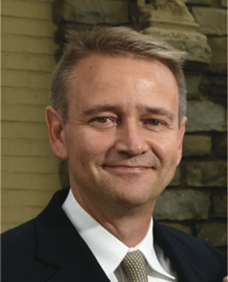
Thursday Webinar
The “Unofficial 3 Levels” of Compressed Air Best Practices® Systems
Rod Smith
Compressed Air Best Practices Magazine® and the Best Practices Expo & Conference
Publisher/Producer
Thursday, May 7, 2020 – 2:00 PM EST
Register for free at
www.airbestpractices.com/magazine/webinars

