Slide 1

How to Design a Centralized Vacuum System
Tim Dugan, P.E., Compression Engineering Corporation
Keynote Speaker
The recording and slides of this webinar will be made available to attendees via email later today.
PDH Certificates will be e-mailed to attendees within two days.
Sponsored by

Slide 2
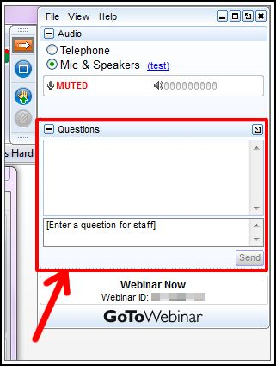
Q&A Format
Panelists will answer your questions during the Q&A session at the end of the Webinar.
Please post your questions in the Questions Window in your GoToWebinar interface.
Direct all questions to Blower & Vacuum Best Practices Magazine
Sponsored by

Slide 3
Handouts

Slide 4
Disclaimer
All rights are reserved. The contents of this publication may not be reproduced in whole or in part without consent of Smith Onandia Communications LLC. Smith Onandia Communications LLC does not assume and hereby disclaims any liability to any person for any loss or damage caused by errors or omissions in the material contained herein, regardless of whether such errors result from negligence, accident, or any other cause whatsoever.
All materials presented are educational. Each system is unique and must be evaluated on its own merits.

Slide 5
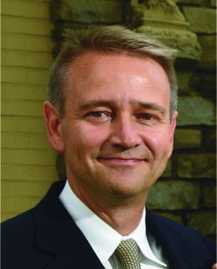
How to Design a Centralized Vacuum System
Introduction by Rod Smith, Publisher
Blower & Vacuum Best Practices Magazine
Sponsored by

Slide 6
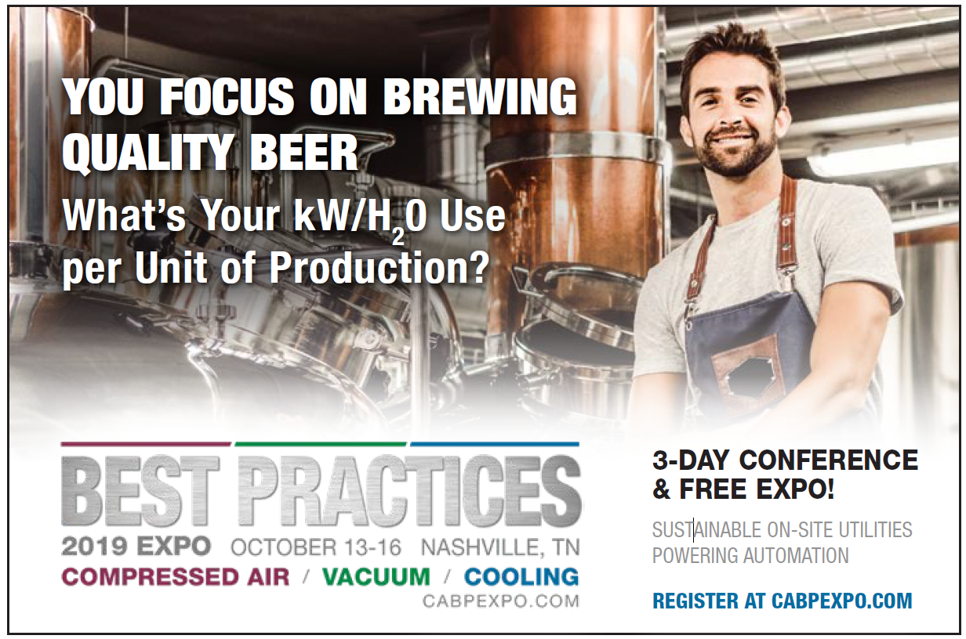
2019 Best Practices EXPO & Conference

Slide 7
2019 Best Practices EXPO & Conference
Call for Abstracts
The conference will focus on sustainable on-site utilities powering automation including compressed air, blower, vacuum and cooling systems. Presentations should encompass one or more of these themes.
Quality & Safety Management
Facility Maintenance & Reliability
Energy Savings / IoT Monitoring
Water Savings / Energy Management
  Abstract submissions are due Friday, March 29, 2019.
  Speakers receive a complimentary Conference Pass, a $675 value!
  To submit an abstract, please visit
  cabpexpo.com/conference/speakers

Slide 8
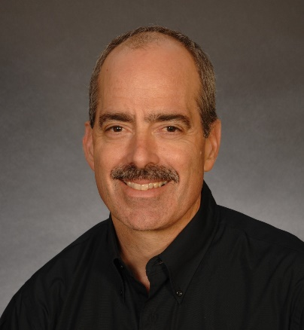
About the Speaker
President and Principal Engineer, Compression Engineering Corporation
Over 25 years of experience in the industry
Tim Dugan, P.E.
Compression Engineering Corporation
Sponsored by

Slide 9
How to Design a Centralized Vacuum System
March 14, 2019
Tim Dugan, P.E.
Compression Engineering Corporation

Slide 10
Outline
Determine Consolidated System Vacuum Level
Determine Demand at That Vacuum Level
Size Vacuum Pump(s)
Size Piping Header
Size receiver
Design Controls

Slide 11
Determine Consolidated System Vacuum Level
Start at the processes, and work your way back
For pressure-critical process, determine needed VACUUM and calculate the FLOW
For flow-critical process, determine the FLOW necessary and calculate the VACUUM
Vacuum is proportional to flow at less than 15”Hg.
Ideally, measure with a flow meter and vacuum gauge.
Some low-cost thermal mass flow meters can work.
This can be done analytically with a detailed audit.

Slide 12
Determine Consolidated System Vacuum Level
Build a table:
23”Hg is the required common vacuum level AT THE PROCESS.

Slide 13
Determine Consolidated System Vacuum Level
What level at the VACUUM PUMP(s)?
Two allowances need to be added:
Pipe restriction allowance - use 1.0”Hg.
Control band allowance – start with +/- 1”Hg for VFD, +/- 2”Hg for start-stop.
For this example, let’s use start-stop. So now, we have an average level of 23+1+2 = 26”Hg for the pump inlets.

Slide 14
Determine Demand at That Vacuum Level
First, calculate new total mass flow, or scfm.
Vacuum influences mass flow, and vice-versa.
For the demands that are less than 15”Hg, increasing vacuum to 25”Hg will not increase mass flow
For the demands that are less than 15”Hg, they will increase, up to 15”Hg, by the square root:
New demand = (15/current vac)^0.5 x mass flow at current vac

Slide 15
Determine Mass Flow at That Vacuum Level
Adjusted mass flow and summed mass flow:
But vacuum pumps are rated in “icfm” (or “acfm”), volume flow at intake, so you can’t size pumps yet!

Slide 16
Determine Peak Demand at That Vacuum Level
Calculate icfm from scfm and vacuum:
icfm = scfm x Pamb / (Pamb – Vac) – neglecting temperature effect
Note that Process D dominates the flow requirement.
These are PEAK flows.

Slide 17
Size Vacuum Pump(s)
Let’s add production utilization numbers before we size pumps.
Some demands are constant and some are not.
In fact, it’s quite “peaky” in this example

Slide 18
Determine Average Demand at That Vacuum Level
To simplify, just calculate WEIGHTED AVERAGE FLOW.
This is more accurately done in an audit.

Slide 19
Size Vacuum Pump(s)
Huge variance - 56 icfm base to 382 icfm 5-10% of the time.
One VFD would not cover the range, and no backup.
Multiple smaller fixed-speed vacuum pumps recommended.
Add safety margin to the total peak flow, 450 icfm.
Use “N+1” design with a good split for following the demand.
A four-plex 150 icfm/ea set is recommended.
A duplex is oversized and inefficient at low demand.
Two VFDs are an alternative, but in reality you would need three to have a back-up.

Slide 20
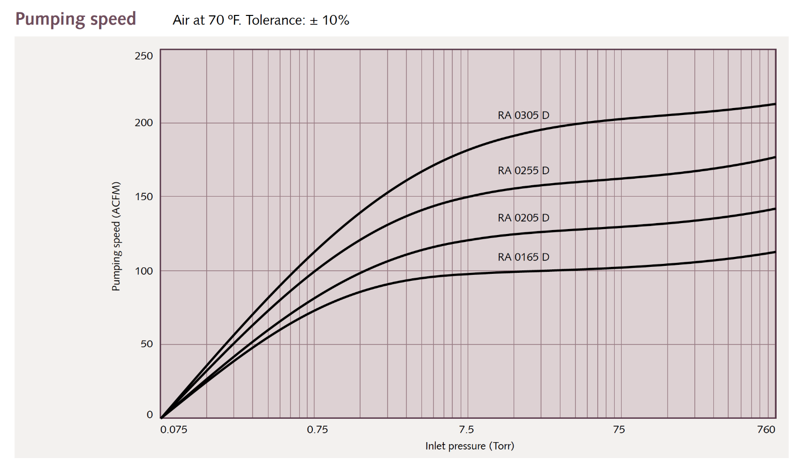
Size Vacuum Pump(s)
A common vacuum pump for this size is a lubricated vane type.
One suppliers’ curve set is below:
150 acfm
26”Hg = 100 Torr

Slide 21
Size Piping
Recall our piping pressure drop “allowance” is 1.0”Hg.
Use a pressure drop calculation tool like https://www.checalc.com/fluid_flow_fitting_losses.html

Slide 22
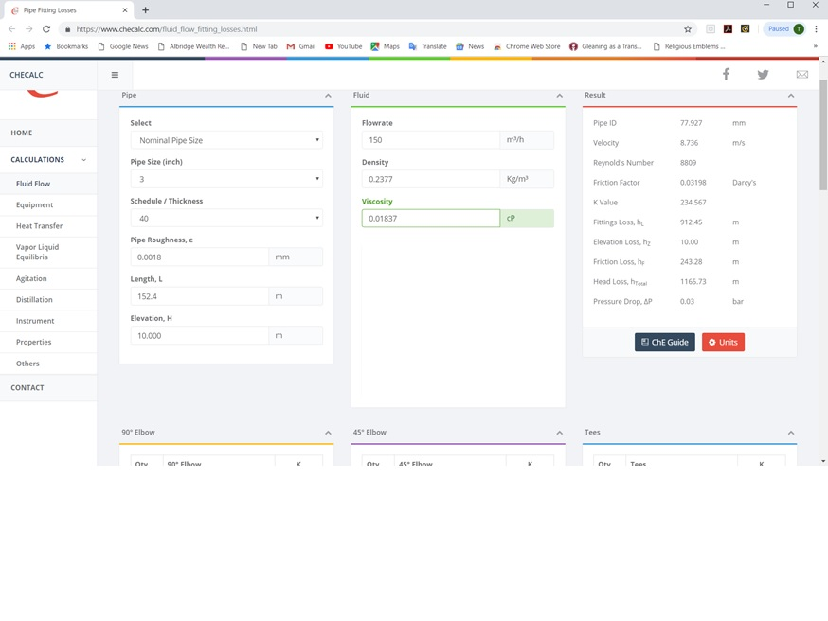
Size Piping

Slide 23
Size Receiver
For energy efficiency, master controls need to work.
Pumps have to start and stop to follow demand.
Which requires STORAGE
This vacuum pump is a 10hp. Start-stop frequency is the issue we are trying to manage with receiver sizing. 10 starts/hr is OK for this hp.
We calculated that a 2,000 gal tank is needed with a +/-2”Hg control band.
Small tanks end up with wide delta Ps and constant-running pumps.

Slide 24
Size Receiver

Slide 25
Design Controls
With a 4-plex, you must have a master controller.
I recommend a “target” algorithm if it is available.
The “trim” vacuum pump should run at the target +/- half of the control band.
“Cascade” not preferred – too wide of delta P.
The “base” pumps run at 100%.
Tune for actual demand changes, not just steady-state.

Slide 26
Summary
Determine Consolidated System Vacuum Level
Determine Demand at That Vacuum Level
Size Vacuum Pump(s)
Size Piping Header
Size receiver
Design Controls

Slide 27
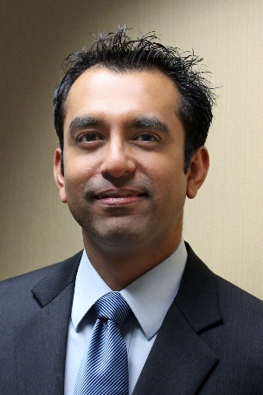
About the Speaker
Systems Engineering Manager, Busch USA
Over 17 years of experience in the industry
VJ Gupta
Busch USA

Slide 28
Sizing an Optimum Central Vacuum Solution
Webinar: How to Design a Centralized Vacuum System
VJ Gupta, Systems Engineering Manager
March 14, 2019
Page 1

Slide 29
Central Vacuum Systems
Why Centralize?
Return on
Investment (ROI)
Uptime Improvements
Process Efficiency
Environmentally
Friendly
Plant Expandability
Utility Savings
Page 2

Slide 30
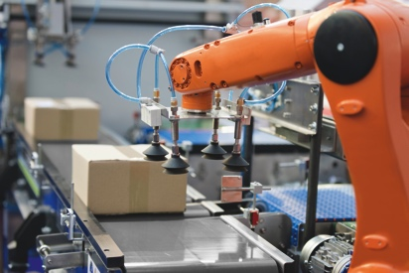
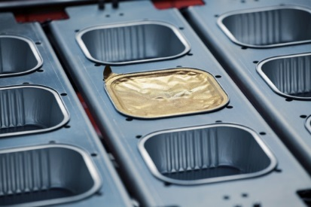


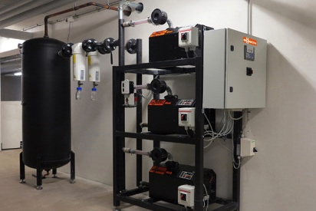
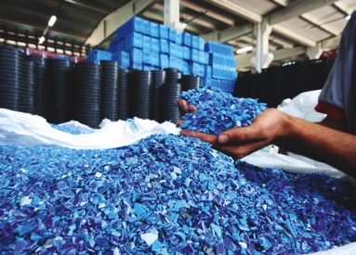
Central Vacuum Systems
Applications
Pick and Place
Molding / Forming
Applications
for Central Systems!
Vacuum Packaging
Pharmaceutical Processing
House Vacuum
Pneumatic Conveying
Page 3

Slide 31
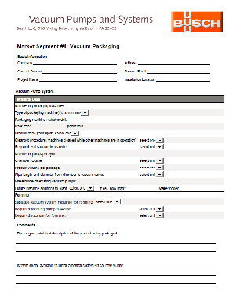

Central Vacuum Systems
Assessing the Vacuum Application
Visit customer’s plant!
Number of machines using vacuum?
Vacuum level on each machine?
Is their vacuum process dynamic, static or both?
Data logging of vacuum level, fluid temperatures etc.
Page 4

Slide 32
Central Vacuum Systems
Determine Customer Needs
Energy rebates realized
Floor space
Faster pump down time
Continuous vacuum demand
Processes with different vacuum levels
High noise levels
Page 5

Slide 33
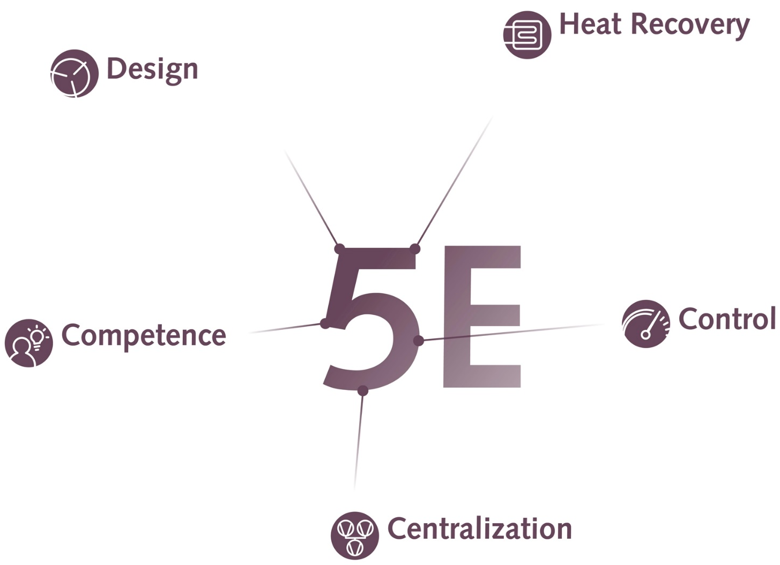
Vacuum Equipment Optimization
5-Elements of Efficiency
During operation, vacuum pumps convert kinetic energy into heat energy. Heat recovery systems can harness this energy.
Selecting the most suitable pump technology for the process is crucial to performance, efficiency and total life costs.
Efficient operation of vacuum processes requires experience in the interaction of all process components.
Control of vacuum systems finely tuned to production ensures optimum process stability and output.
A central vacuum supply offers the potential to reduce operating costs and increase energy efficiency.
Page 6

Slide 34
Design Considerations
Different Vacuum Levels
Process 1
50 acfm
10”HgV
Process 2
50 acfm
20”HgV
 | Pumping Capacity (acfm)
Process 1; at 10”HgV | 50
Process 2; at 20”HgV | 50
Process 1 + Process 2; at 20”HgV
150
100 ?
Pump 1
Pump 2
Why is this important?
It is common to have processes within a plant to have significantly different vacuum levels.
Vacuum centralization should be done only where it makes sense! Sometimes, Point-of-Use (POU) pumps are better suited.
Page 7

Slide 35
Design Considerations
Pressure Drop
ΔP = 1.5”Hg
What is the requirement here?
Process or
Machinery
P₁V₁ = P₂V₂
Need 144 ACFM @ 26.5”HgV
Vacuum Pump
Requirement here = 100 ACFM @ 25”HgV
Why is this important?
Pressure drop directly affects pump size and power consumption.
Vacuum centralization is not just about the pump.
Page 8

Slide 36
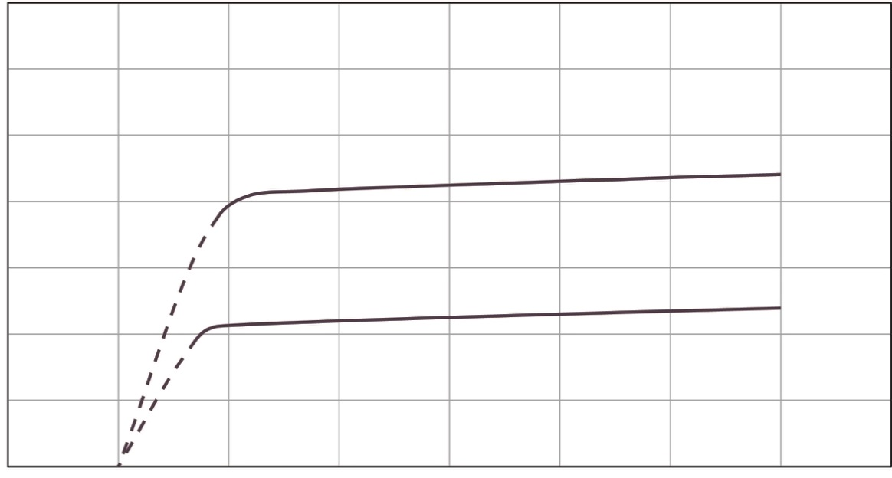
Design Considerations
To VSD or Not to VSD?
Process 1
50 ACFM
20” HgV
Process 2
50 ACFM
20” HgV
160
Pump Curve
110
Two Processes Running
Pumping Speed (ACFM) ➔
Pump
2nd Pump
Pump Curve
60
One Process Running
29.92"
20"
0"
Vacuum (″ HgV)
➔
Why is this important?
VSD is not the solution for all applications.
Multiple fixed speed pumps offer simplicity, higher efficiency and redundancy.
Page 9

Slide 37
Design Considerations
Sensor Location
Sensor on Vacuum Pump Suction
Sensor on Process (away from pump)
Sensor
Process
Sensor
VSD
VSD
Vacuum Pump
Why is this important?
Sensor provides real time feedback to VSD from a location that is critical to the process.
If sensor is installed at process, VSD can respond faster to demand changes.
Page 10

Slide 38
Design Considerations
Buffer Tanks
Machines
Buffer Tank
Vacuum Pump
Why is this important?
Centralizing applications with large flow requirements can generate significant vacuum spikes. VSD alone is unable to keep up!
Buffer tanks are a cost effective solution but must be sized correctly.
Page 11

Slide 39

Sizing an Optimum Central Vacuum Solution
Conclusion
Every Customer’s plant requirements are unique. Usually, there are different processes in one plant with different vacuum requirement levels.
Only centralize machines that make economical sense!
There is no “One Size Fits All” solution! An Optimal Centralized System is custom tailored to meet customer needs.
Conduct a complete study to determine customer requirements. Busch can help with this!
Consider all available options, i.e. various pump technologies, control schemes, buffer tanks, pipe header sizing, VSD etc.
Central systems can be a great solution but needs to be done right….
You need to work with an expert who can help with the detailed analysis and offers custom tailored solutions with minimal risks.
Page 12

Slide 40
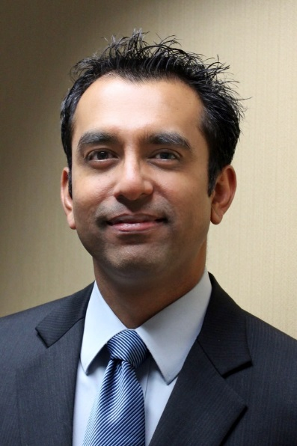
Sizing an Optimum Central Vacuum Solution
Contact Us
Thank you!
For more information about Busch Vacuum Pumps and Systems, please visit: www.buschusa.com
VJ Gupta
Systems Engineering Manager for Busch USA Office: (757) 502-7084 • Cell: (757) 373-0099 vj.gupta@buschusa.com
Page 13

Slide 41
How to Design a Centralized Vacuum System
Q&A
Please submit any questions through the Question Window on your GoToWebinar interface, directing them to Blower & Vacuum Best Practices Magazine. Our panelists will do their best to address your questions, and will follow up with you on anything that goes unanswered during this session.
Thank you for attending!
Sponsored by

Slide 42
Thank you for attending!
The recording and slides of this webinar will be made available to attendees via email later today.
PDH Certificates will be e-mailed to Attendees within two days.
Sponsored by

Slide 43
2019 Best Practices EXPO & Conference

Slide 44
2019 Best Practices EXPO & Conference
Call for Abstracts
The conference will focus on sustainable on-site utilities powering automation including compressed air, blower, vacuum and cooling systems. Presentations should encompass one or more of these themes.
Quality & Safety Management
Facility Maintenance & Reliability
Energy Savings / IoT Monitoring
Water Savings / Energy Management
  Abstract submissions are due Friday, March 29, 2019.
  Speakers receive a complimentary Conference Pass, a $675 value!
  To submit an abstract, please visit
  cabpexpo.com/conference/speakers

Slide 45



April 2019 Webinar
Safety and Quality in Compressed Air: Why You Should Care
Sponsored by
Loran Circle
Circle Training & Consulting
Keynote Speaker
Thursday, April 4, 2019 – 2:00 PM EST
Register for free at
www.airbestpractices.com/magazine/webinars

