Slide 1
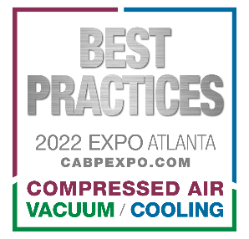
How to Hunt for Vacuum Leaks: Is it Worthwhile?
Ron Marshall, Marshall Compressed Air Consulting
Keynote Speaker
The recording and slides of this webinar will be made available to attendees via email later today.
PDH Certificates will be e-mailed to attendees by within 2 days.

Slide 2
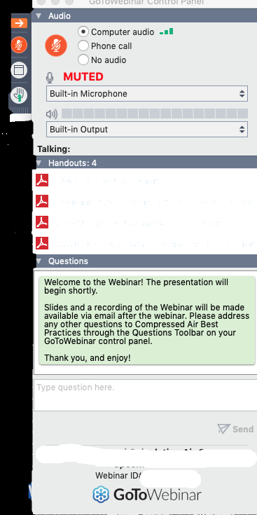
Q&A Format
Panelists will answer your questions during the Q&A session at the end of the Webinar.
Please post your questions in the Questions Window in your GoToWebinar interface.
Direct all questions to Blower & Vacuum Best Practices® Magazine
Sponsored by

Slide 3
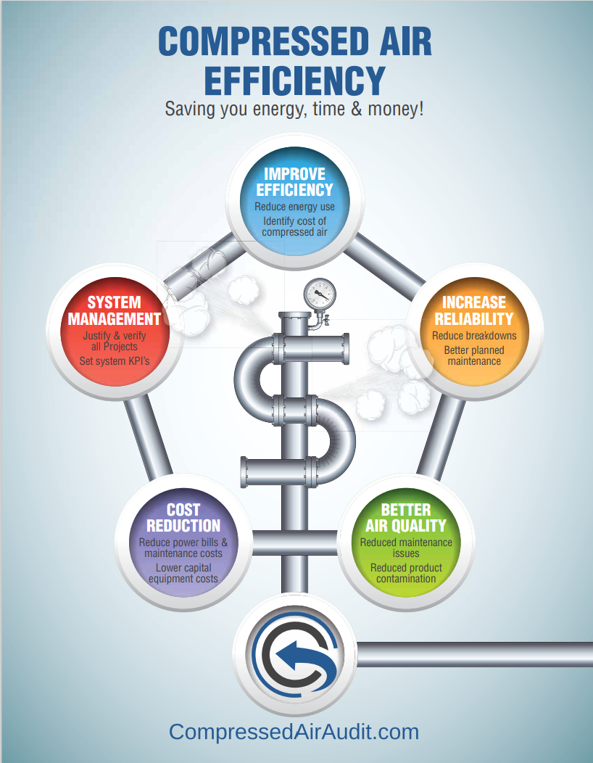
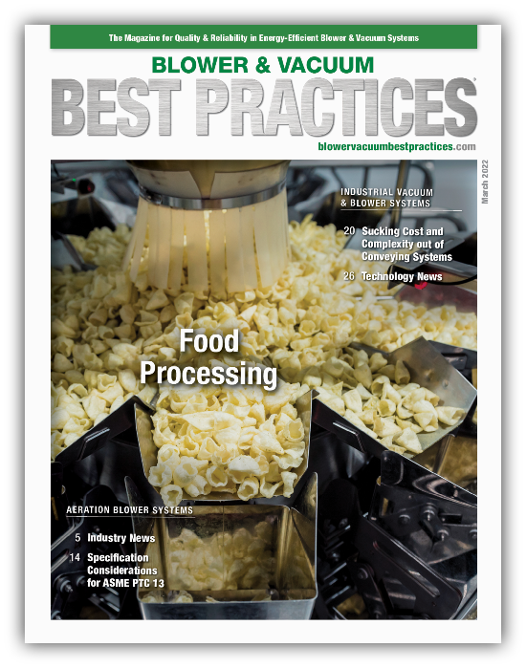
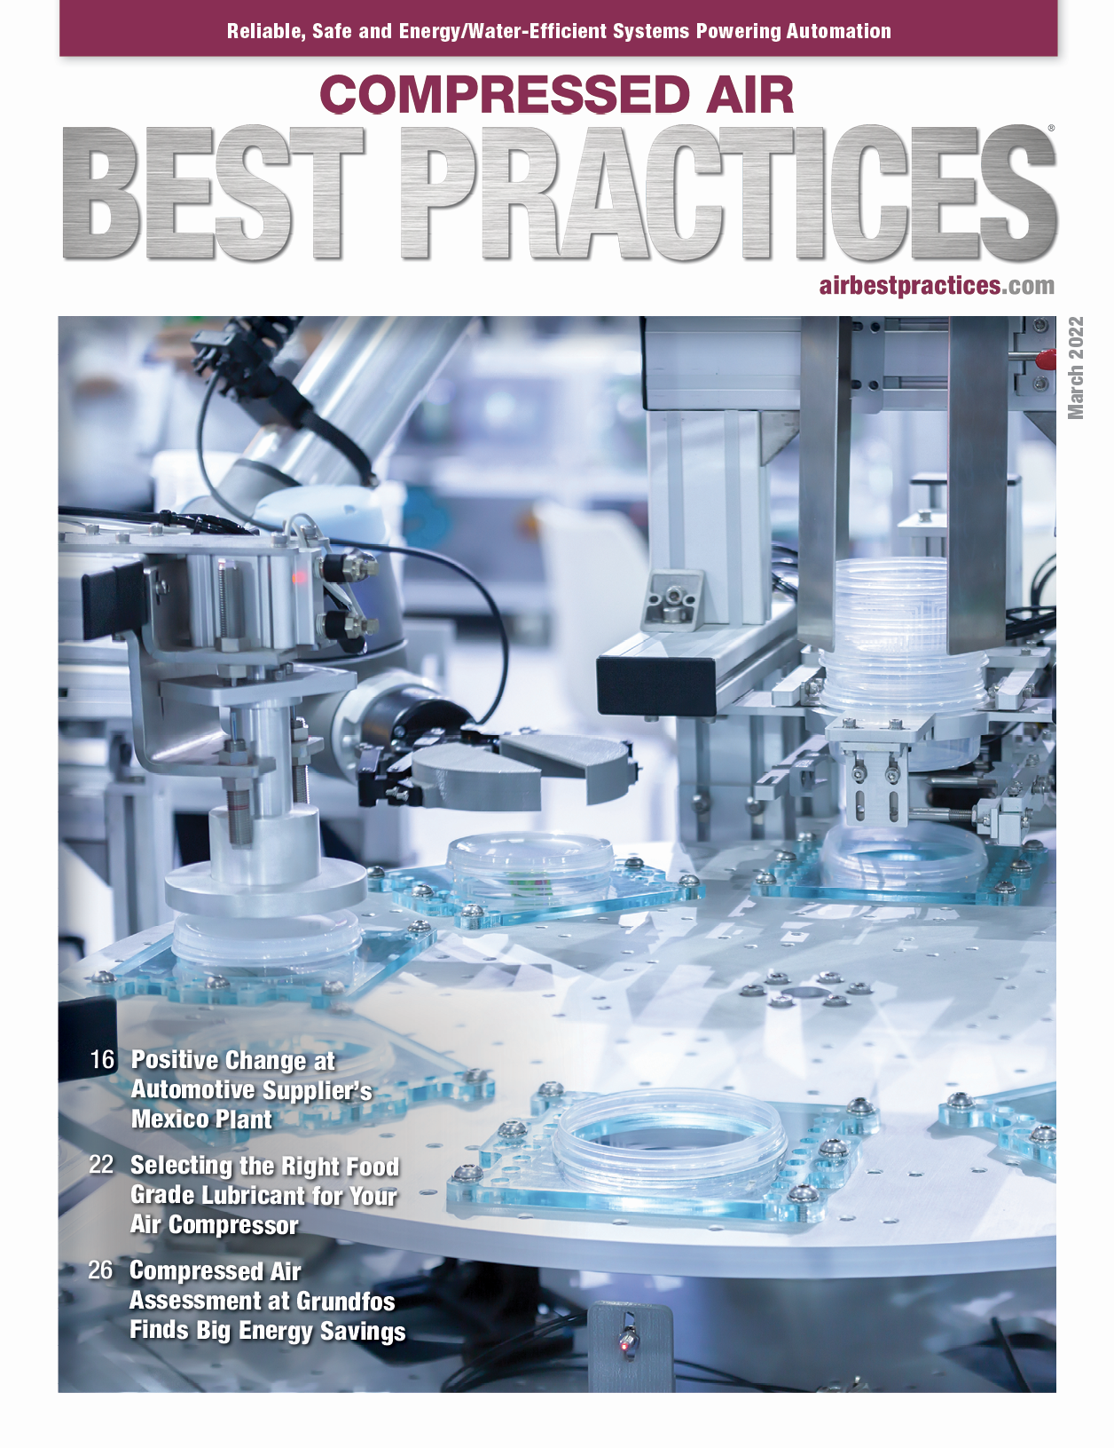
Handouts

Slide 4
Disclaimer
All rights are reserved. The contents of this publication may not be reproduced in whole or in part without consent of Smith Onandia Communications LLC. Smith Onandia Communications LLC does not assume and hereby disclaims any liability to any person for any loss or damage caused by errors or omissions in the material contained herein, regardless of whether such errors result from negligence, accident, or any other cause whatsoever.
All materials presented are educational. Each system is unique and must be evaluated on its own merits.

Slide 5
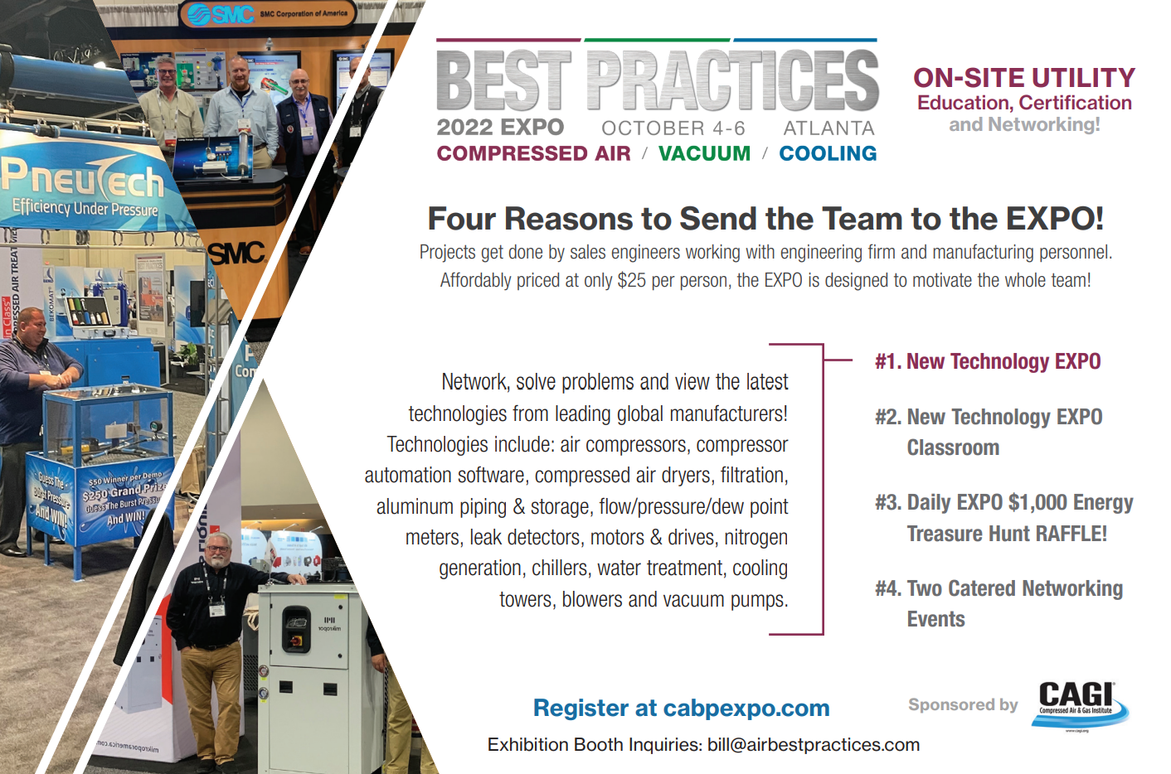
At the end of the webinar, we are having a fun contest for a chance to win a free full conference pass valued at $675!

Slide 6
Call for Speakers!
Interested in speaking at Best Practices 2022 EXPO & Conference?
Presentations should also encompass one or more of these themes:
Track 1
Sustainability Through Energy/Water Conservation Measures
Track 2
Quality, Safety and Reliability
Speakers receive FREE conference access – a $675 value!
Please submit your abstracts at
cabpexpo.com/speaker-submission/
Deadline: Friday, July 15

Slide 7
How to Hunt for Vacuum Leaks: Is it Worthwhile?
Introduction
Blower & Vacuum Best Practices Magazine
Sponsored by

Slide 8
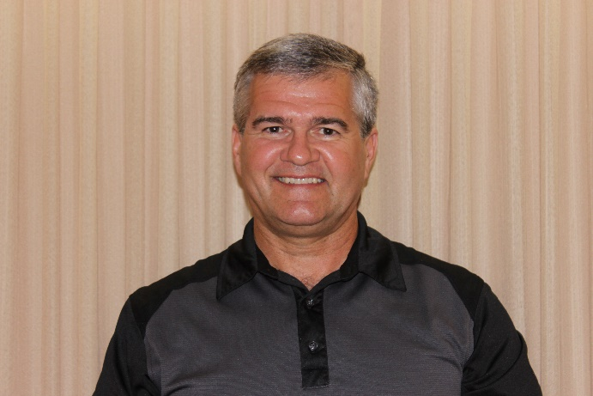
About the Speaker
Consultant MCAC
38 Years with Power Utility
24 Years Technical Support
CAC Level 2 Instructor
International Trainer UNIDO
600+ Projects Completed
Ron Marshall
Marshall Compressed Air Consulting
Sponsored by

Slide 9
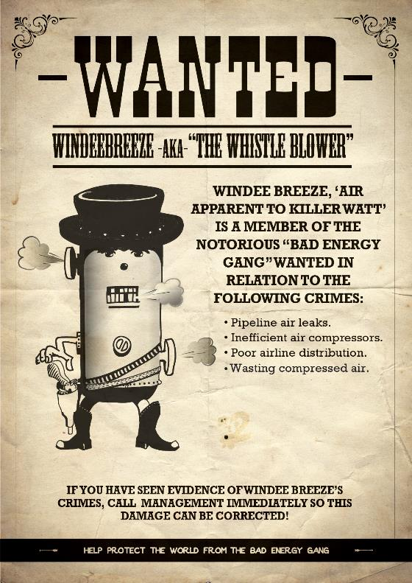
Wanted Energy Wasters

Slide 10
Coming up
Observations – hunting for leaks
Tools for finding leaks
Effect of vacuum leaks
Does fixing leaks save power?
Control comparisons
Vacuum leak savings solution

Slide 11
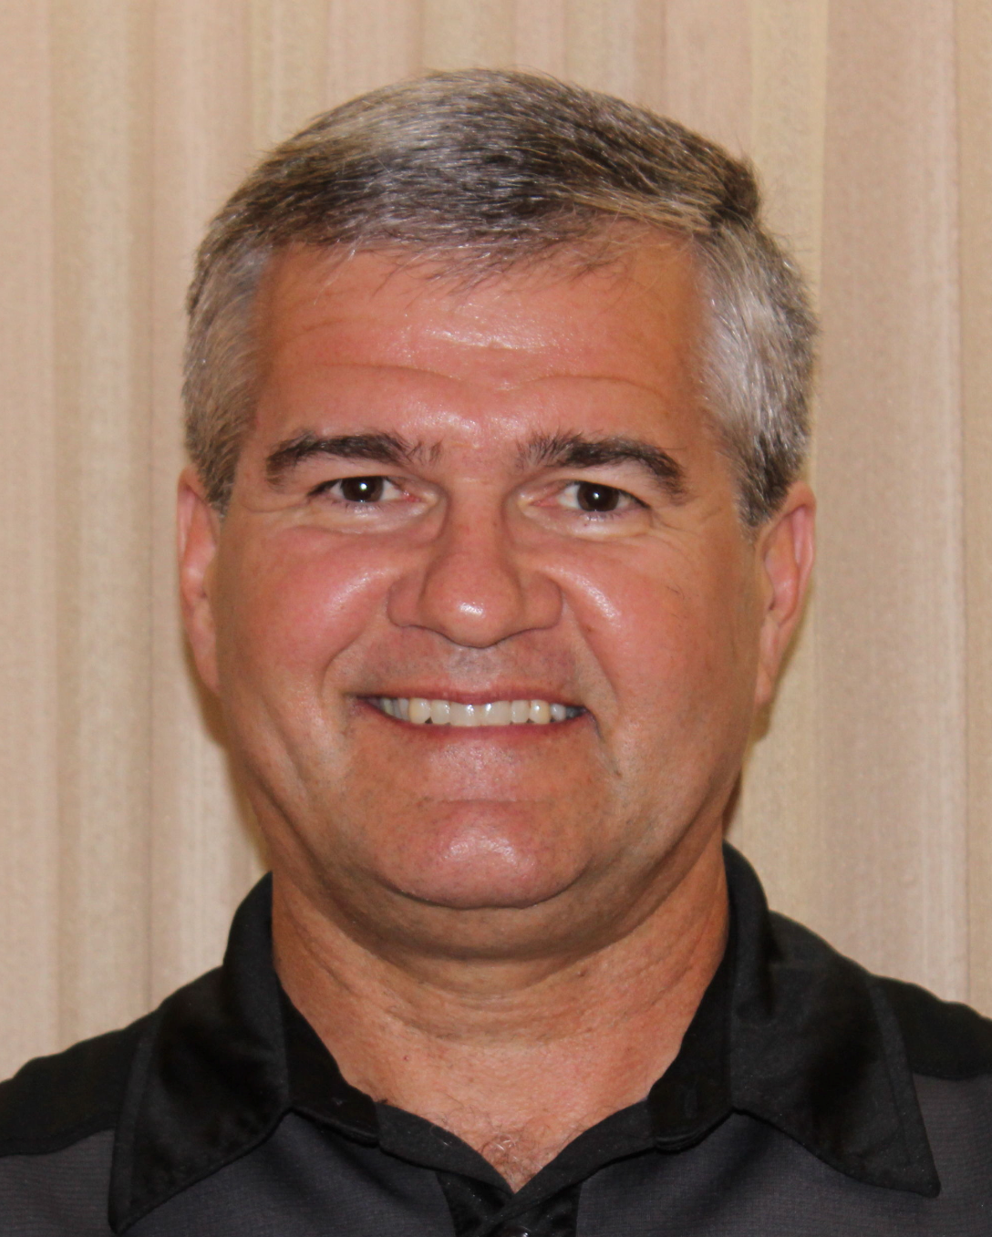
Clarification (Confession)
Most of my experience is in compressed air assessment
I still have a lot to learn about vacuum systems
That being said:
I find a lot of vacuum leaks when assessing compressed air
I am always curious how much these leaks cost
I have measured systems, mostly positive displacement
I have found system costs usually relate to the size of the vacuum pumps and how they are controlled
Vacuum exists between these

Slide 12
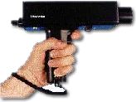
Finding Vacuum (and compressed gas) Leaks
Most basic tool are the detectors on the side of your head
But these are almost useless in a noisy industrial environment
Use ultrasonic detector to block out industrial noise
Basic detectors

Slide 13
How Ultrasonic Leak Detection Works
During a leak, a fluid (liquid or gas) moves from a high pressure to a low pressure
As it passes through the leak site, a turbulent flow is generated with strong ultrasonic components, which are heard through headphones and seen as intensity increments on the meter
It can be generally noted that the larger the leak, the greater the ultrasound level

Slide 14
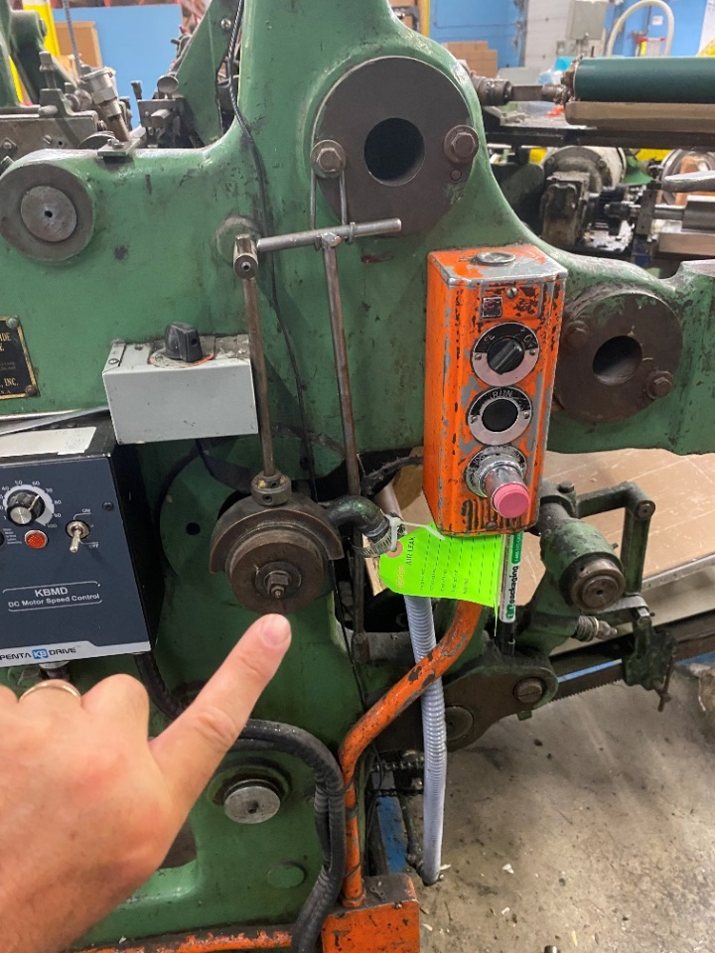
Finding a Leak
Detectors are directional, so wave the unit side to side and follow the sound
As you get closer the general location is found
Isolate the pick-up microphone with special narrow tip to precisely locate
Feel around for the source
Basic ultrasonic detectors are very affordable and can be used for other uses

Slide 15
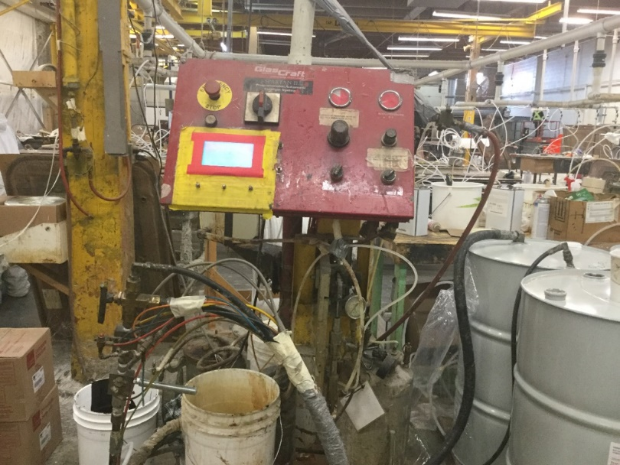
Problems with Ultrasonic Detection
Sound can reflect and cause false signals
Large or multiple leaks can wash out signals of smaller leaks
Actual end uses give off the same signals
Other things give off signals too like compressed air, spinning saw blades, fan tips, pumps
It is sometimes dangerous to get close to the source, or impossible if barriers prevent
Leak sources can be complex jumble of hoses and tubing

Slide 16
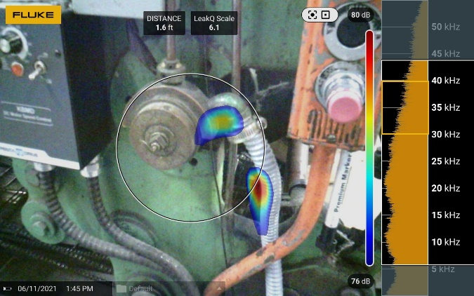
High-end detectors can make job easier
Visual imagers show leaks from a distance
Can identify multiple locations

Slide 17
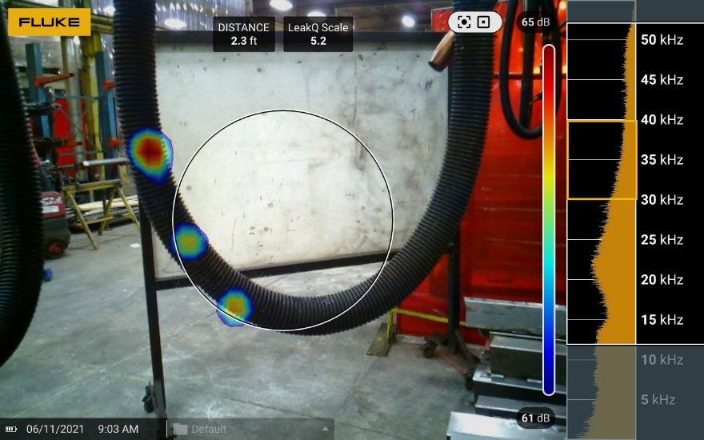
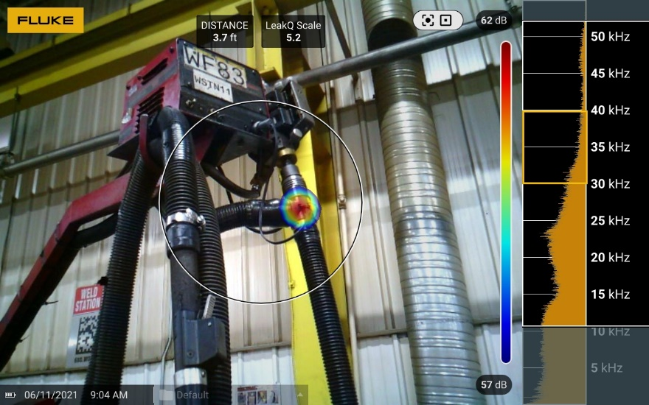
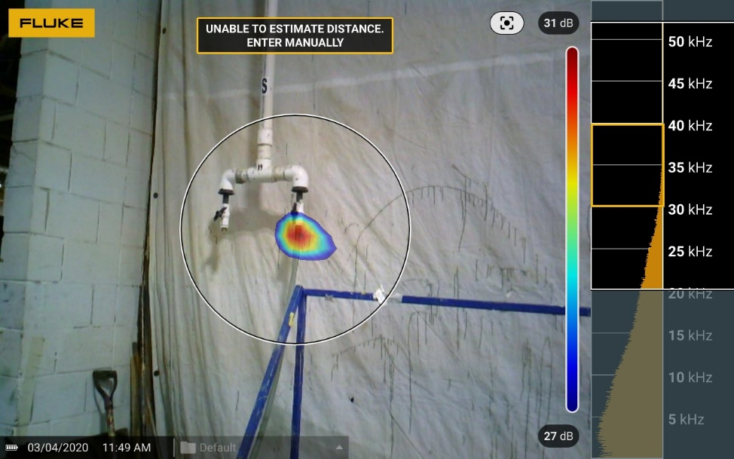
Leak Audit Examples

Slide 18
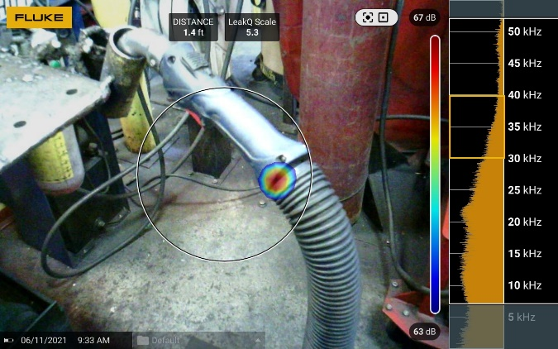
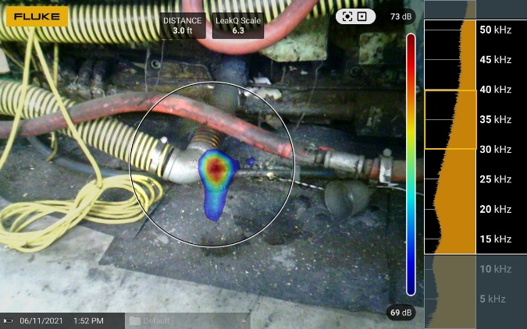
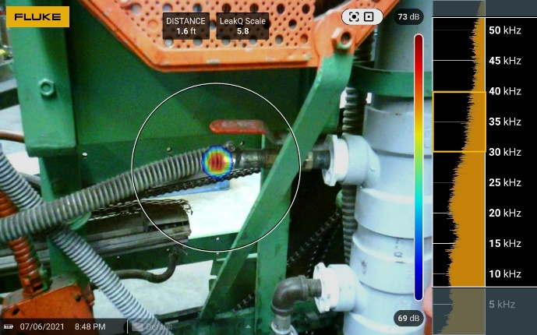
Leak Audit Experience

Slide 19
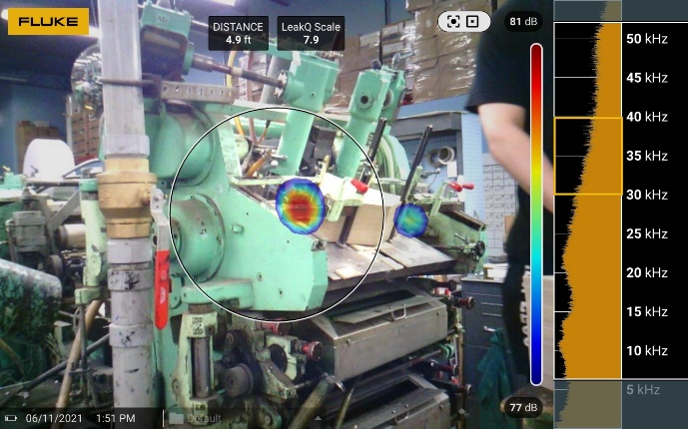
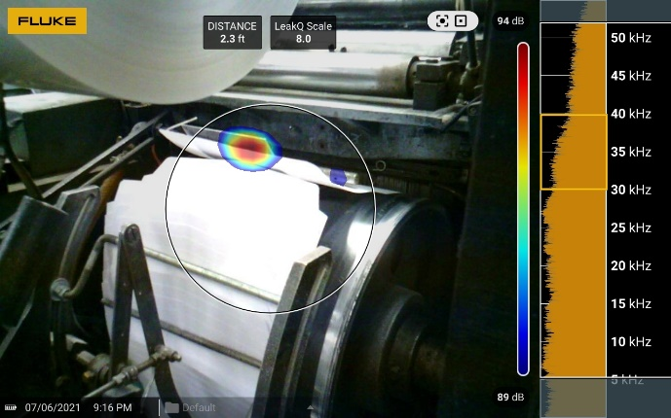
Leak Audit Experience – Actual Demands

Slide 20
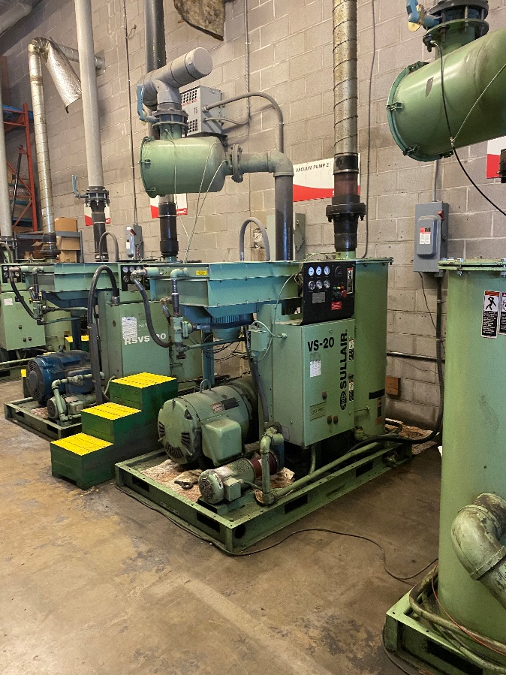
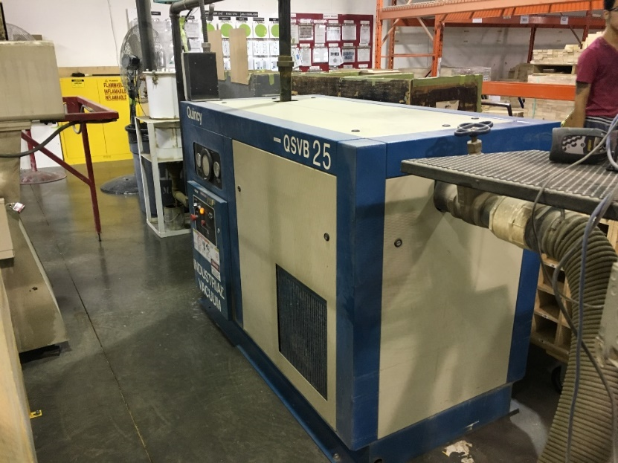
Does fixing leaks save power?

Slide 21
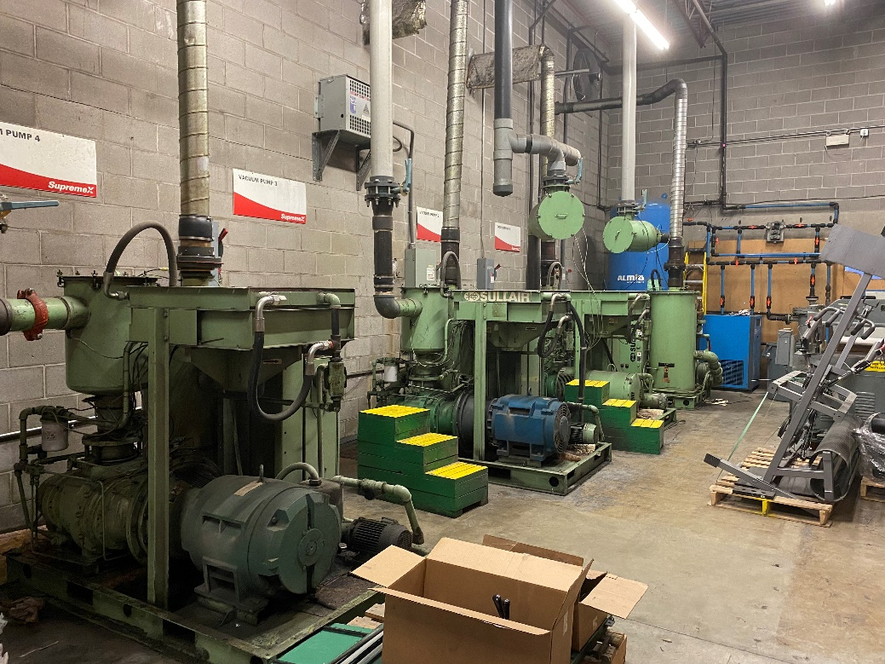
Vacuum Leak Consequences
Lower vacuum level due to higher loading
Poor performing processes
Need for additional capacity
Higher heat loading
Higher electrical costs
Higher maintenance costs

Slide 22
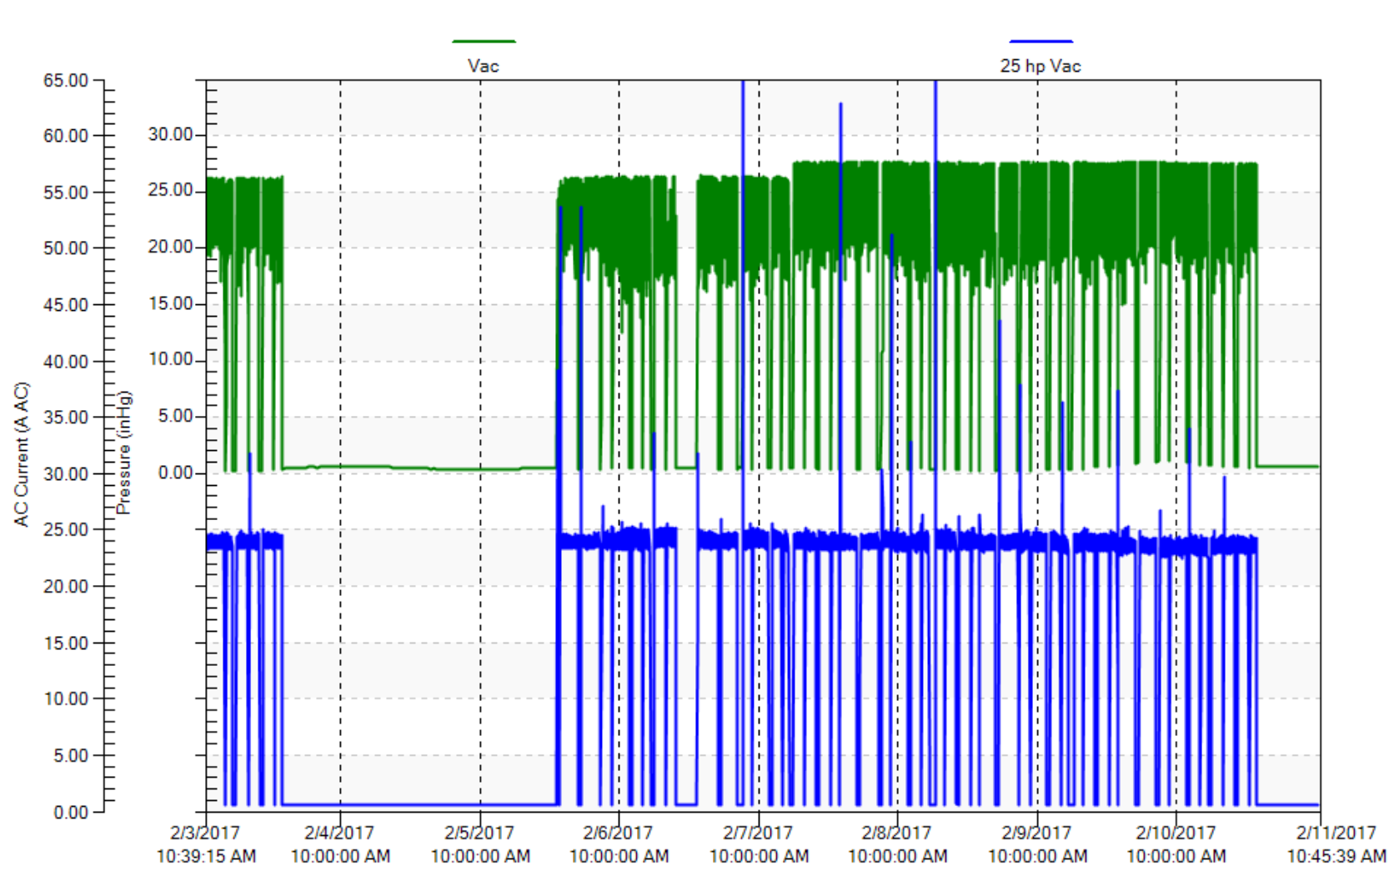
You be the judge – Cabinetry Hold Down

Slide 23
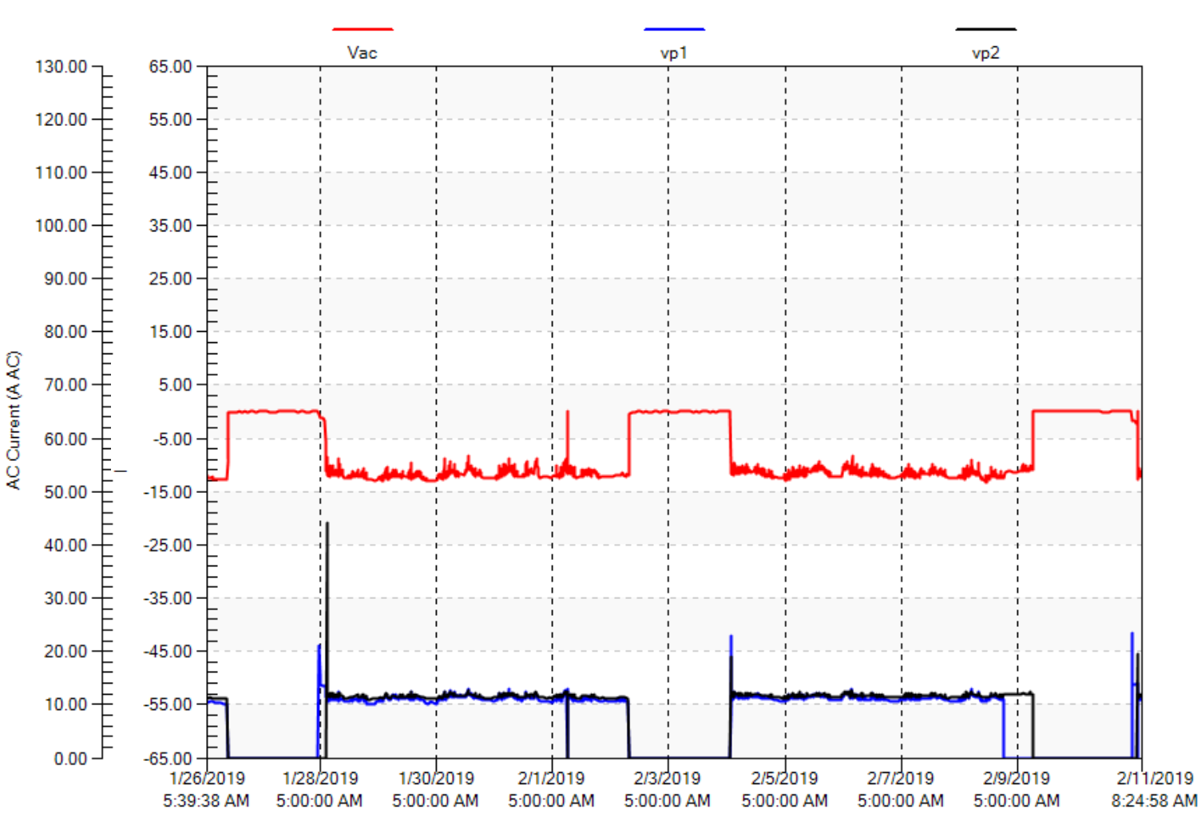
You be the judge – Fiberglass Curing

Slide 24
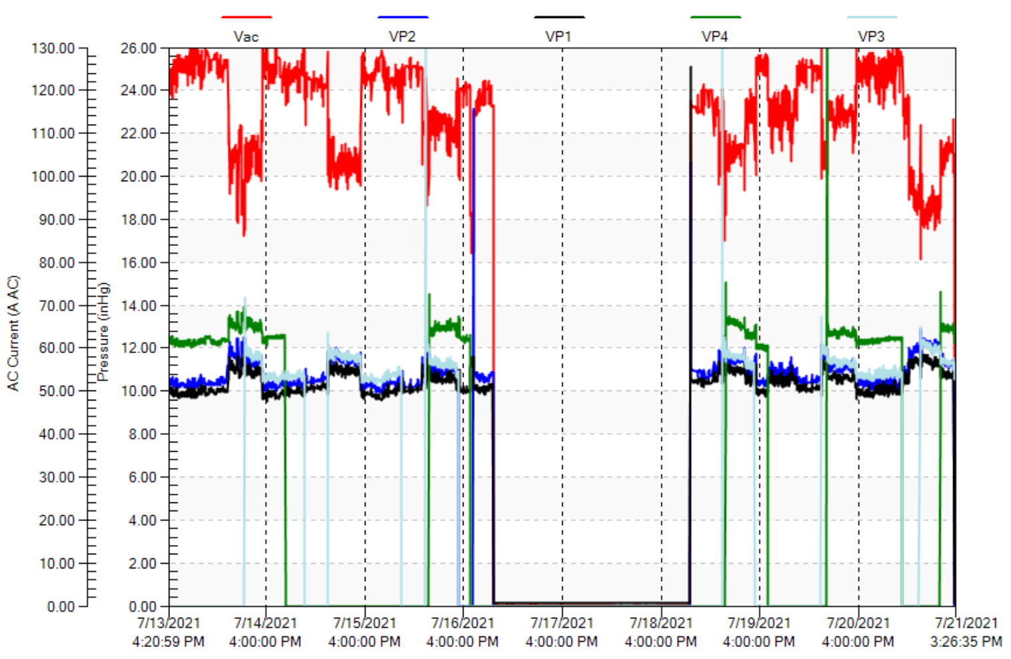
You be the judge - Printing

Slide 25
Poor Power Turn-down
Most PD fixed speed pumps have poor power turn-down – limited return on leak repair effort
Poorly controlled systems consume about the same energy all the time
Example system only needs 20 inches but floats to 26 inches and as low as 17 inches
When flow goes down the vacuum level rises, making the existing pumps equivalently smaller
Scfm = Pabs / Patm x icfm
At 20”Hg vacuum= (30-20)/30 x 1000 = 333 scfm
At 25”Hg vacuum= (30-25)/30 x 300 = 166 scfm
Vacuum level actually controlling pump capacity

Slide 26
Solution: Variable Speed Technology Example
VSD pumps have very good turn down
VSD controls vacuum level – 20 inches – much improved

Slide 27
Solution: Variable Speed Technology Example
VSD pump in this case almost equal to 3 x 75 hp
VSD can be used for leakage testing

Slide 28
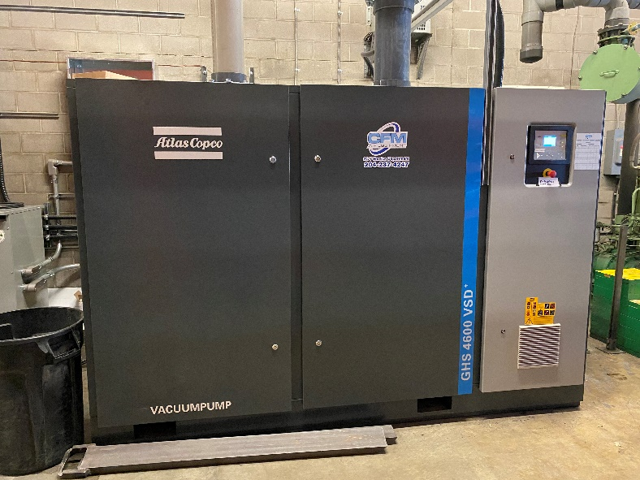
Solution: Variable Speed Technology Example
100 kW VSD in this case almost equal to 3 x 75 hp
More accurate vacuum level
Lower noise level
35% electrical savings worth $26,000 per year
Significant utility incentive

Slide 29
Summary
Use ultrasonic detection to find leaks
Visual imagers make leak hunting easier
PD pumps have flat power profiles
If you have poor control very little power savings from leakage repair
Lower the vacuum level the more effective any pump performs
New VSD pump technology can save $ and provide good return on leak efforts
VSD pump can be used to estimate leaks

Slide 30
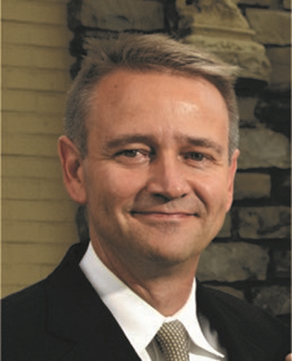
About the Speaker
2006- Present: Publisher, Compressed Air Best Practices® Magazine
1992-2006: Former VP Sales & Marketing, Quincy Compressor and SPX Hankison
Rod Smith
Best Practices EXPO & Magazines
Sponsored by

Slide 31
Recognizing Compressed Air as a Food Ingredient - Establishing a Safety/Quality Process
Preview of Track 2 on Quality/Safety at the Best Practices 2022 EXPO & Conference by Roderick Smith, Publisher, Best Practices EXPO & Magazines

Slide 32
Recognizing Compressed Air as a Food Ingredient - Establishing a Safety/Quality Process – Track 2 Quality/Safety Preview
Speak with any Compressed Air System Professional and they will say, “We are Aware that Many Food Product Labels Should Include this Line….”
CONTAINS CONTAMINANTS SUPPLIED BY COMPRESSED AIR

Slide 33
Recognizing Compressed Air as a Food Ingredient - Establishing a Safety/Quality Process – Track 2 Quality/Safety Preview
What are the Contaminants Potentially Supplied by Compressed Air and are they a Safety & Hygiene Concern?
YES, they are a Safety & Hygiene Concern
Oil and Oil Vapor
Moisture
Particulates of dust/rust/plastic tubing
Microorganisms

Slide 34
Recognizing Compressed Air as a Food Ingredient - Establishing a Safety/Quality Process – Track 2 Quality/Safety Preview
Two Ways Compressed Air Enters Into Contact with Food Products
Indirect Contact with Food (examples)
Beverage bottle blowing
Food Container (plastic, aluminum, glass) manufacturing
Food packaging process

Slide 35
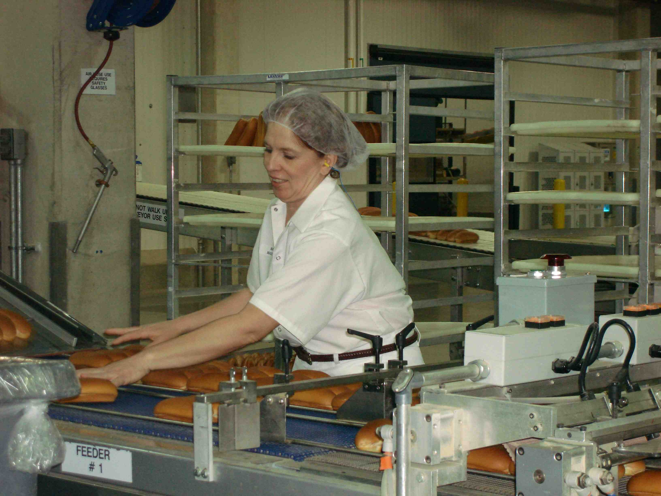
Recognizing Compressed Air as a Food Ingredient - Establishing a Safety/Quality Process – Track 2 Quality/Safety Preview
Two Ways Compressed Air Enters Into Contact with Food Products
Indirect Contact with Food
Direct Contact with Food (examples)
Blowing crumbs off bread in commercial bakeries
Food processing: sorting, cutting, shaping, packaging

Slide 36
Recognizing Compressed Air as a Food Ingredient - Establishing a Safety/Quality Process – Track 2 Quality/Safety Preview
We invested in a modern compressed air system – how could there be contaminants?
Yes, modern compressed air systems supply contaminant-free air…but:
Maintenance of the Systems is Critical – Poor Maintenance will cause contaminants to break through – and often does
How high a profile does maintenance of these components have in your Quality System?
Image credit: “Compressed Air System Drawings: A Picture can Save Tens of
Thousands of Dollars”, Paul Edwards, Compressed Air Consultants,
Source: www.airbestpractices.com

Slide 37
Recognizing Compressed Air as a Food Ingredient - Establishing a Safety/Quality Process – Track 2 Quality/Safety Preview
Yes, modern compressed air systems supply contaminant-free air…but:
What is your Compressed Air Quality Specification for Contaminants? (dew point, oil content, and particulates-including microorganisms)
Do you Measure, Monitor & Verify Compliance with your Quality Specification? If/When Maintenance Fails – What Alarms Exist!?
A small % of firms monitor/alarm when maintenance failures occur
A stand-alone dew point monitor
Image credit: “Proactively Maintaining Desiccant Dryers Yields Efficiencies
And Reliable Service”, Russ Jones, BEKO Technologies
Source: www.airbestpractices.com

Slide 38
Recognizing Compressed Air as a Food Ingredient - Establishing a Safety/Quality Process – Track 2 Quality/Safety Preview
Track 2 will teach attendees to:
Establish a Compressed Air Quality Specification
Conduct a Risk Assessment of Existing System and Maintenance Practices
Learn to Measure, Monitor & Verify Compliance with the Quality Specification
Specification Reference Example
British Compressed Air Society & British Retail Consortium
Food Grade Purity Recommendations
Chart Provided by Parker domnick Hunter
Source: “Compressed Air System Design Recommendations for Food
Processors”, by Roderick Smith, Compressed Air Best Practices® Magazine
Source: www.airbestpractices.com

Slide 39
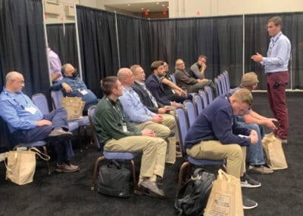
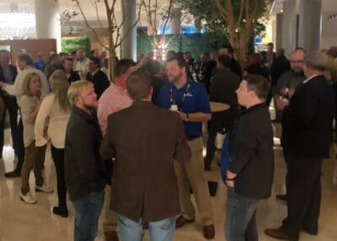
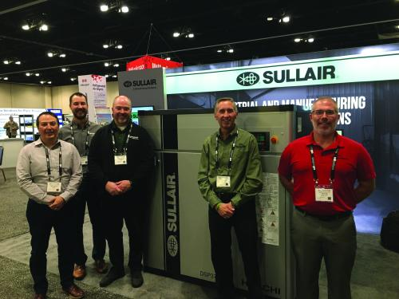
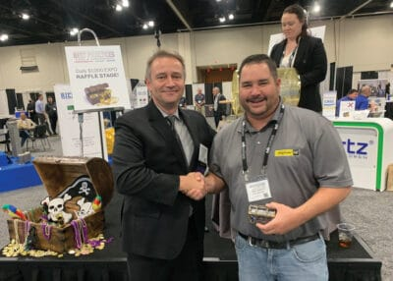
Recognizing Compressed Air as a Food Ingredient - Establishing a Safety/Quality Process – Track 2 Quality/Safety Preview
Join us October 4-6, 2022 at the upscale Cobb Galleria EXPO Centre in Atlanta!
Education, Certification & Networking!
CAGI Exam for Certified Compressed Air System Specialist Certification
Compressed Air Challenge Level 1 Fundamentals Workshop
New Technology EXPO
Register today at
https://cabpexpo.com
Source: “Compressed Air System Design Recommendations for Food
Processors”, by Roderick Smith, Compressed Air Best Practices® Magazine
Source: www.airbestpractices.com

Slide 40
How to Hunt for Vacuum Leaks: Is it Worthwhile?
Q&A
Please submit any questions through the Question Window on your GoToWebinar interface, directing them to Blower & Vacuum Best Practices Magazine. Our panelists will do their best to address your questions and will follow up with you on anything that goes unanswered during this session.
Thank you for attending!
Sponsored by

Slide 41
Best Practices EXPO Contest
Play for a chance to win a FREE Full Conference Pass to the Best Practices 2022 EXPO & Conference!! This is a $675 value! This contest is open to factory personnel, compressed air distributors, utility incentive programs and engineering firms. Exhibiting and sponsor companies are not qualified. Winners will be randomly selected from those who submitted a correct answer and notified tomorrow via email.
Please submit your answer in the questions box.
What can I learn by attending Track 2 at the Best Practices 2022 EXPO & Conference?
A
Establish a Compressed Air Quality Specification
B
Conduct a Risk Assessment of Existing System and Maintenance Practices
C
Learn to Measure, Monitor & Verify Compliance with the Quality Specification
*By entering you are giving permission to announce your name if you are a winner

Slide 42
Best Practices EXPO Contest
Play for a chance to win a FREE Full Conference Pass to the Best Practices 2022 EXPO & Conference!! This is a $675 value! This contest is open to factory personnel, compressed air distributors, utility incentive programs and engineering firms. Exhibiting and sponsor companies are not qualified. Winners will be randomly selected from those who submitted a correct answer and notified tomorrow via email.
Please submit your answer in the questions box.
What can I learn by attending Track 2 at the Best Practices 2022 EXPO & Conference?
A
Establish a Compressed Air Quality Specification
B
Conduct a Risk Assessment of Existing System and Maintenance Practices
C
Learn to Measure, Monitor & Verify Compliance with the Quality Specification
*By entering you are giving permission to announce your name if you are a winner

Slide 43
Thank you for attending!
The recording and slides of this webinar will be made available to attendees via email later today.
PDH Certificates will be e-mailed to Attendees by within 2 days

Slide 44
April 2022 Webinar Air Compressor Cooling, Water- or Air-Cooled?
Tom Taranto
Data Power Services
Keynote Speaker
Thursday, April 28, 2022 – 2:00 PM EST
Register for free at
www.airbestpractices.com/webinars

