Slide 1


Vacuum Specification Fundamentals: Flow vs. Pressure
Andy Smiltneek, Growth Solutions Consultants
Keynote Speaker
The recording and slides of this webinar will be made available to attendees via email later today.
PDH Certificates will be e-mailed to attendees by within 2 days.

Slide 2
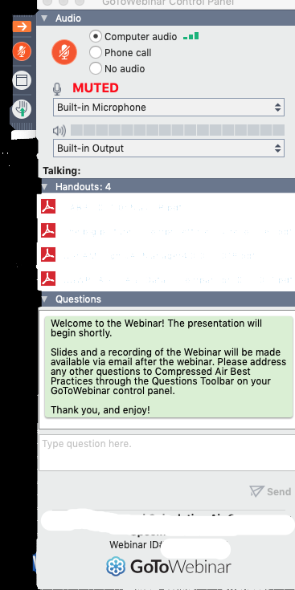
Q&A Format
Panelists will answer your questions during the Q&A session at the end of the Webinar.
Please post your questions in the Questions Window in your GoToWebinar interface.
Direct all questions to Compressed Air Best Practices® Magazine
Sponsored by

Slide 3
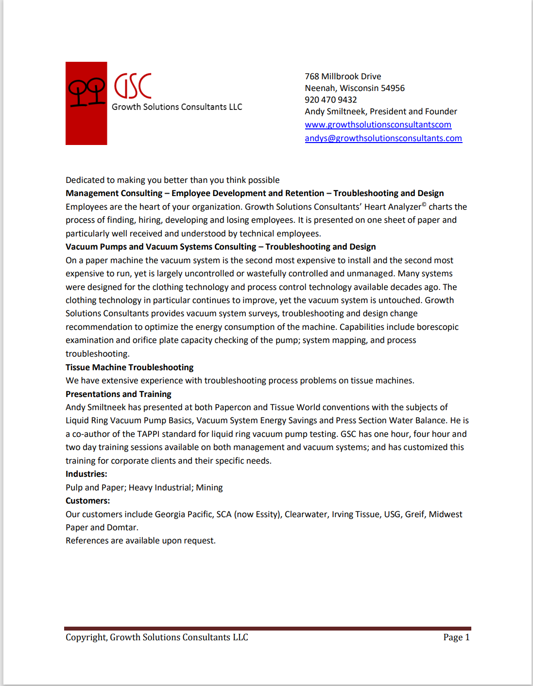

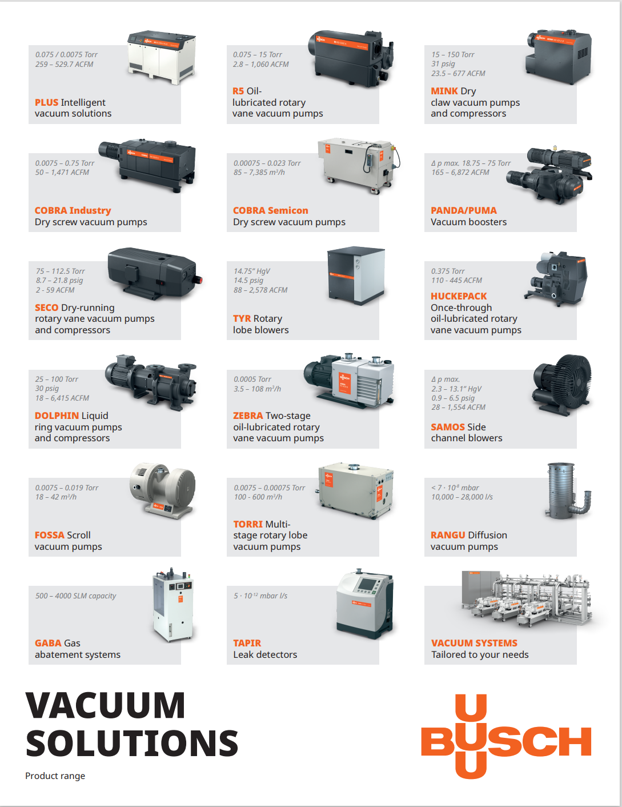
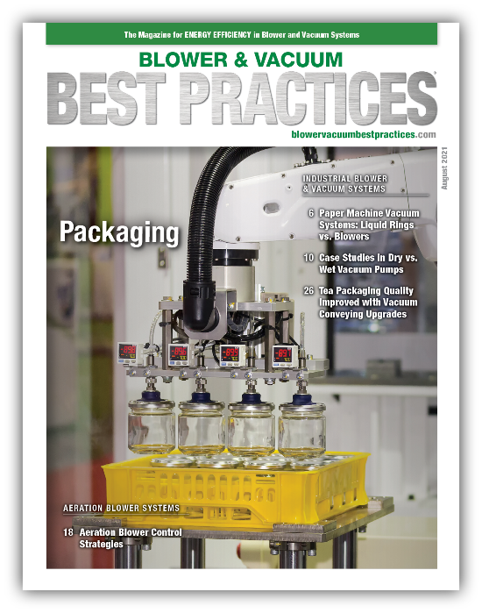
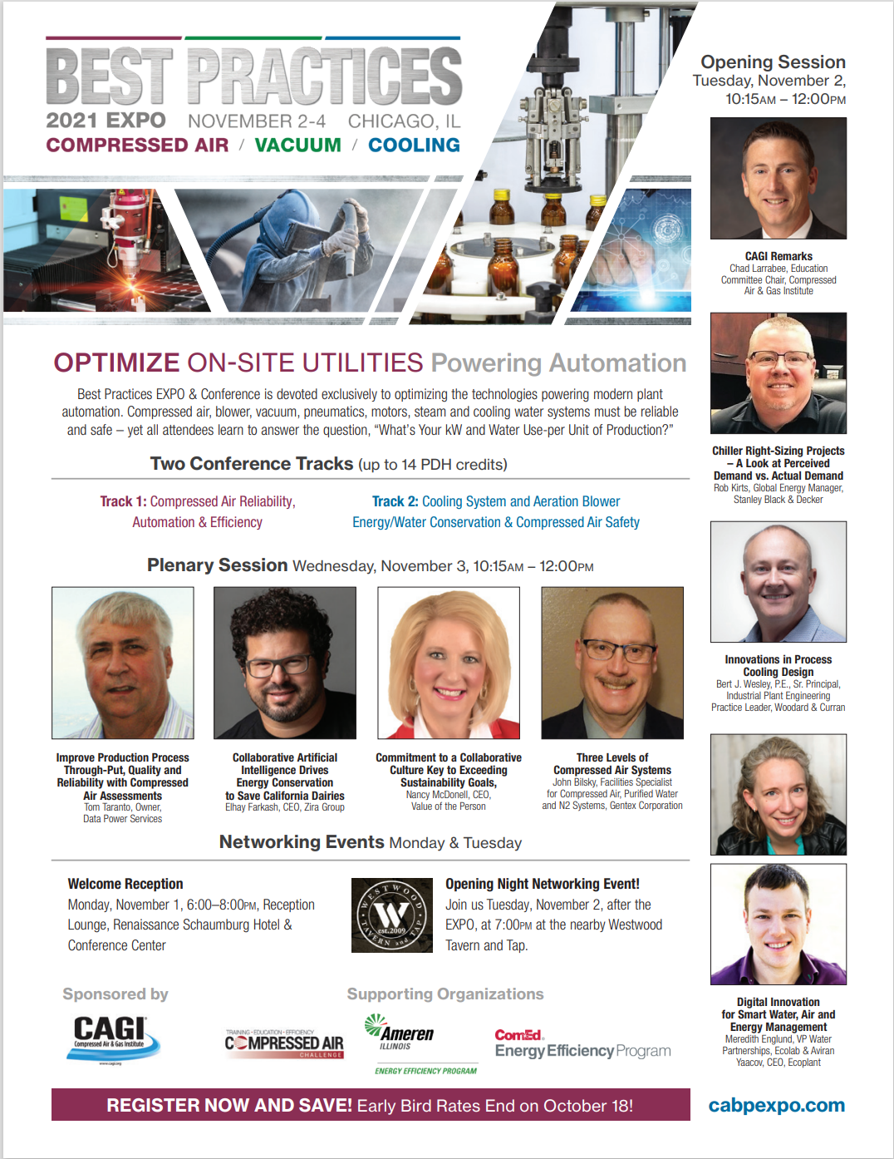
Handouts

Slide 4
Disclaimer
All rights are reserved. The contents of this publication may not be reproduced in whole or in part without consent of Smith Onandia Communications LLC. Smith Onandia Communications LLC does not assume and hereby disclaims any liability to any person for any loss or damage caused by errors or omissions in the material contained herein, regardless of whether such errors result from negligence, accident, or any other cause whatsoever.
All materials presented are educational. Each system is unique and must be evaluated on its own merits.

Slide 5
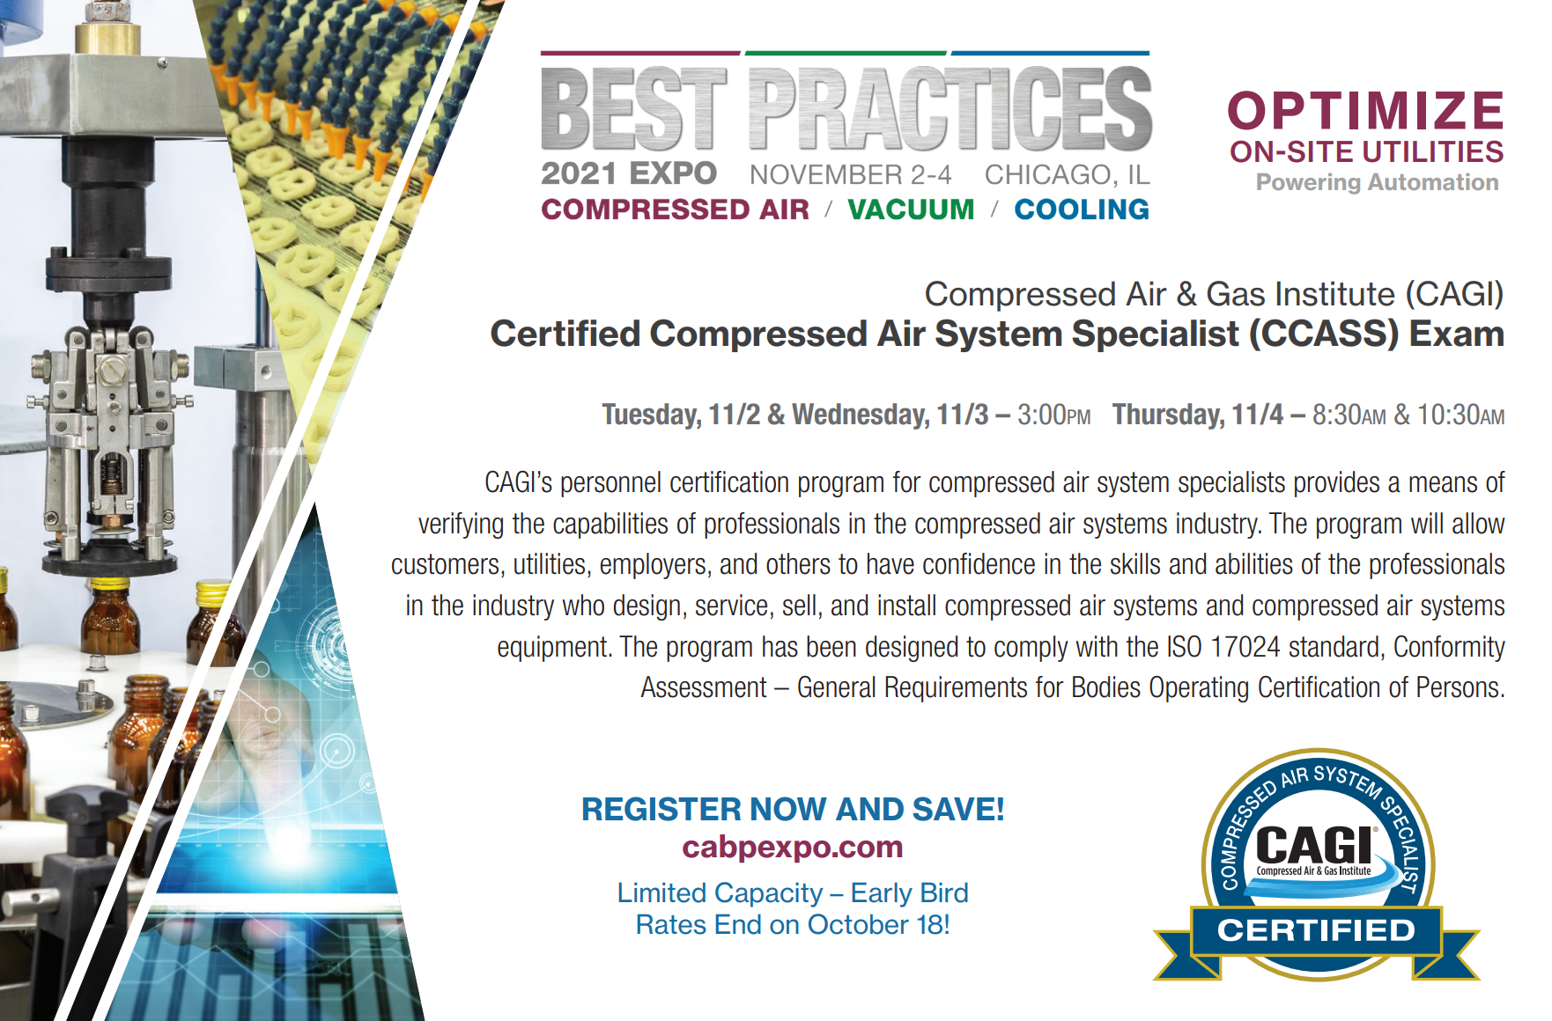
At the end of the webinar, we are having a fun contest for a chance for two people to win a free full conference pass valued at $675!

Slide 6
Vacuum Specification Fundamentals: Flow vs. Pressure
Introduction
Blower & Vacuum Best Practices Magazine
Sponsored by

Slide 7

About the Speaker
President, Growth Solutions Consultants
Spent 30 Years at Kimberly-Clark
Prior Director of Tissue Machine Design with Asia Pulp and Paper in China
Prior Technical Director at Somarakis
Andy Smiltneek
Growth Solutions Consultants
Sponsored by

Slide 8
Vacuum System Fundamentals
September 30, 2021
Andy Smiltneek
President
Growth Solutions Consultants LLC

Slide 9

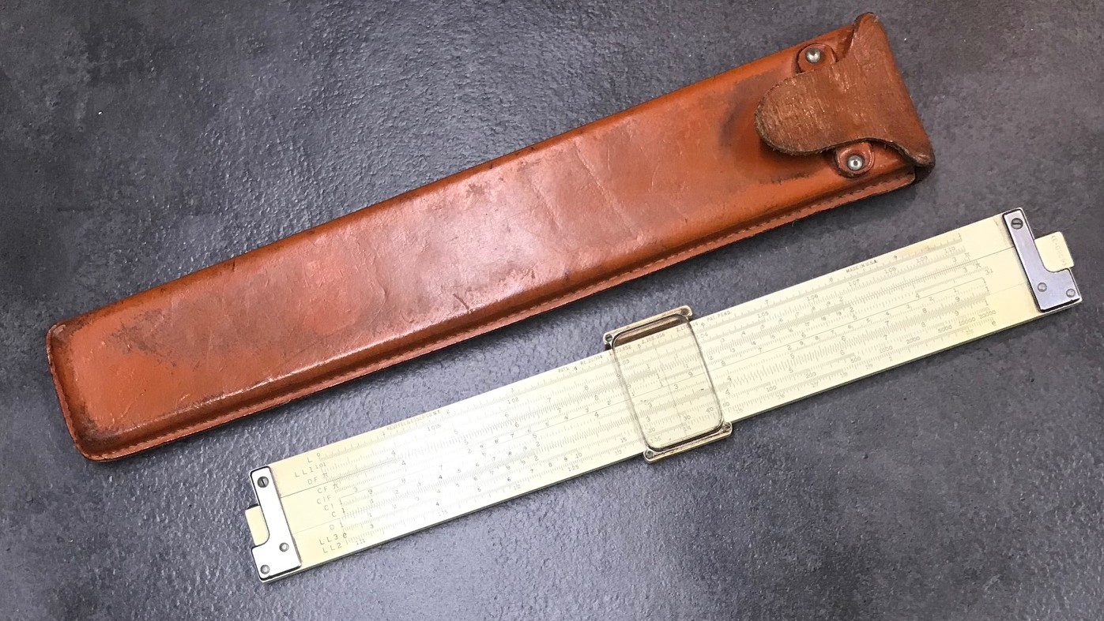
Basic, and two significant places
Gentlemen,
This is a football
Vince Lombardi
Ladies and Gentlemen,
This is a sliderule

Slide 10
Basic Definition of Vacuum and Vacuum Pump
For our purposes, any air pressure lower than local atmospheric is called a vacuum
A device that is capable of removing a gas from a confined space faster than the surrounding gas can leak in is called a vacuum pump

Slide 11
Measuring vacuum – atmospheric pressure
Suppose we have a 40” long glass cylinder closed at the bottom and open at the top filled with mercury and covered with an upside-down bowl
The mercury pool has atmospheric pressure (the weight of 65 miles of air) pushing on it which pushes up the mercury column; thus measuring the height of the column measures atmospheric pressure – 29.92 “HgA
Now we carefully and quickly rotate the cylinder and bowl
At sea level, the mercury will fall until the top of the column is 29.85 inches above the mercury pool in the bowl and the upper 10 inches will contain mercury vapor at a pressure of .07 inches of mercury
29.85”
Atmospheric Pressure
If the column was water, the height would be 33.8 feet
The pressure at the bottom of the column is 14.7 psia

Slide 12
Measuring Vacuum
If we have a cylinder open on both ends with a mercury pool sealing the bottom end and a way to remove air from the top end, as you remove air the pressure will drop and the mercury column will rise to balance the drop in pressure. The height of the mercury column is the vacuum level, or the pressure below local atmospheric
If the column is 29.92 inches long, the height of the air from the mercury to the end of the column is the absolute pressure
20” Hg absolute
10” Hg vacuum

Slide 13
Pressure Equivalents at sea level
30”Hg vacuum is the same as 0”Hg absolute (HgA) is the same as 0 psia
0” vacuum is the same as 29.92 “Hg is the same as 14.7 psia
0” vacuum is the same as 0 psig (gauge pressure)
29.92”Hg is the same as 1 barr is the same as 101.3 mPa is the same as 10113mb

Slide 14
Basic Specifications - CFM
Suppose at sea level we have 2 cubic feet of air at 60ºF at 14.7 psia (29.92”HgA, 0”Hg vacuum) and 0% humidity
2 Cubic Feet

Slide 15
Basic Specifications - CFM
Now we remove one cubic foot of air in one minute – this is 1 CFM
0 psia
14.7 psia
14.7 psia
1 cubic foot
2 Cubic Feet

Slide 16
Basic Specifications - CFM
The remaining air fills the whole vessel and the pressure drops in half, and we now have 3 cubic feet of air
7.35 psia or 15”Hg vacuum
1 cubic foot
2 cubic feet

Slide 17
Basic Specifications - CFM
Now we remove another cubic foot of air from the vessel
0 psia or 30”Hg vacuum
7.35 psia or 15”Hg vacuum
14.7psia or 0”Hg vacuum
7.35 psia or 15”Hg vacuum
1 cubic foot
1 cubic foot
2 cubic feet

Slide 18
Basic Specifications - CFM
The remaining air fills the whole vessel and the pressure drops in half, and we now have 3 ½ cubic feet of air, but to discharge the air removed at 7.35 psia we must compress it to 14.7 psia
14.7psia or 0”Hg vacuum
3.67 psia or 22.5”Hg vacuum
Compressed to 14.7psia or 0”Hg vacuum
1 cubic foot
1/2 cubic foot
2 cubic feet

Slide 19
Basic Specifications - CFM
The vacuum pump does not pump vacuum, it is a compressor that removes air from an enclosure more quickly than air can leak in
The vacuum pump will be rated by the air it can remove at standard conditions at the vacuum level (the pump inlet, since it is compressing the air the output in cubic feet is less than the input)
The vacuum pump rating is usually presented in a pump curve
The pump curve will also show the power required versus the vacuum level

Slide 20
Condensation Effect
79°F Water Spray
Suppose we have an air stream at 115°F and 15”Hg vacuum at 100% humidity
If we cool the air stream to 79°F
This cooling is typically done with spray nozzles spraying water cooler than the air stream into the vacuum pump inlet. It effectively increases the size of the vacuum pump.
If the water is hotter than the air stream, turn it off!
It will be 6% water vapor, with 14% of the original water vapor condensing thus decreasing the volume by 14%
It will be 20% water vapor

Slide 21
Evacuation with variable resistance
Felt Velocity 6566 FPM
Air Velocity 1080 FPM
Water 1100 GSM
Air Velocity 18000/36000 FPM
Water 940 GSM
Slot Width 1”
Dwell Time .76 msec
Felt Thickness
.080
Vacuum 15”Hg
Air Velocity 2160 FPM
Air Volume 15 CFM per sq in uhle box opening (8700 CFM in 2 msec)
Water Volume .0005 CFM per sq in uhle box opening (402 gpm)
Air goes 34 times the felt thickness in .76 msec

Slide 22

Pressure and Flow
November 10, 1975
Air Pressure 28.6 “Hg
Sustained Wind 80 mph
Gusts over 100 mph
The Edmund Fitzgerald is wrecked in Lake Superior
This is the power of 1.3”Hg vacuum
Average velocity through 9/16” hole at 1.3”Hg 120 mph

Slide 23
Measuring Flow
Flow Restriction
If you measure the pressure drop across any restriction in a new installation, you can repeat this measurement as a regular maintenance procedure to measure the relative performance of your pump
100 CFM
100 CFM
There will be a pressure drop related to the flow and gas properties

Slide 24
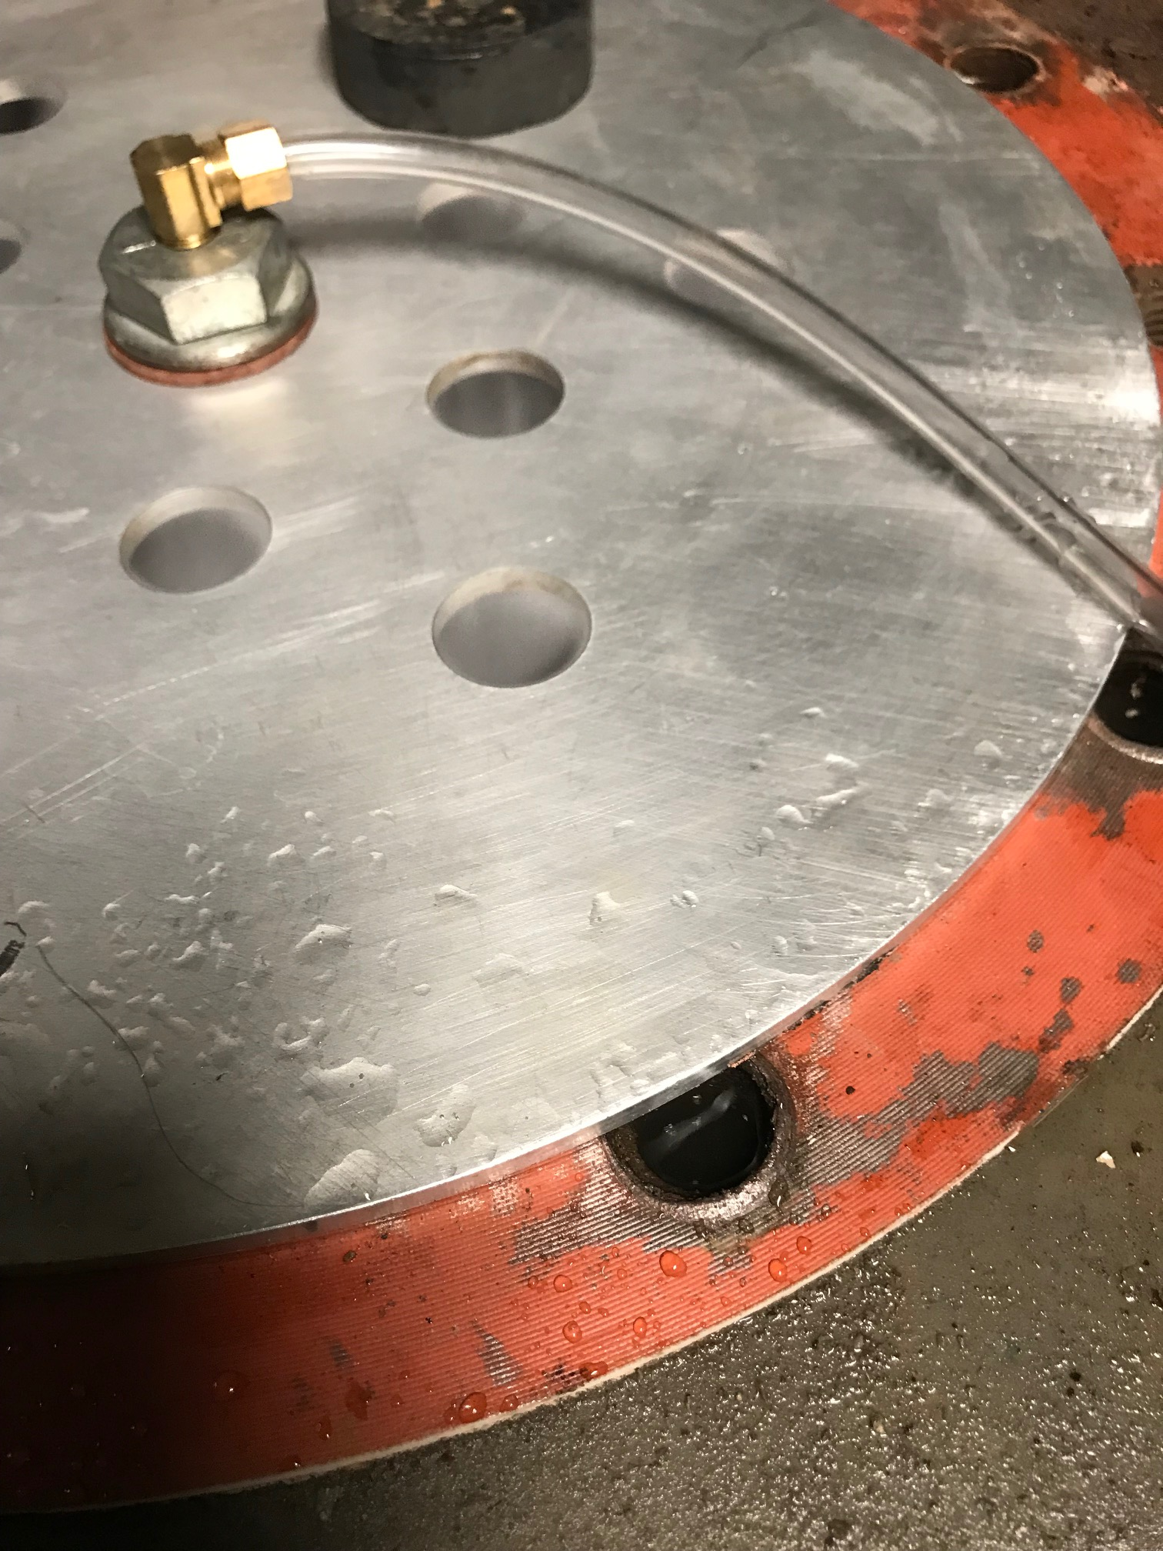
Measuring vacuum pump performance
Orifice plate test

Slide 25
Flow guidelines
For relatively dry air, design for 6000 fpm to minimize pressure loss
For air with entrained water, 3500 feet per minute is recommended
To drop the water out of the flow stream, 500 fpm is the norm.

Slide 26
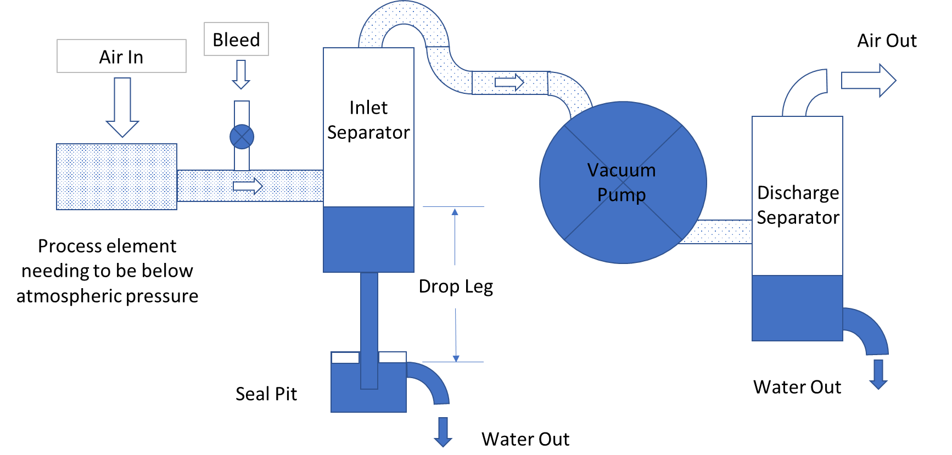
Typical Vacuum System

Slide 27
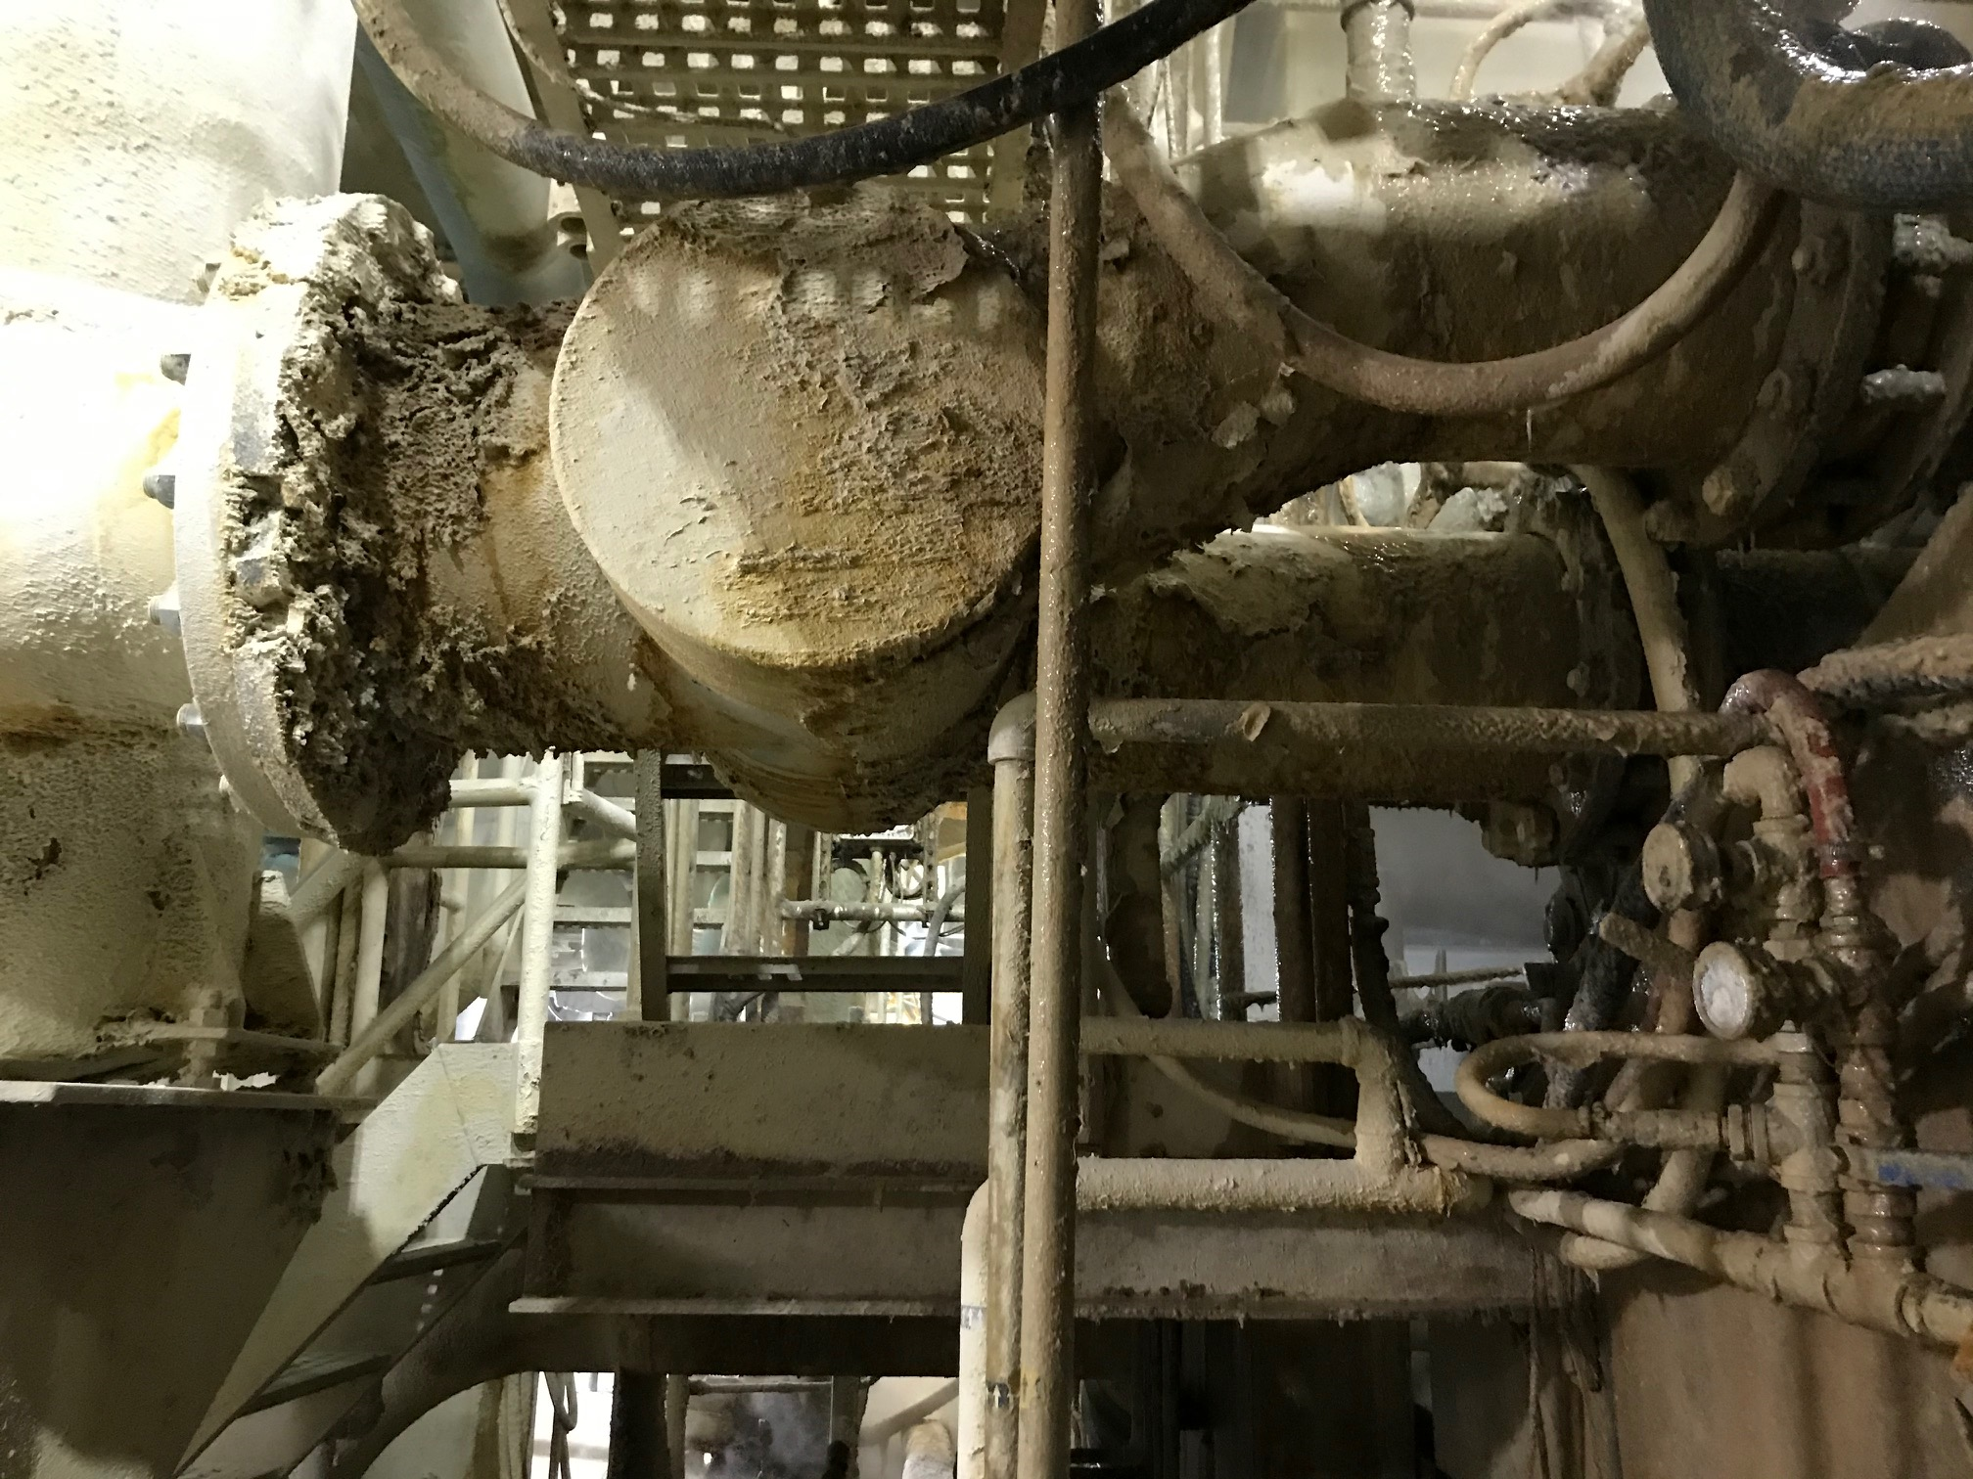
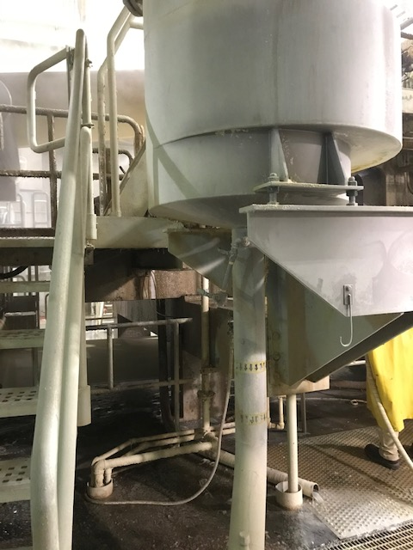
A Quick Example –Vacuum Variation
Measurement Points

Slide 28
System
To vacuum pump
When the vacuum level reached 16.8 “Hg the water coming from the uhle box almost completely blocked the air flow into the inlet separator
The air velocity increased until the water was entrained and pulled into the vacuum pump
The slug of water into the vacuum pump dropped the vacuum level and thus the water level in the separator
Air flow through the uhle box increased, raising the vacuum level, and the cycle repeated every second!
Uhle Box #1
Separator
Separator Water Level at 16.8 "Hg
Separator Water Level at 15.4 "Hg
Uhle Box #2
210 inches
Drop leg
229 inches
Seal Pit Water Level

Slide 29
Solution
To vacuum pump
Uhle Box #1
Drop the water level in the seal box by 11 inches (fortunately this was easily done)
The drop in seal box water level dropped the water level in the separator so the pipe could not be covered and the variation disappeared
Separator
Separator Water Level at 16.8 "Hg
Uhle Box #2
Separator Water Level at 15.4 "Hg
218 inches
199 inches
Drop leg
Seal Pit Water Level

Slide 30
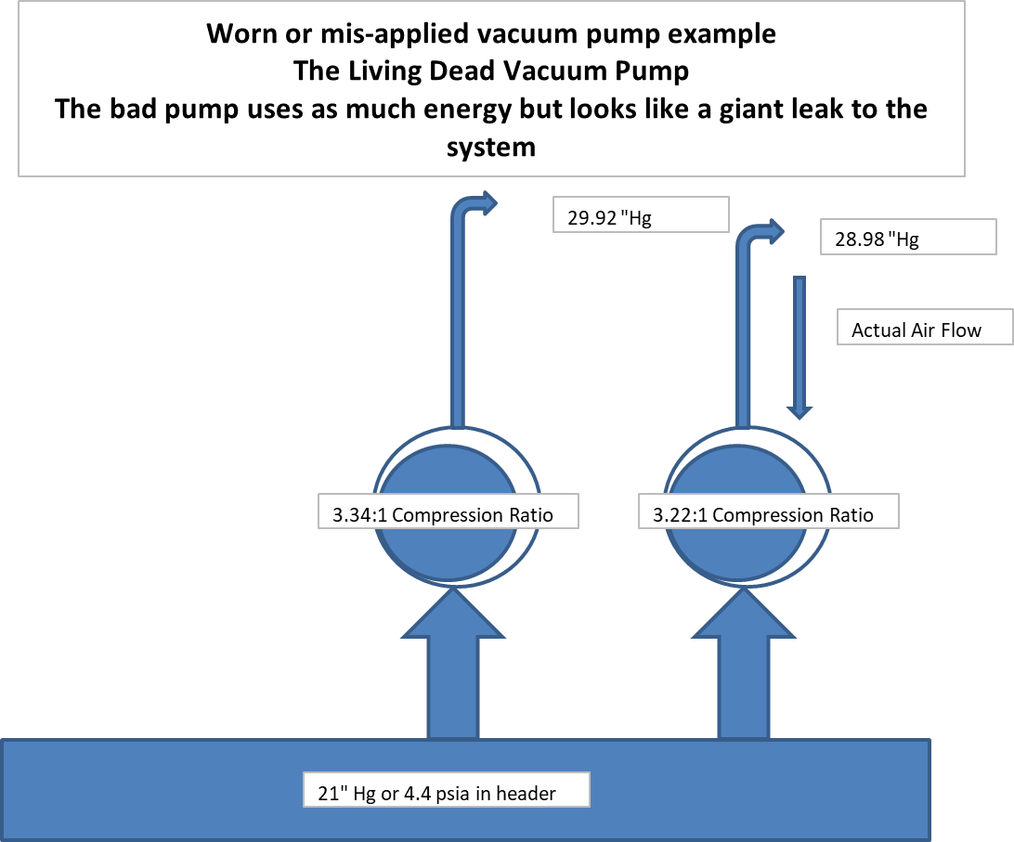
Vacuum Pumps in Parallel

Slide 31
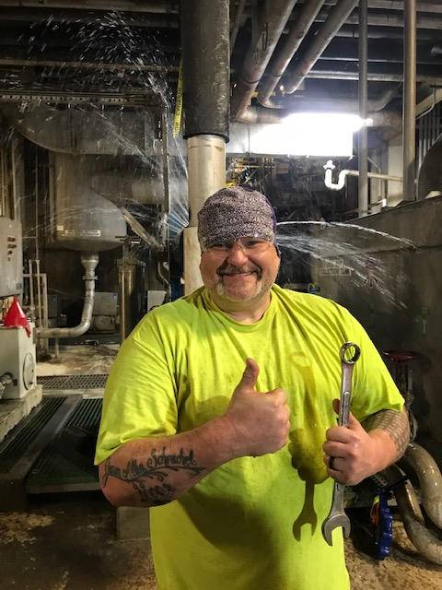
Thinking too hard about vacuum pumps

Slide 32
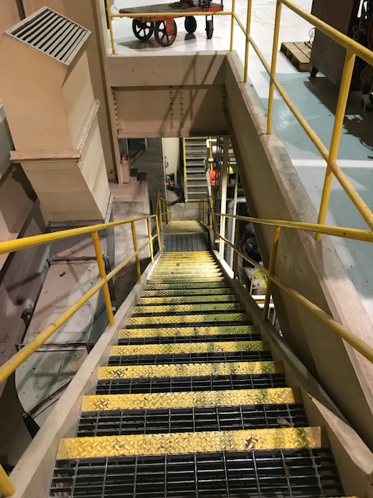
Find the vacuum pump

Slide 33
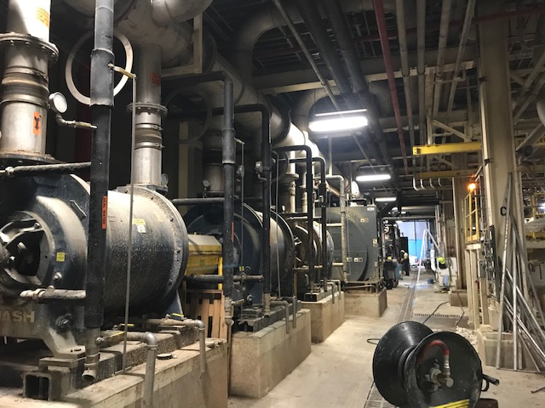
Look feel and Listen
Inlet
Look for water leaking out of the pump, feel the temperature of the inlet (less than 130°F) and discharge (should be 30°F)
Listen for cavitation
Discharge

Slide 34
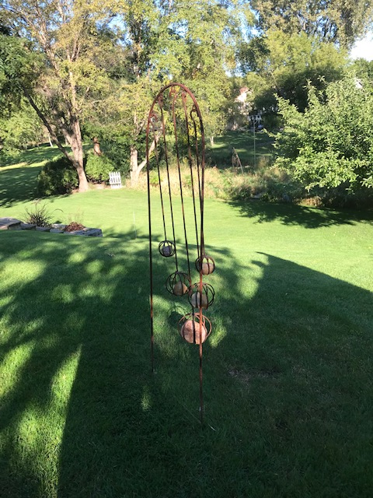
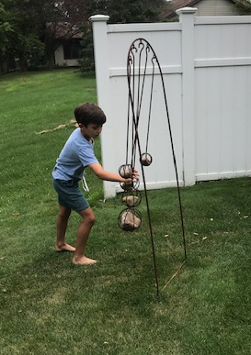
A Note About Consultants
Weather Rocks
Weather Rock Operator
Grandpa, Look how windy it is!

Slide 35
Questions and Critique
And Thanks for your time
For more information, follow my blog at the growthsolutionsconsultants.com website, much of this information is explained in more depth
Contact me at:
andys@growthsolutionsconsultants.com
920 470 9432

Slide 36

About the Speaker
Product and Marketing Manager (Systems), Busch USA
Over 19 years of experience in the industry
VJ Gupta
Busch Vacuum Solutions
Sponsored by

Slide 37
Vacuum pump working principles & troubleshooting
VJ Gupta | September 30th, 2021

Slide 38

Vacuum Pump Technology
Topics
Working Principles
  “Wet” Vacuum Pumps
  “Dry Running” Vacuum Pumps
  Rotary Vane “Oil-Sealed”
  Liquid Ring
  Dry Rotary Claw
  Dry Rotary Screw
  Vacuum Booster
Solutions for Smoother Operation
We are innovative and constantly working on optimization.

Slide 39
Vacuum Pump Technology

Slide 40
Vacuum Pump Basics
What defines it?
A Vacuum Pump is characterized by:
-Ultimate Pressure
-Flow Rate (which varies with operating pressure)
-Type (which varies with operating pressure)

Slide 41
Vacuum Pump Basics
Performance Curve
“Nominal Flow Rate” or “Maximum Pumping Speed”
A Vacuum Pump is characterized by:
-Ultimate Pressure
-Flow Rate (which varies with operating pressure)
-Type (which varies with operating pressure)
Standard Atmospheric Pressure
“Blank Off” or “Ultimate Pressure”

Slide 42
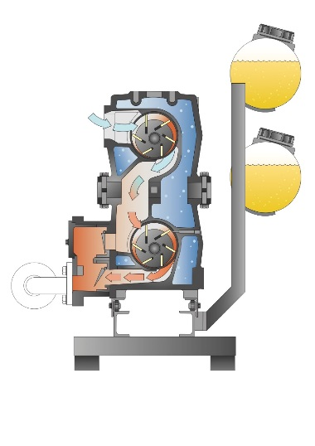
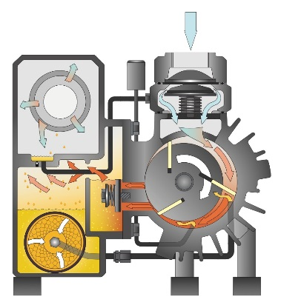
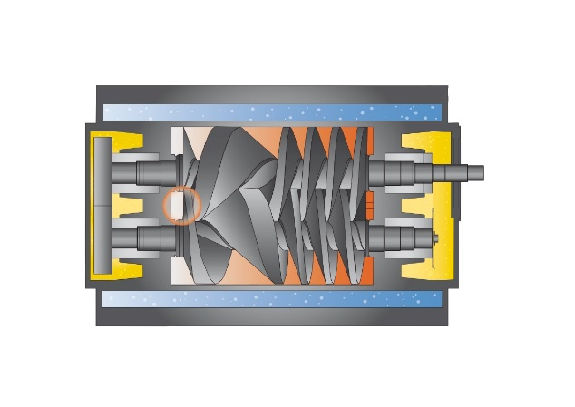
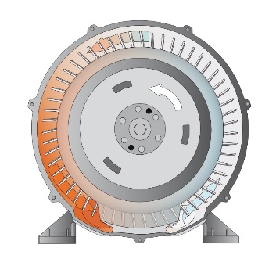
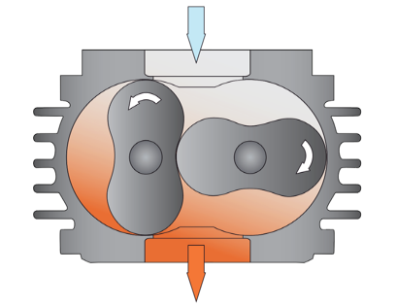
Vacuum Pump Technology
Many Choices!
WET
WET
WET
DRY
DRY
Oil-Lubricated Rotary Vane
Liquid Ring
Once-Through Oil-Lubricated Rotary Vane
Dry Screw
Dry Claw
DRY
DRY
DRY
DRY
DRY
Rotary Lobe Blowers
Side Channel Blowers
Dry-Running Rotary Vane
Vacuum Booster
(with Bypass)
Vacuum Booster
(without Bypass)

Slide 43
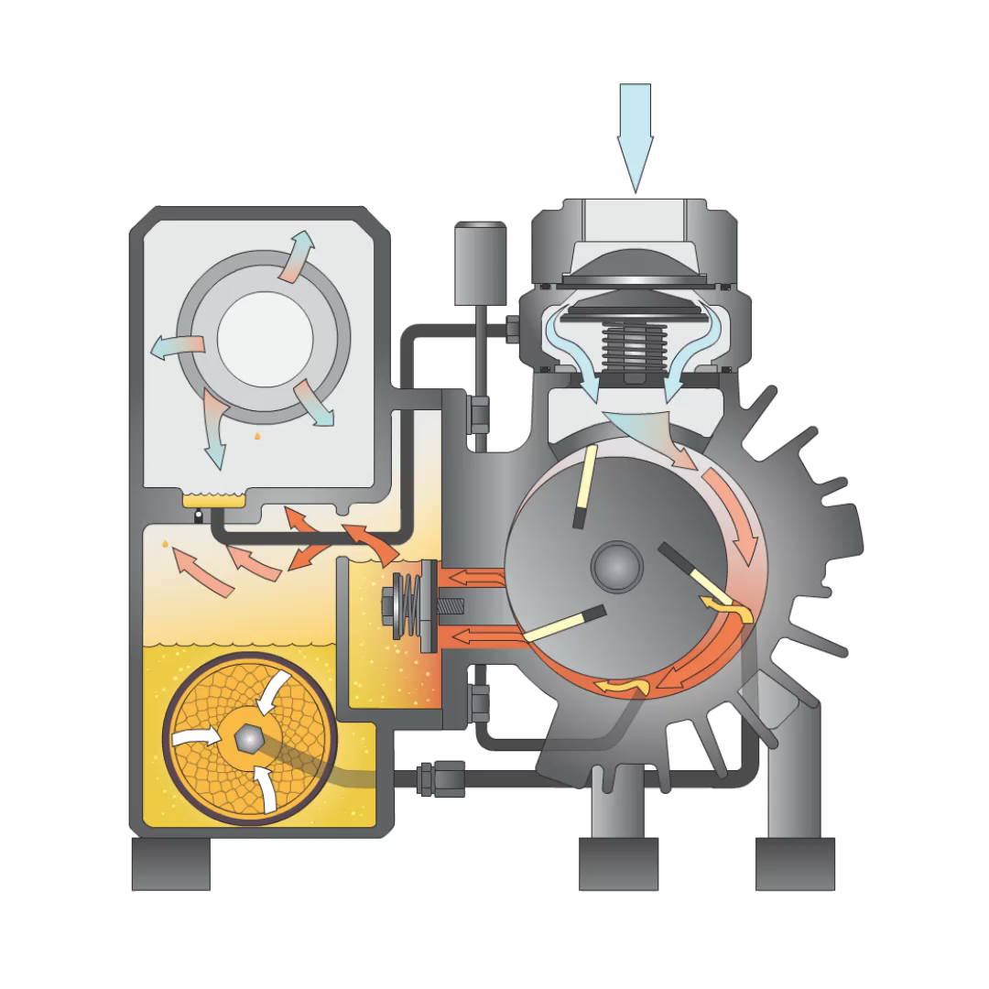
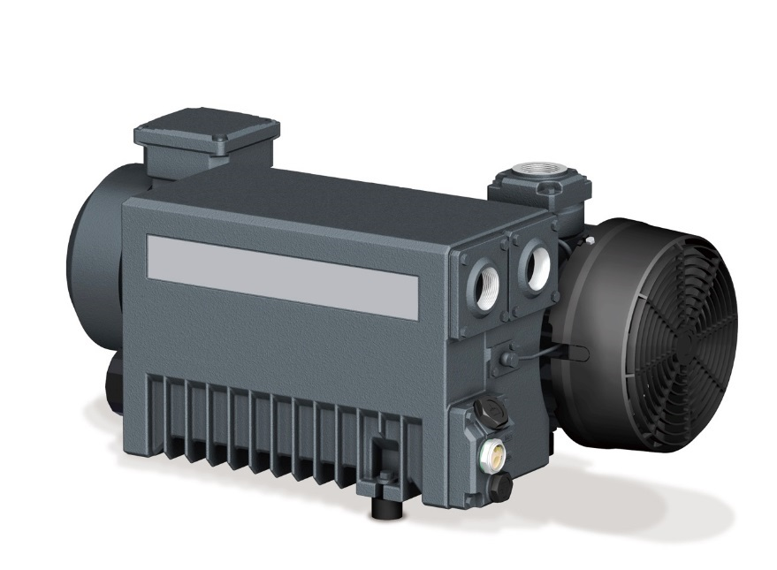
Vacuum Pump Technology
Rotary Vane (oil-sealed)
Powerful, efficient vacuum
Maintenance: Oil & filters
Oil recirculating
Quiet, smooth

Slide 44
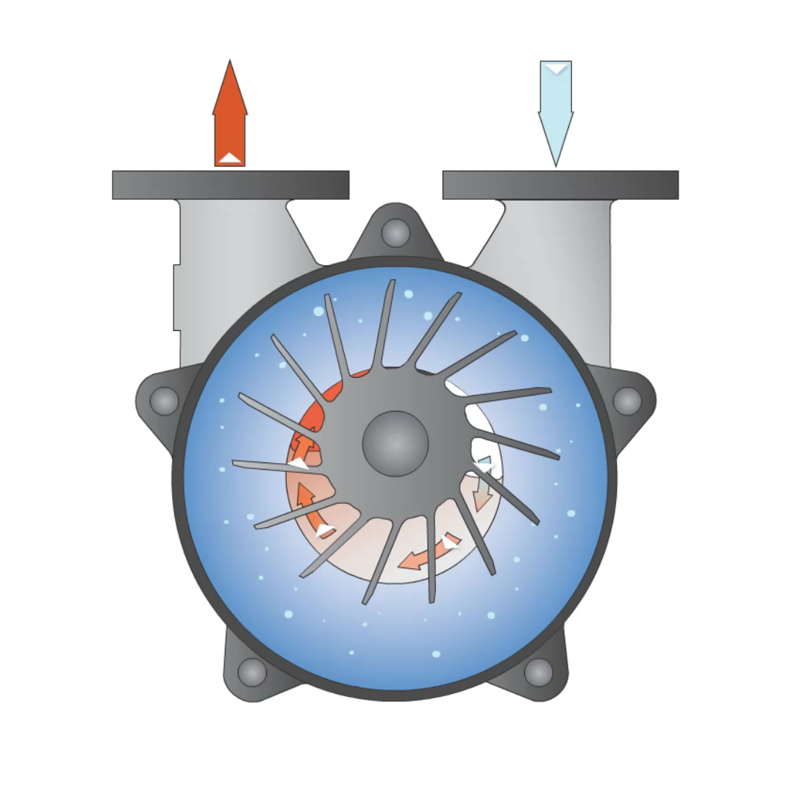
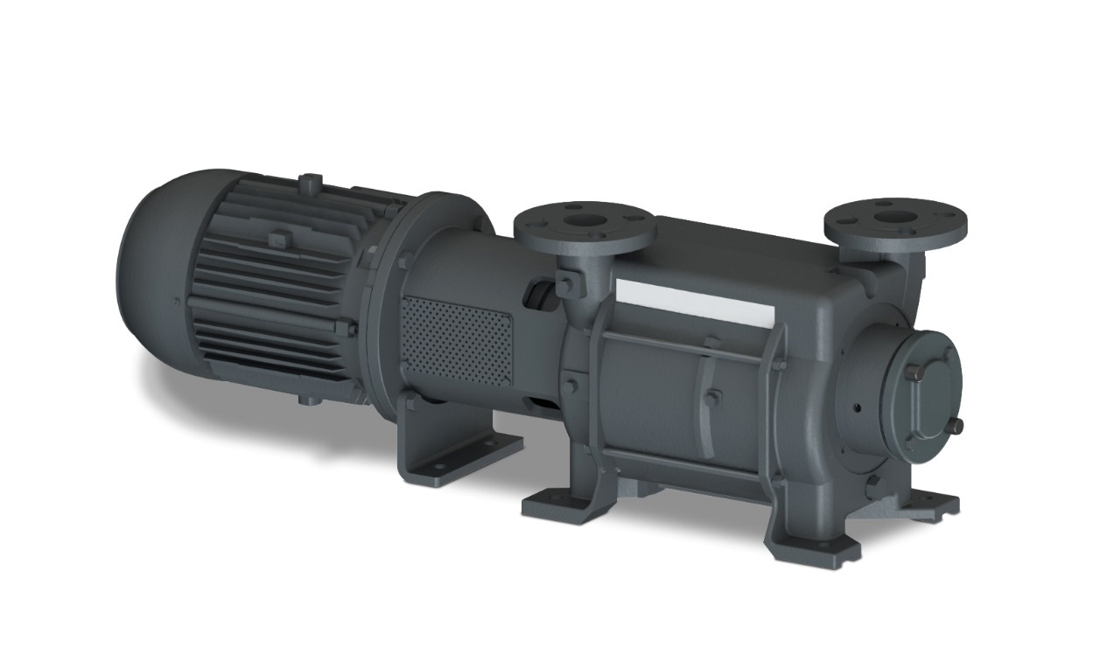
Vacuum Pump Technology
Liquid Ring
Choice of Seal Liquid
Different MOC
Water in Pump Chamber
High water handling capability

Slide 45

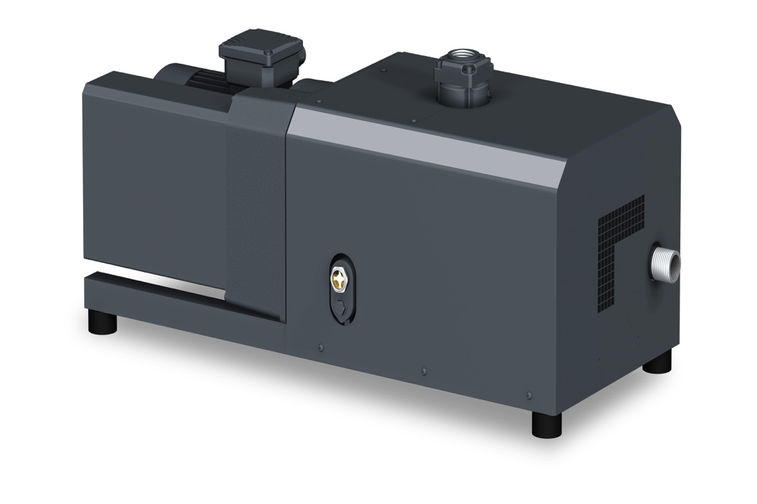
Vacuum Pump Technology
Dry Rotary Claw
Efficient
Low maintenance
Dry, non-Contacting
Limited vacuum level

Slide 46
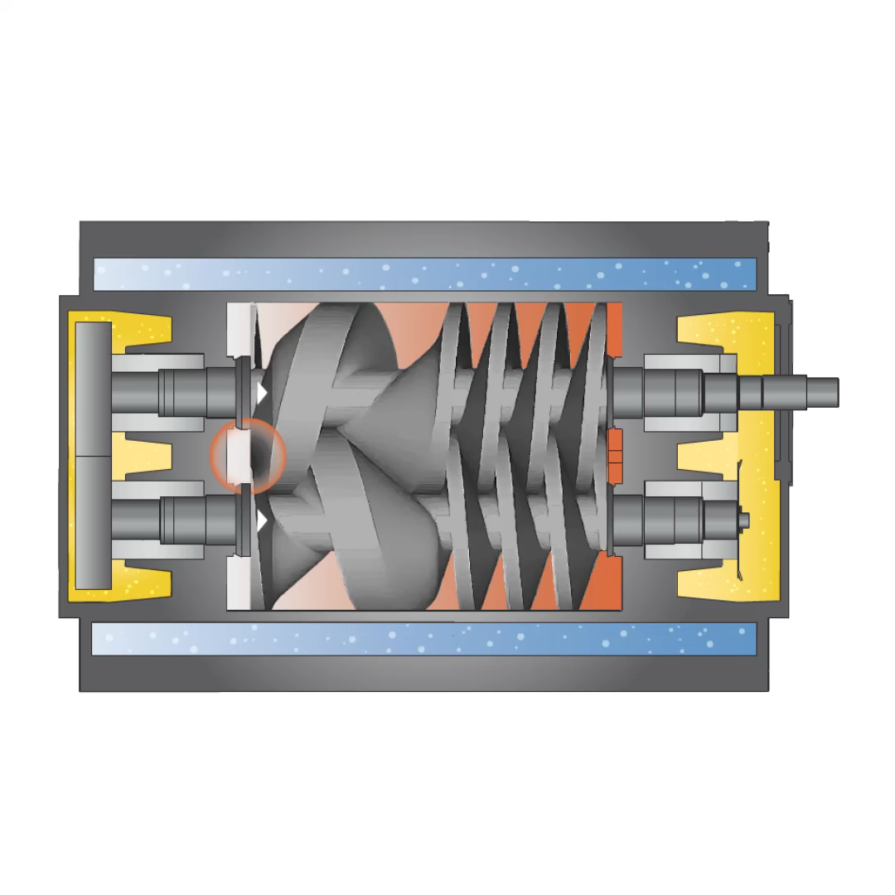
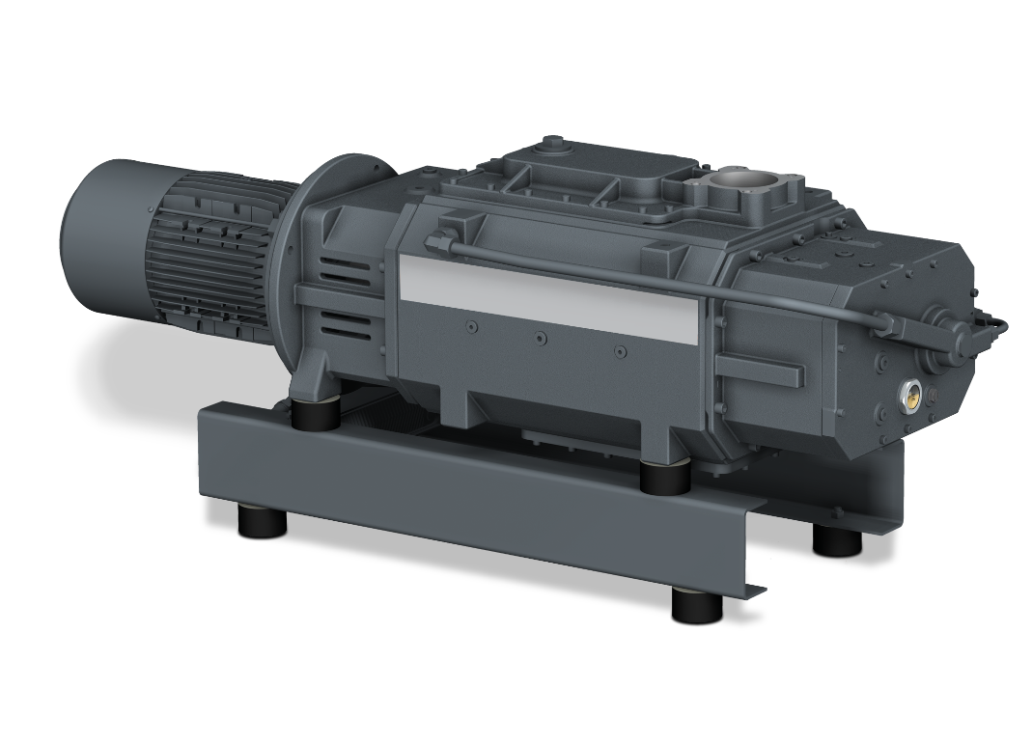
Vacuum Pump Technology
Dry Rotary Screw
  Non-Contacting
  Corrosive applications

Slide 47
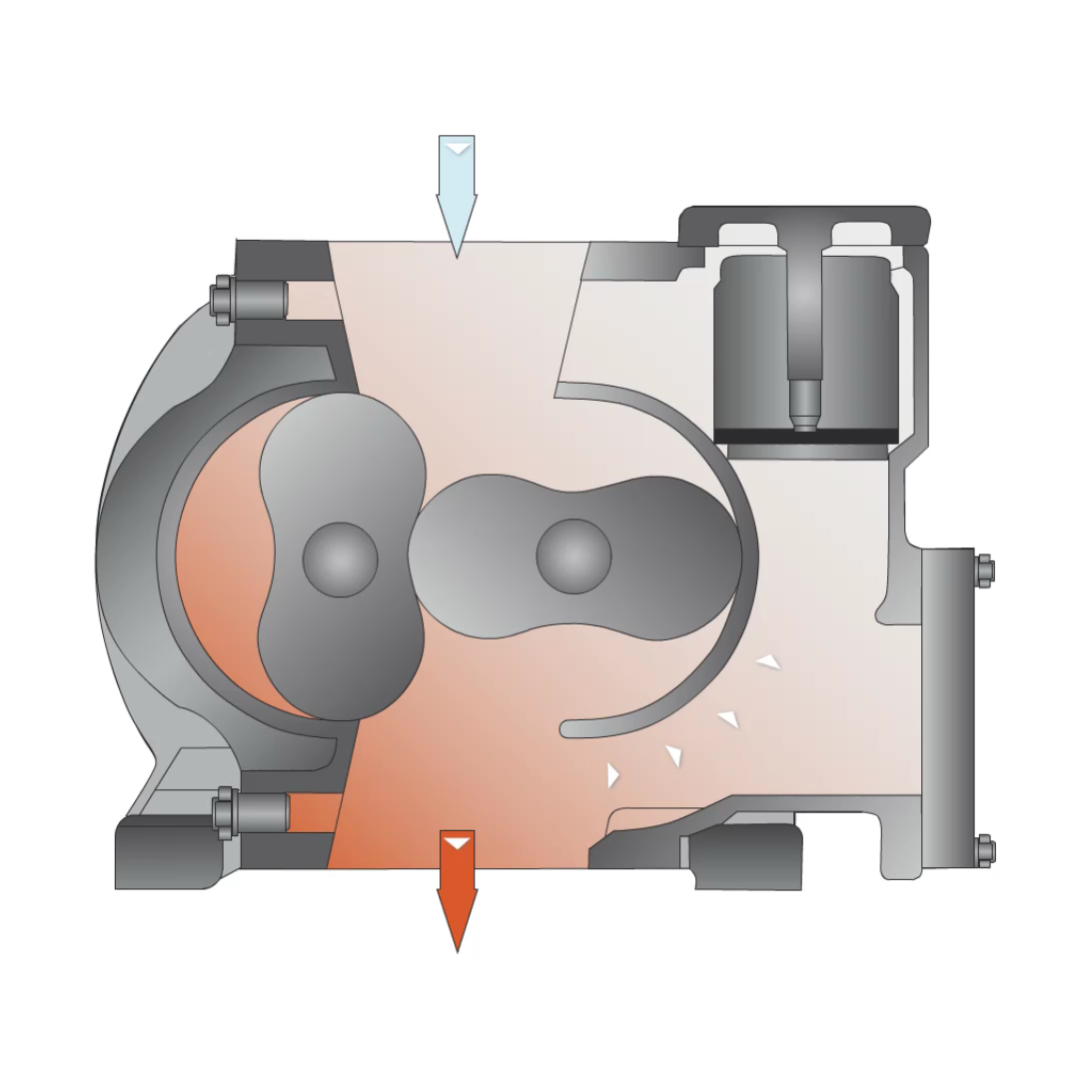
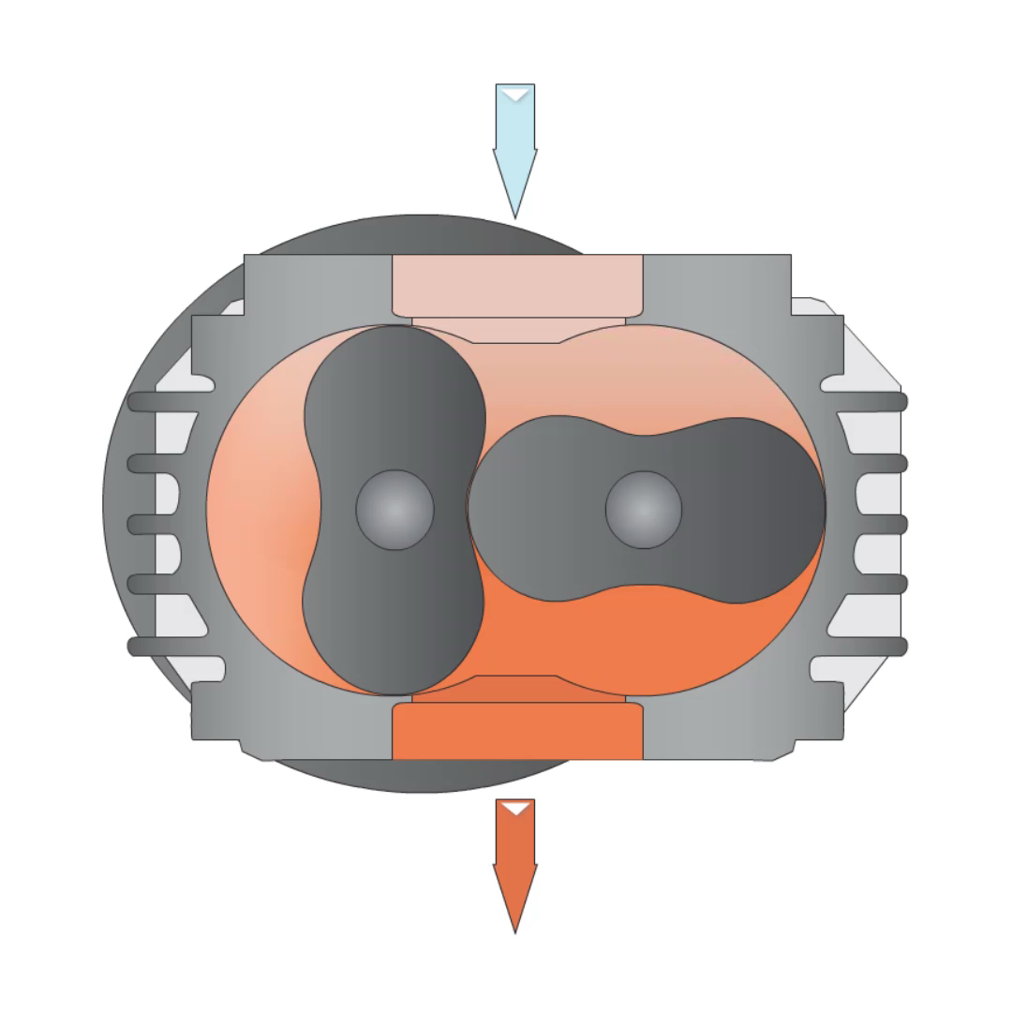
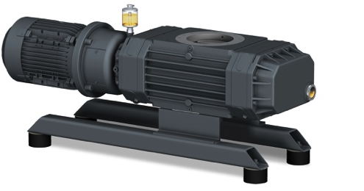
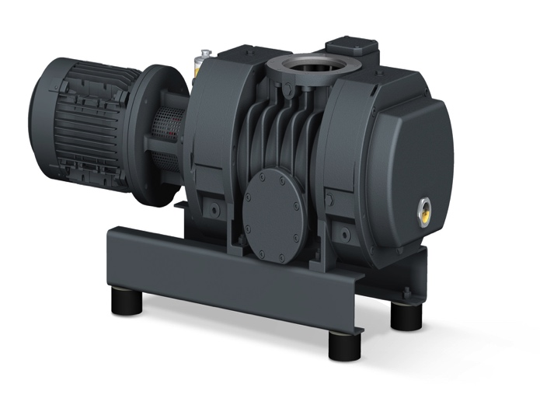
Vacuum Pump Technology
Rotary Lobe Vacuum Boosters
Bypass
Non-Bypass
Work in conjunction with a vacuum pump
(limited in differential pressure)

Slide 48
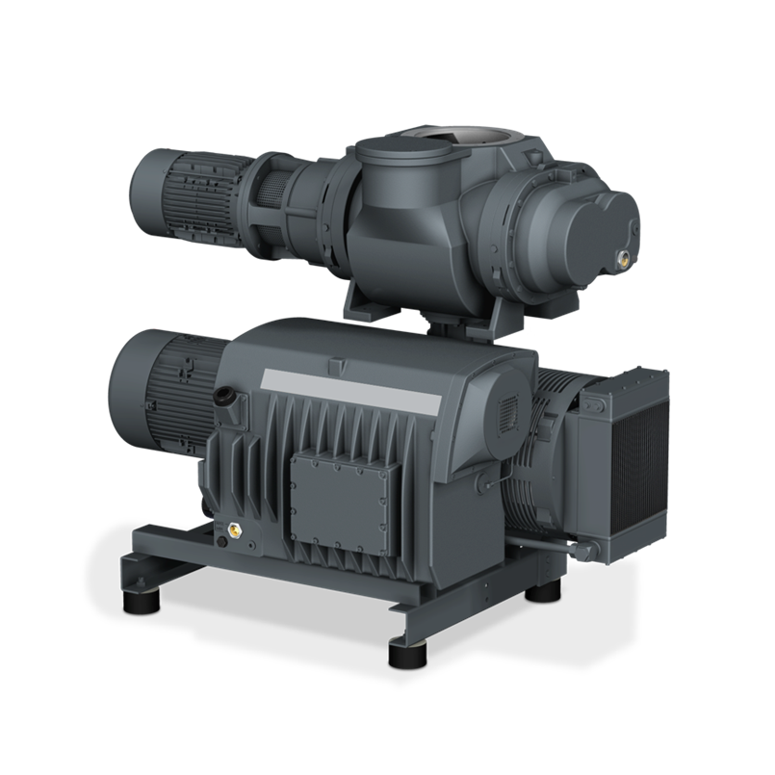
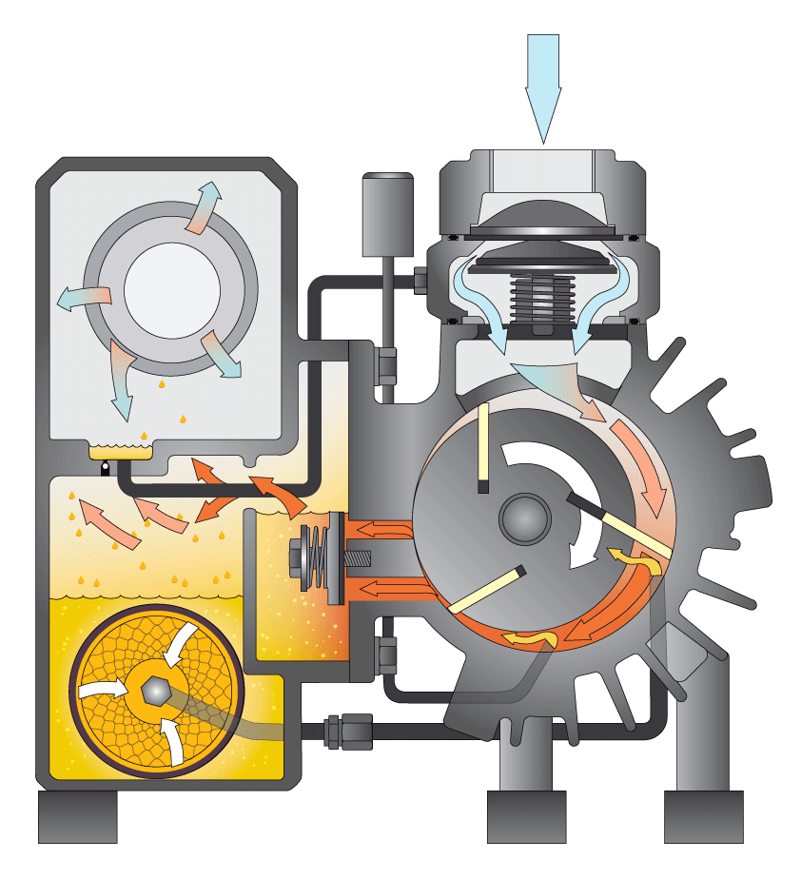
Vacuum Pump Technology
Booster + Vacuum Pump Combi
10 torr
P₁V₁
Vacuum Booster
=
40 torr
P₂V₂
Vacuum Pump
=
760 torr
P₃V₃

Slide 49
Vacuum Pump Technology
Performance Enhancement with Vacuum Boosters

Slide 50
Solutions for Smoother Operation

Slide 51

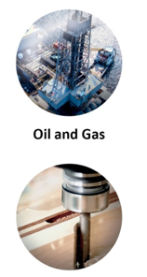
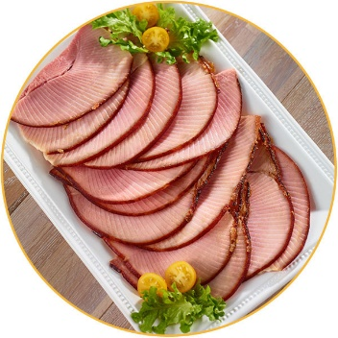

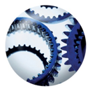
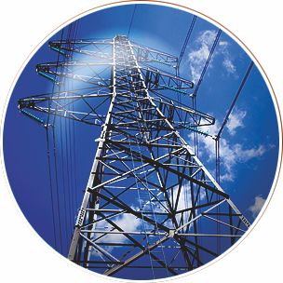
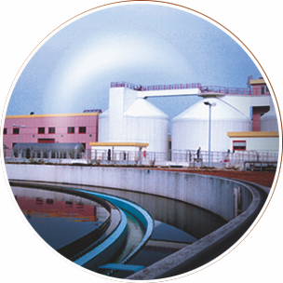

Solutions & Accessories
Industry Applications
Chemical
Chemical Oil & Gas Food Ceramics & Glass Metallurgy
Plastics
Semiconductor Wood Power Generation Wastewater & Sewage Medical & Hospitals
and many more …
Circuit board testing

Slide 52
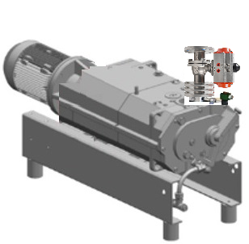
Solutions & Accessories
Inlet Gas Purge
Process Isolation Valve
Allows clean dry gas inside the vacuum pump to push volatile or condensable process vapors out of the discharge port
Automatic or Manual operation possible
Wetted material and Electrical rating flexibility
Purge Solenoid Valve

Slide 53
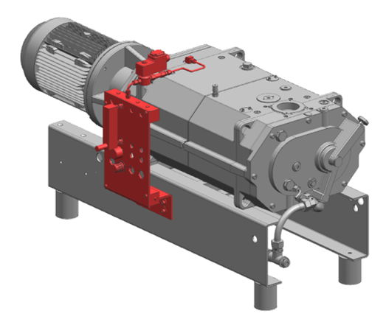
Solutions & Accessories
Gas Ballast
Used to allow clean dry gas inside the pumping chamber for dilution and prevent condensation
Standard connection available on pump casing
Ambient air or inert gases possible

Slide 54
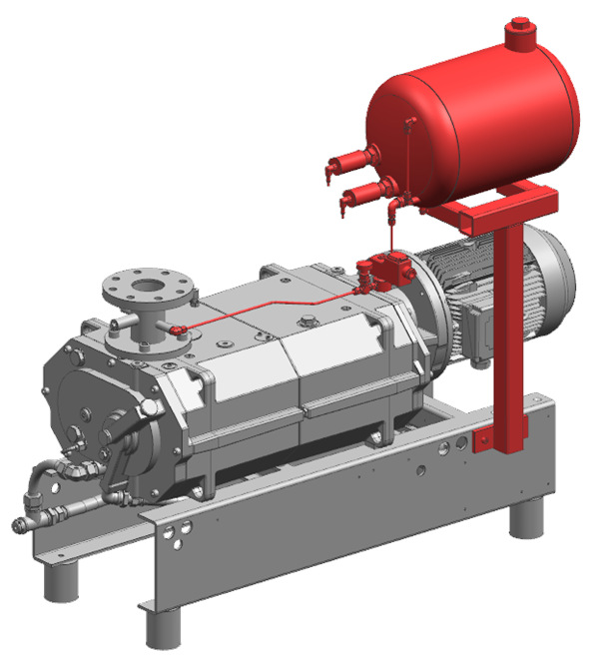
Solutions & Accessories
Inlet Flushing
Water or Solvent is used to cleanse the pump internals off process residue or solids
Reduced pump speeds allow for maximum residence time for better cleaning
Minimal impact to process vacuum levels when flushing during normal operation

Slide 55
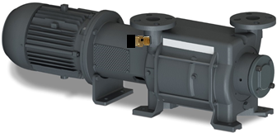
Solutions & Accessories
Anti-Cavitation Protection
Preset pressure setpoint allows gas bleed into the pumping chamber to prevent internal vacuum levels from getting too close to the sealing fluid vapor pressure
Choice of compatible material possible
Actuation can be automatic or manual
Using recirculated process vapors from discharge prevent external contamination
Anti-Cavitation Valve

Slide 56
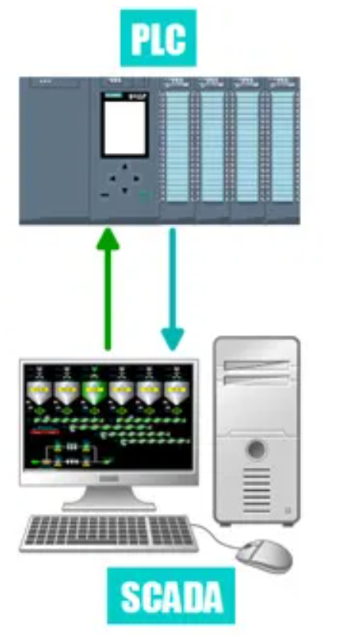

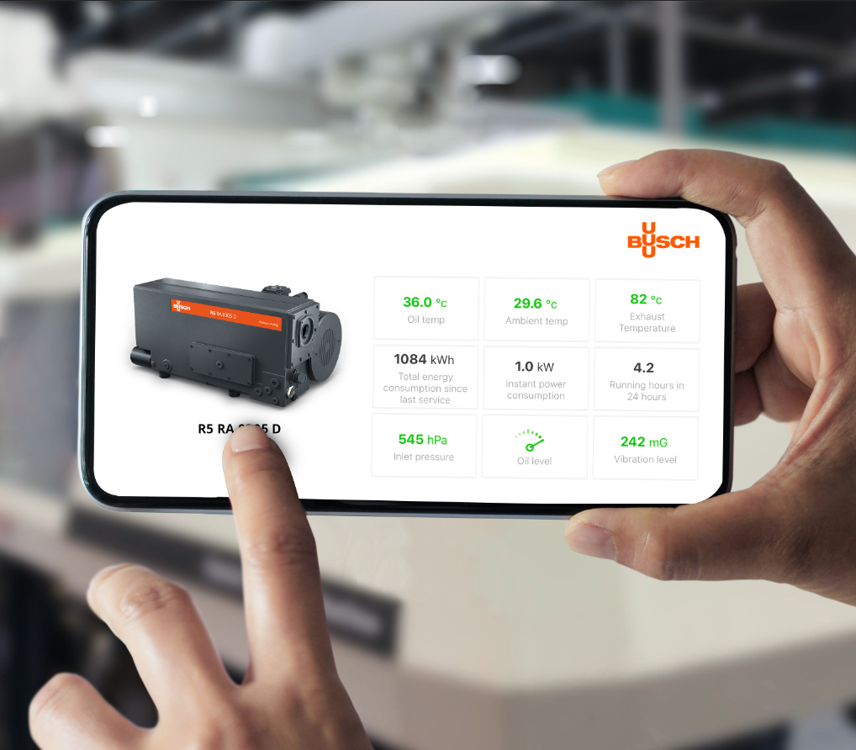
Solutions & Accessories
Digital Monitoring
Critical processes can be continuously monitored using manufacturer’s app
Preventative maintenance and monitoring subscriptions flexibility possible
Datalog vacuum pump performance and save history in Manufacturer’s cloud storage

Slide 57
Solutions & Accessories
Choose the right vacuum pump!

Slide 58
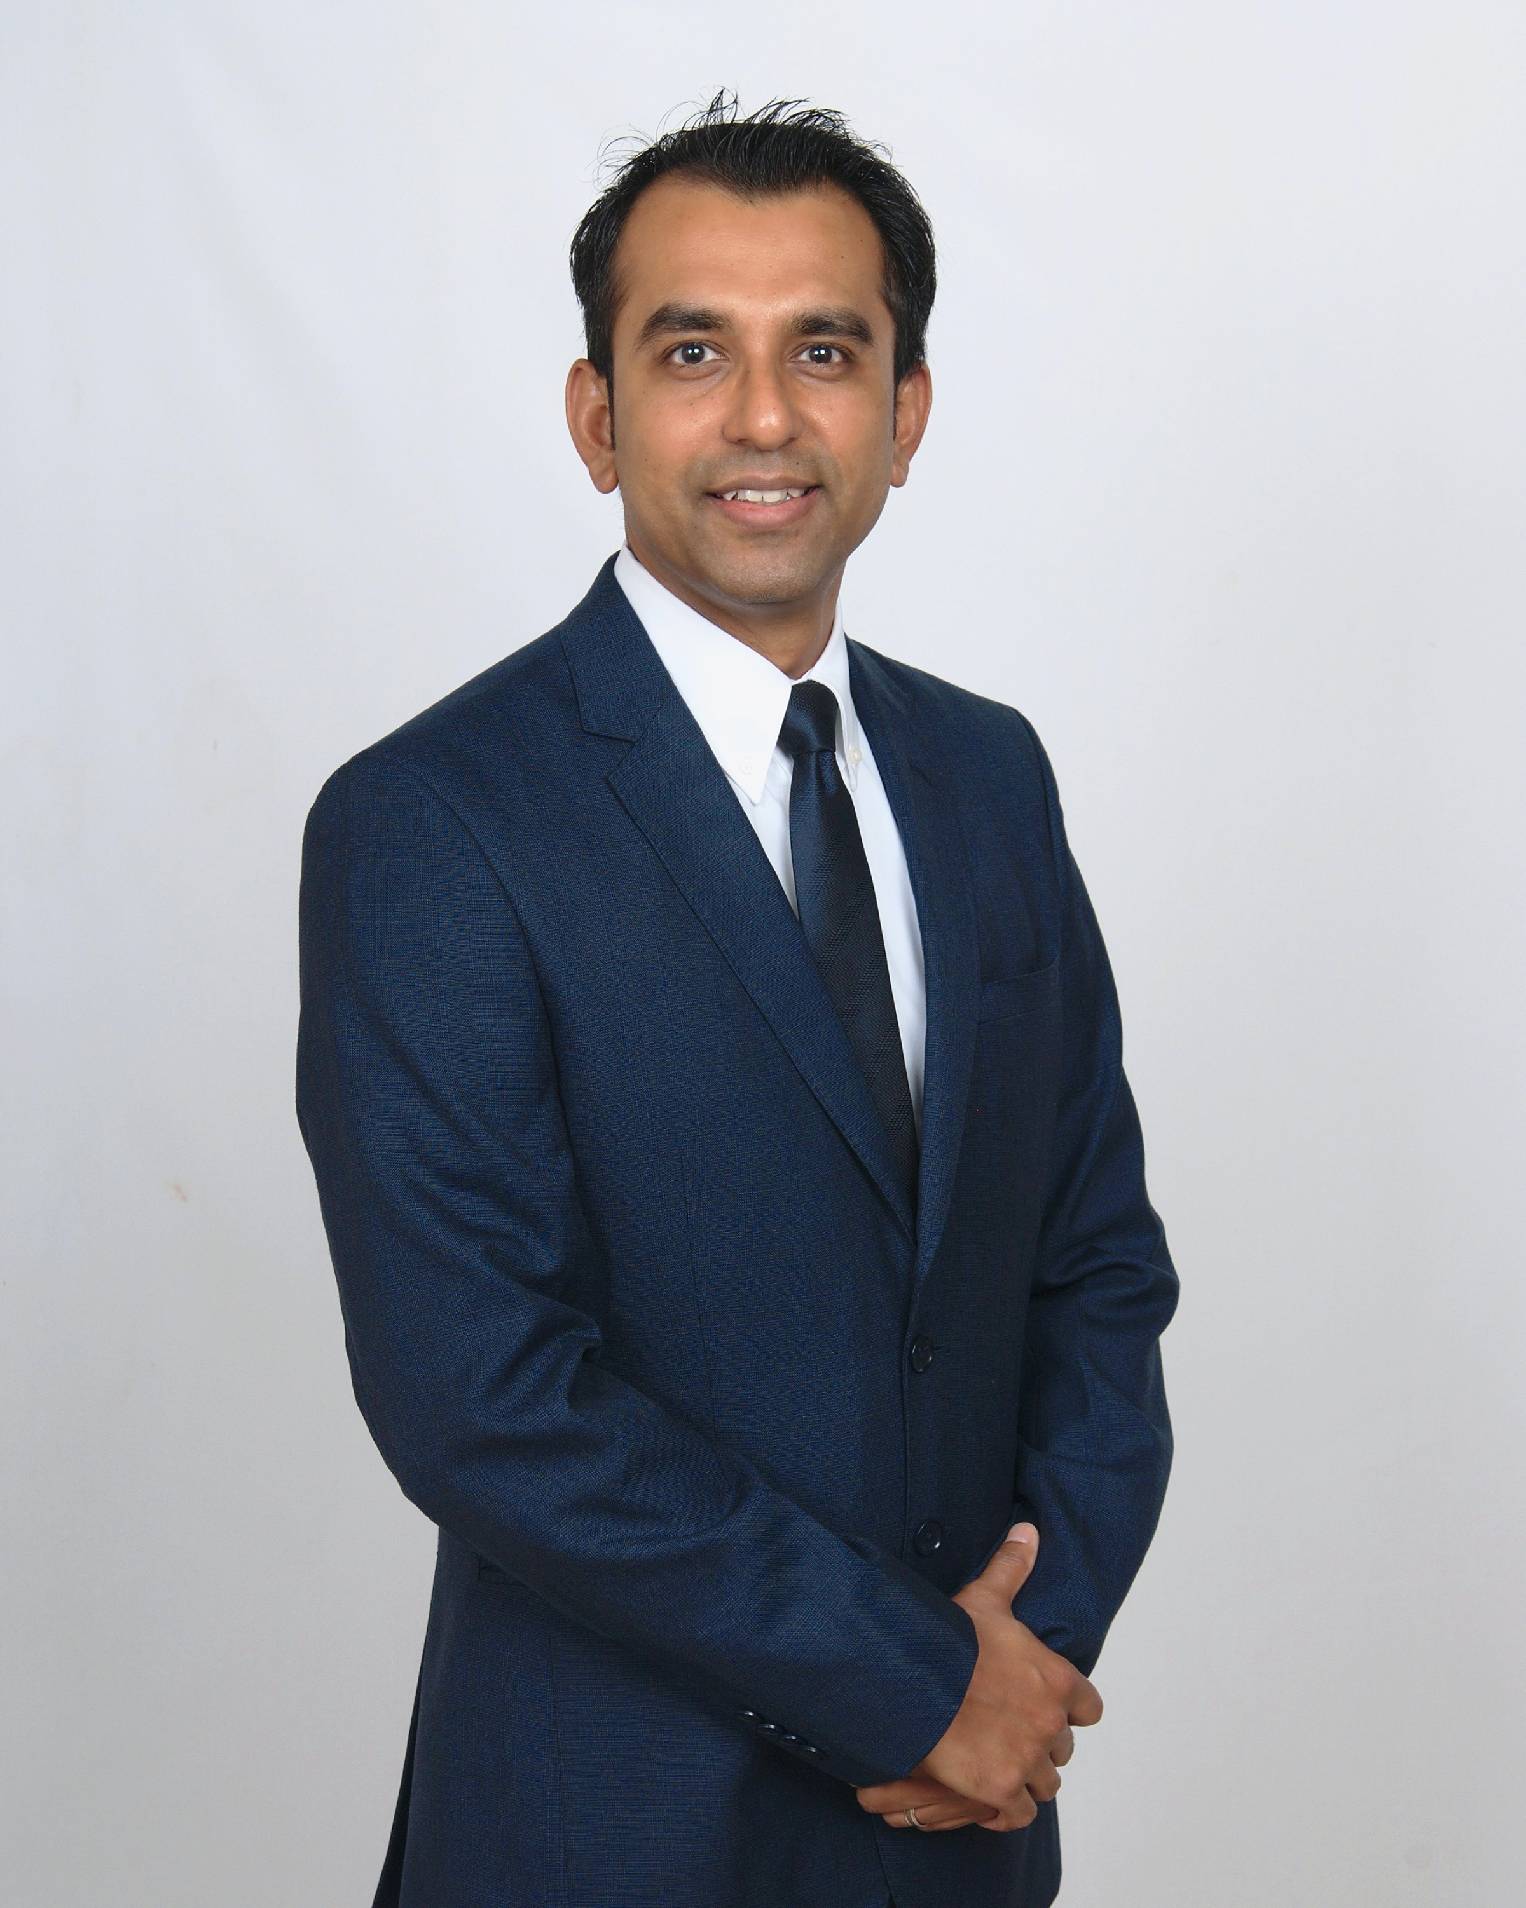
Thank you.
For more information about Busch Vacuum Pumps and Systems, please visit: www.buschusa.com
VJ Gupta
Product Marketing Manager (Systems) for Busch USA
Cell: (757) 373-0099
vj.gupta@buschusa.com

Slide 59
Vacuum Specification Fundamentals: Flow vs. Pressure
Q&A
Please submit any questions through the Question Window on your GoToWebinar interface, directing them to Blower & Vacuum Best Practices Magazine. Our panelists will do their best to address your questions and will follow up with you on anything that goes unanswered during this session.
Thank you for attending!
Sponsored by

Slide 60
Best Practices EXPO Contest
Play for a chance to win a FREE Full Conference Pass to the Best Practices 2021 EXPO & Conference!! This is a $675 value! This contest is open to factory personnel, compressed air distributors, utility incentive programs and engineering firms. Exhibiting and sponsor companies are not qualified. TWO winners* will be randomly selected from those who submitted at least 1 correct answer and notified tomorrow via email.
The next slide will show a statement related to today’s topic that needs to be filled in. You will be provided the first letter of the words as a clue. Please submit your answers in your questions box.
Example
When I think of a beach vacation, I think of _______.
T_ _ _ _
T_ _ _ B_ _
S_ _ S_ _ _ _ _
*By entering you are giving permission to announce your name if you are a winner

Slide 61
Best Practices EXPO Contest
Play for a chance to win a FREE Full Conference Pass to the Best Practices 2021 EXPO & Conference!! This is a $675 value! This contest is open to factory personnel, compressed air distributors, utility incentive programs and engineering firms. Exhibiting and sponsor companies are not qualified. TWO winners* will be randomly selected from those who submitted at least 1 correct answer and notified tomorrow via email.
The next slide will show a statement related to today’s topic that needs to be filled in. You will be provided the first letter of the words as a clue. Please submit your answers in your questions box.
Example
When I think of a beach vacation, I think of _______.
TOWEL
TIKI BAR
SEA SHELLS
*By entering you are giving permission to announce your name if you are a winner

Slide 62
Best Practices EXPO Contest
Play for a chance to win a FREE Full Conference Pass to the Best Practices 2021 EXPO & Conference!! This is a $675 value! This contest is open to factory personnel, compressed air distributors, utility incentive programs and engineering firms. Exhibiting and sponsor companies are not qualified. TWO winners* will be randomly selected from those who submitted at least 1 correct answer and notified tomorrow via email.
Based on the clues below, please submit your answer in the questions box.
When I think of “Measuring Vacuum,” I think of _______.
P _ _ _ _ _ _ _
F _ _ _
*By entering you are giving permission to announce your name if you are a winner

Slide 63
Best Practices EXPO Contest
Play for a chance to win a FREE Full Conference Pass to the Best Practices 2021 EXPO & Conference!! This is a $675 value! This contest is open to factory personnel, compressed air distributors, utility incentive programs and engineering firms. Exhibiting and sponsor companies are not qualified. TWO winners* will be randomly selected from those who submitted at least 1 correct answer and notified tomorrow via email.
Based on the clues below, please submit your answers in the questions box.
When I think of “Measuring Vacuum,” I think of _______.
PRESSURE
FLOW
*By entering you are giving permission to announce your name if you are a winner

Slide 64
Thank you for attending!
The recording and slides of this webinar will be made available to attendees via email later today.
PDH Certificates will be e-mailed to Attendees by within 2 days

Slide 65

November 2021 Webinar
Precise Cooling Temperature Control Ensures Quality and Increased Cycle Counts
Bert J. Wesley, P.E.
Woodard & Curran
Keynote Speaker
Thursday, November 11, 2021 – 2:00 PM EST
Register for free at
www.airbestpractices.com/magazine/webinars

